Slide 1



IOP workshop on Heavy Fermions
and Quantum Phase Transitions
November 10-12, 2012, Beijing
Dimensional Reduction and Odd-Frequency Pairing of the
Checkerboard-Lattice Hubbard Model at ¼-Filling
Kazuo Ueda
Institute for Solid State Physics
University of Tokyo
In collaboration with
Yuki Yanagi (ISSP)
Yasufumi Yamashita (Nihon University)

Slide 2

Superconductivity：mechanism for condensation of Cooper pairs
Conventional BCS superconductors: phonons
3He superfluidity: paramagnetic spin fluctuations
PW Anderson and P Morel, Phys. Rev. 123, 1911 (1961)
R Balian and NR Werthamer, Phys. Rev. 131, 1553 (1963)
Heavy Fermion superconductors: antiferromagnetic spin fluctuations
K Miyake, S Schmitt-Rink and CM Varma: Phys. Rev. B34, 6554 (1986)
DJ Scalapino, E Loh and JE Hirsch: Phys. Rev. B34, 8190 (1986)
Question: other type of bosonic excitations?
charge fluctuations, multipole fluctuations,
anharmonic phonons

Slide 3
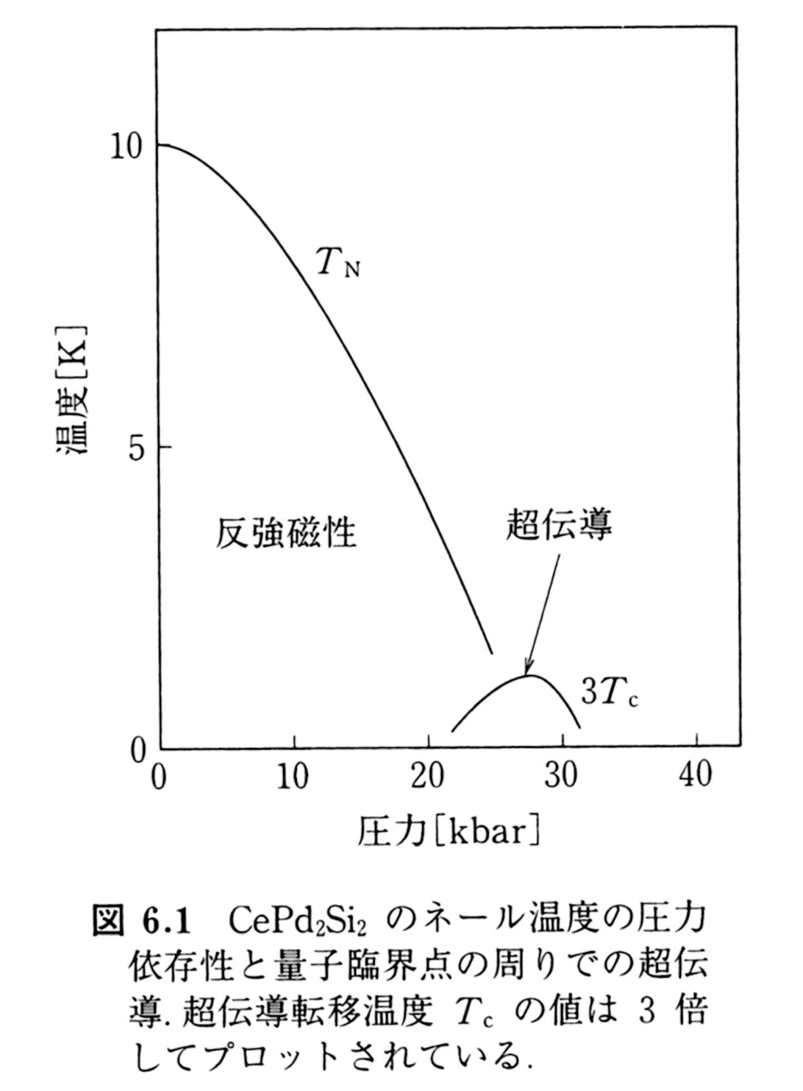
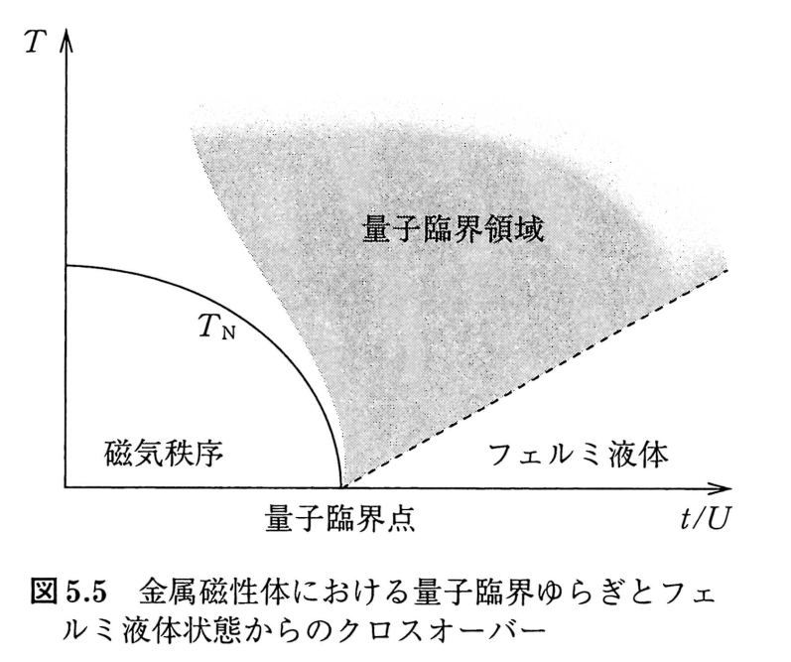
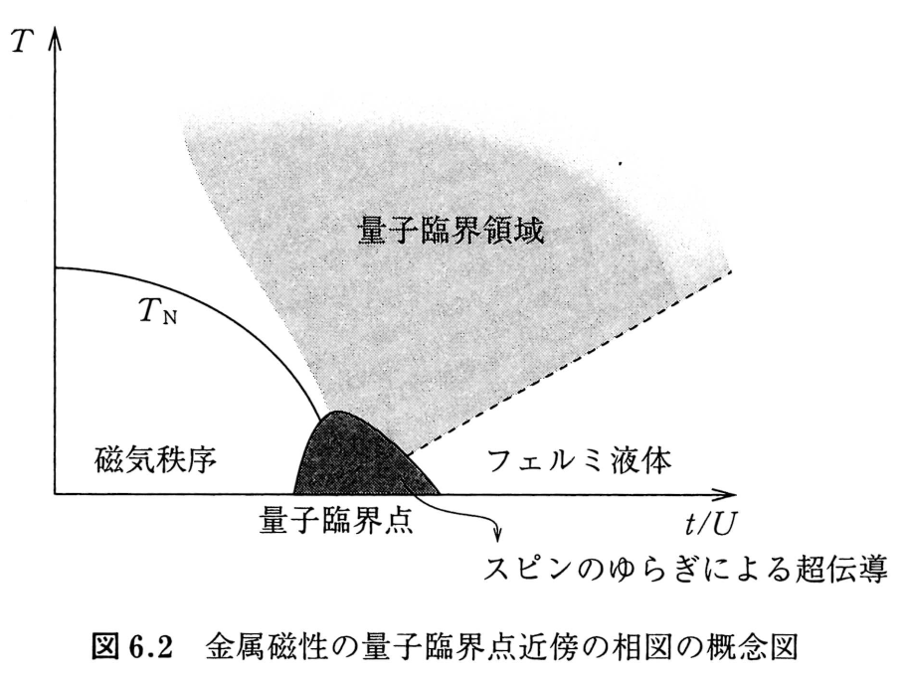
Superconductivity close to quantum critical point
N.D Mathur et al.: Nature 394 (1998) 39

Slide 4
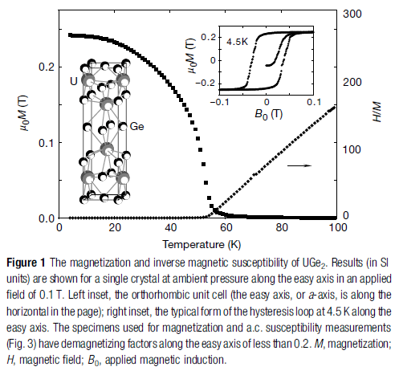
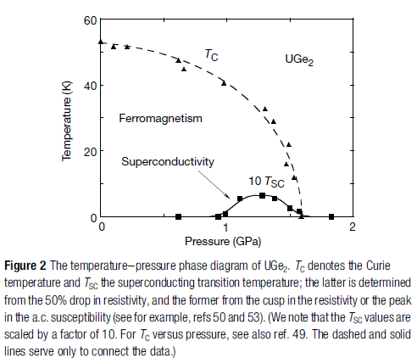
Frontiers of research on heavy Fermions rich variety of order parameters
Superconductivity in a ferromagnetic metallic state: UGe2
SS Saxena et al, Nature 406, 587 (2000)

Slide 5
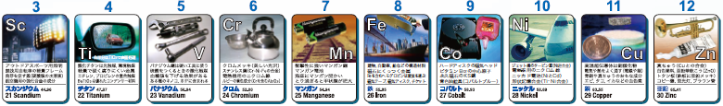
Initial motivation of this research
search for a ferromagnetic Hubbard model
various models are available for antiferromagnetism
at half filling in particular
known exact results for ferromagnetism
Nagaoka ferromagnetism
Mielke model
Tasaki model
Question: quarter filling is favorable for ferromagnetism?
Moriya theory （Alexander-Anderson-Moriya model)
exact ground state of the square lattice Hubbard
model is not known yet

Slide 6
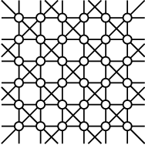
checkerboard lattice
t₁=t₂
t₁≠0, t₂=0
t₁=0, t₂≠0
checkerboard lattice
n=1/2(quarter-filling):
Mielke’s ferromagnetism
square lattice
1-d chains
t₂
t₁
A
B

Slide 7
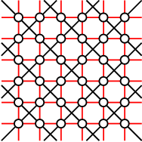
checkerboard lattice
t₁=t₂
t₁≠0, t₂=0
t₁=0, t₂≠0
checkerboard lattice
n=1/2(quarter-filling):
Mielke’s ferromagnetism
square lattice
1-d chains

Slide 8
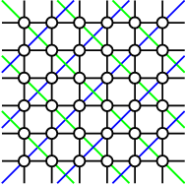
checkerboard lattice
t₁=t₂
t₁≠0, t₂=0
t₁=0, t₂≠0
checkerboard lattice
n=1/2(quarter-filling):
Milke’s ferromagnetism
square lattice
1-d chains

Slide 9
Hamiltonian
Along the lines at k_{x}=π and k_{y}=π the off-diagonal term vanishes
→ one-dimensional character

Slide 10
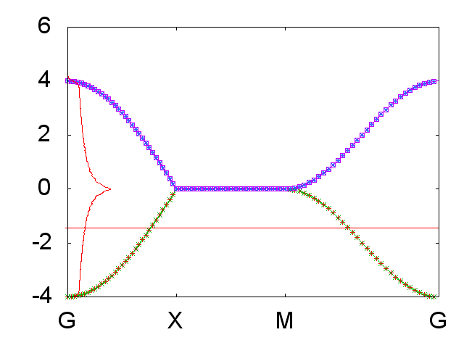
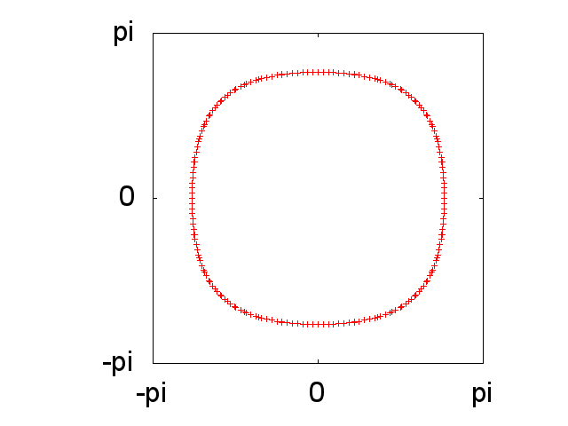
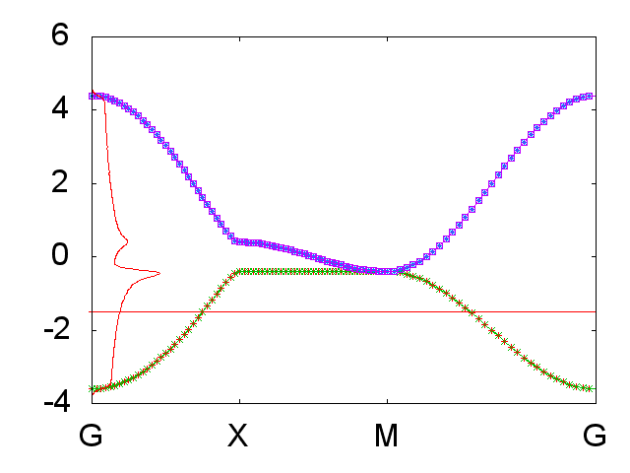
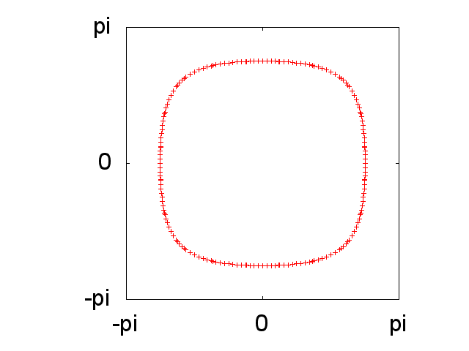
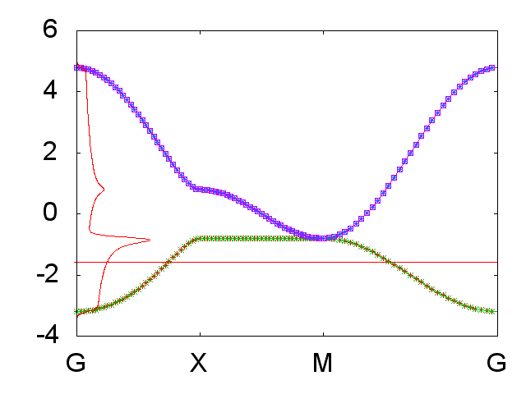
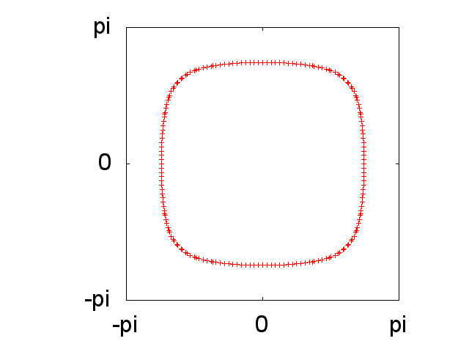
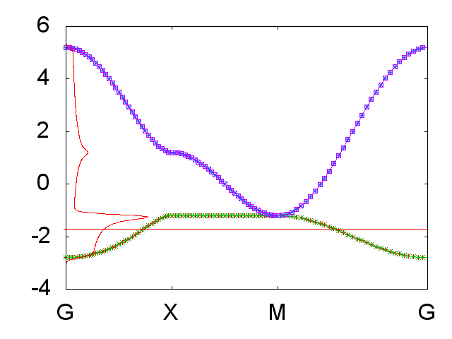
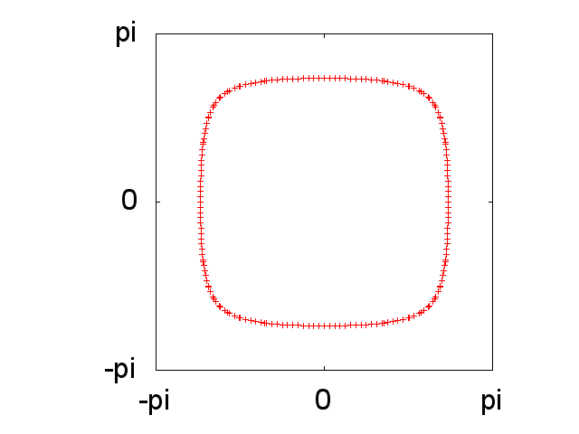
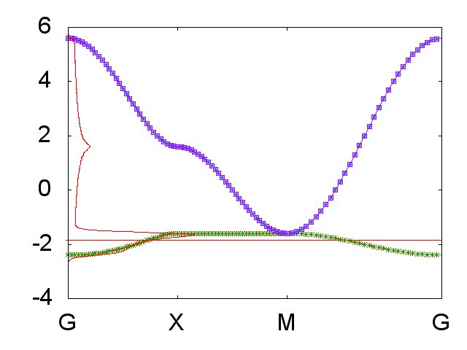
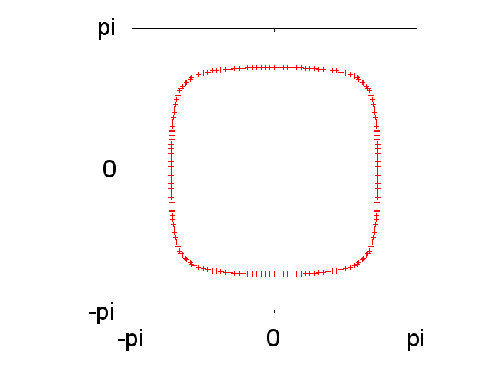
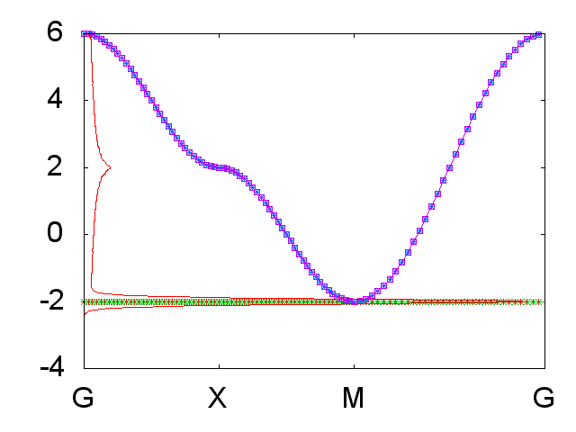
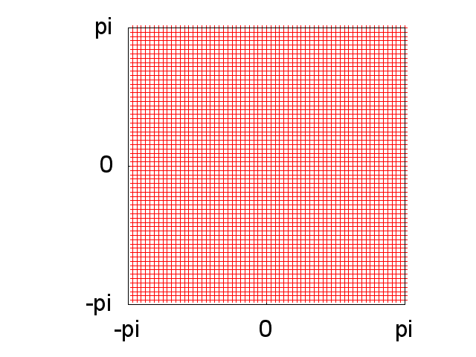
dispersion, DOS, and Fermi surface for t1=1 with various t2
t2 =0.0
t2 =0.2
t2 =0.4
t2 =0.6
t2 =0.8
t2 =1.0

Slide 11
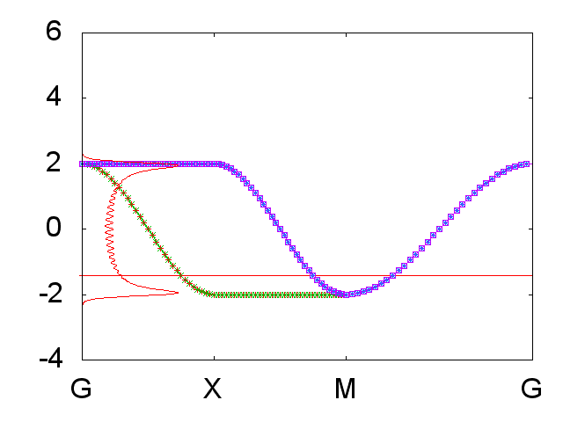
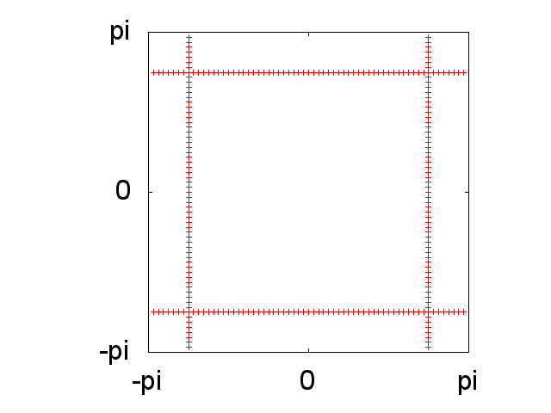
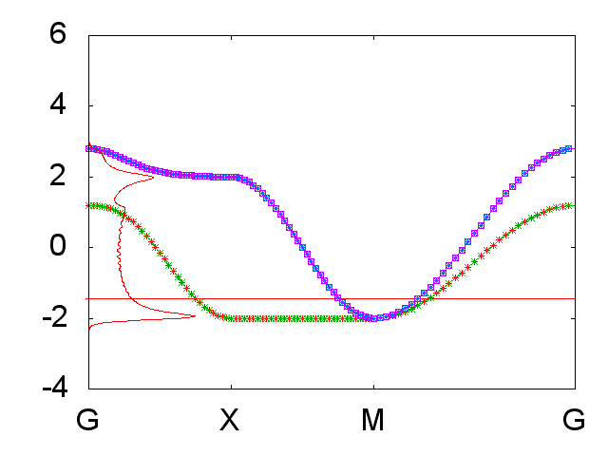
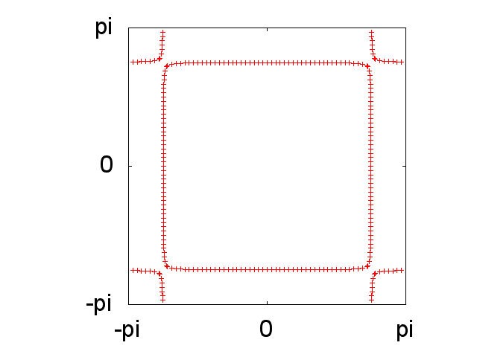
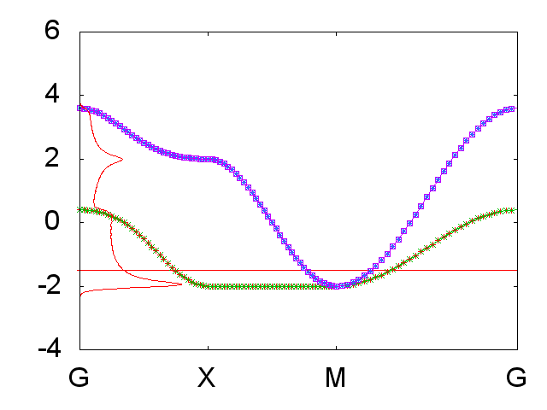
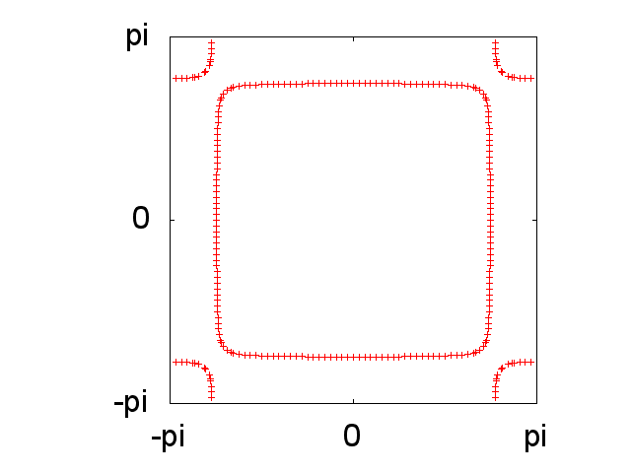
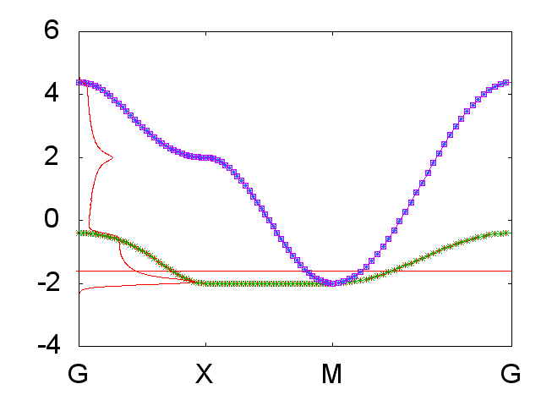
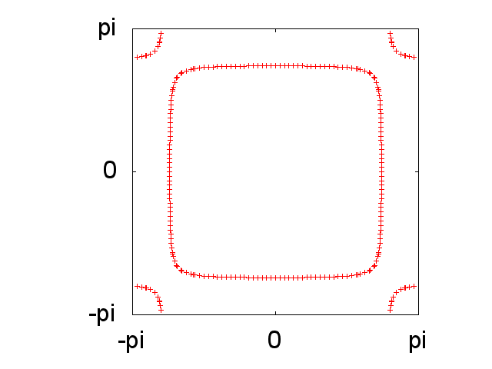
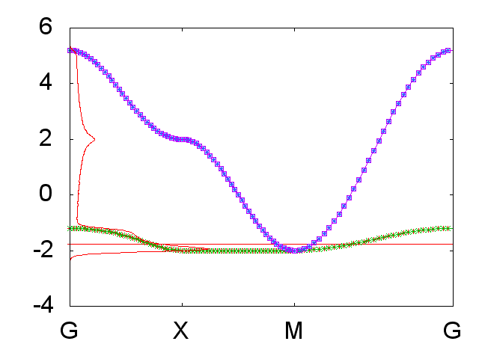
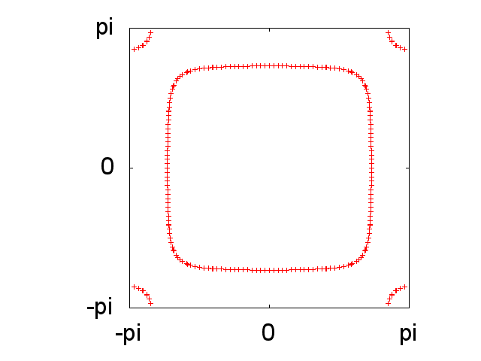
dispersion, DOS, and Fermi surface for t2 =1 with various t1
t1=0.0
t1=0.2
t1=0.4
t1=0.6
t1=0.8
t1=1.0

Slide 12
Dyson-Gor’kov Equation・Eliashberg Equation
normal Green function
anomalous Green function
anomalous Green function
Dyson-Gorkov equation
Eliashberg equation
linearized equation
eigenvalue problem with λ=1

Slide 13
General form of superconducting order parameter
Antisymmetric property of Fermions
Even frequency, spin-singlet, even parity (ESE)
Even frequency, spin-triplet, odd parity (ETO)
Odd frequency, spin-singlet, odd parity (OSO)
Odd frequency, spin-triplet, even parity (OTE)
A. Balatsky and E. Abrahams,
PRB 45, 13125 (1992)
V. L. Berezinskii,
JETP Lett. 20, 628 (1974)
※ 空間反転対称性がない場合にはパリティが混ざる

Slide 14
analysis of Eliashberg equation
Eliashberg equation

Slide 15
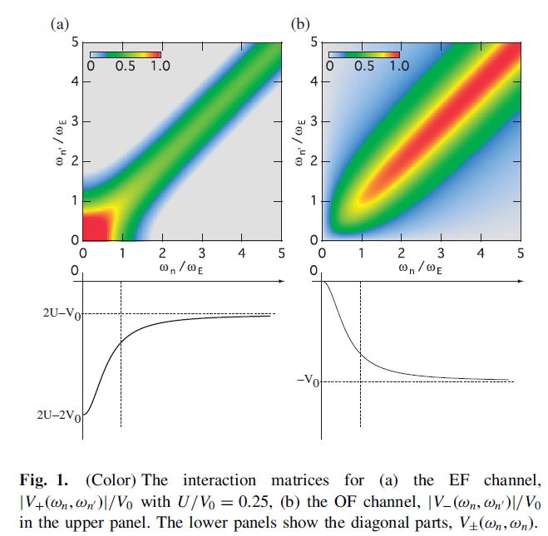



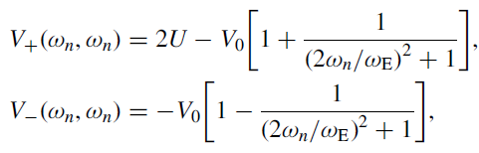
Odd frequency pairing (1) : electron-phonon coupling
V_{φ}(ω_{n},ω_{n’})
even
odd
even
odd
H. Kusunose et al.,
JPSJ 80, 044711 (2011)
Effect of retardation

Slide 16
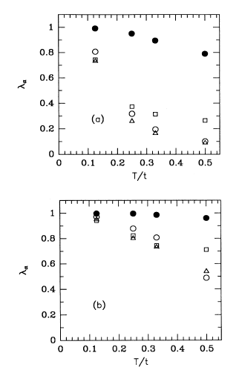
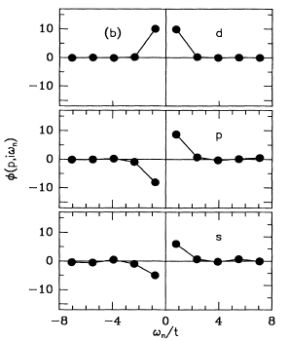
Odd frequency pairing (2) : square lattice
T-dependence
U=4t
QMC
8×8
half-filling
N. Bulut et al.,
PRB 47, 14599 (1992)
●AFM
○ESE
□OSO
△OTE
ω_{n}-dependence
U=8t

Slide 17
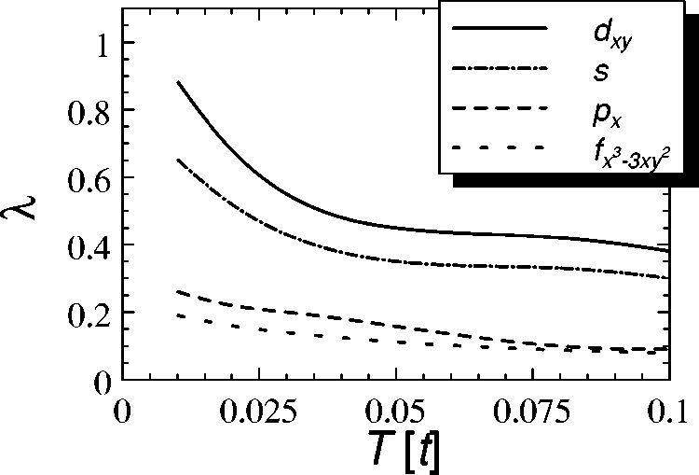
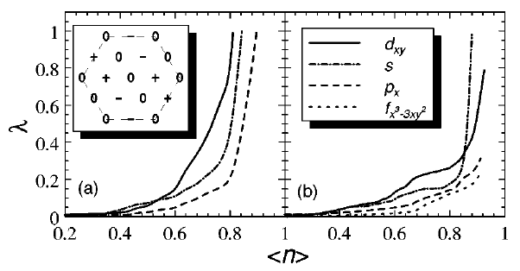
Odd frequency pairing (3) : triangular lattice
RPA
M. Vojta and E. Dagotto,
PRB 59, R713 (1999)
T-dependence
U=3.5t, half-filling
n-dependence
U=3.5t, T=0.02
e
o
ギャップ関数のω_{n}依存性
o
o
d-wave correlation is suppressed by geometrical frustration

Slide 18
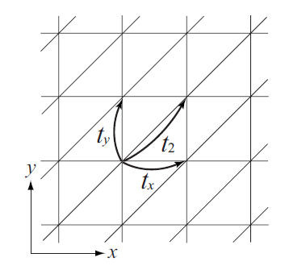
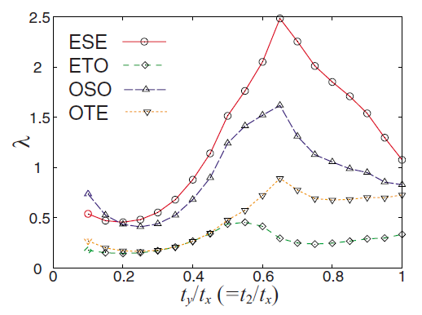
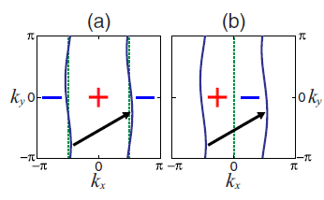
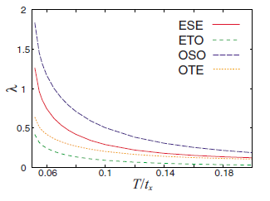
Odd frequency pairing (4) : quasi 1-D system
RPA
λのt_{y}=t₂依存性
α_{s}=0.97, T=0.04t_{x}
half-filling
RPA
λのT依存性
U=1.6t_{x}, t_{y}= t₂=0.1
half-filling
K. Shigeta et al.,
PRB 79, 14507 (2009)

Slide 19
favorable conditions for the odd-frequency pairing
strong retardation
critical fluctuations (QCP)
soft phonons
frustration
suppression of the conventional (even frequency)
pairing
3. one dimensionality
the checkerboard lattice Hubbard model offers
an ideal opportunity for the odd-frequency pairing

Slide 20
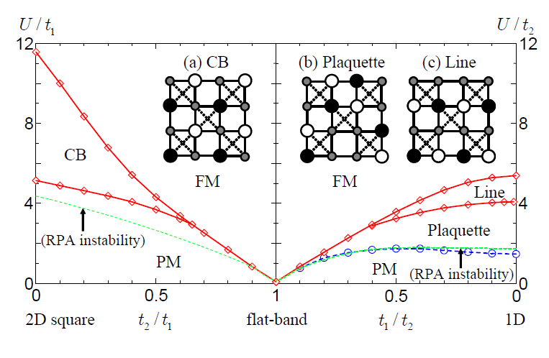
Magnetic phase diagram
– mean field approximation -

Slide 21

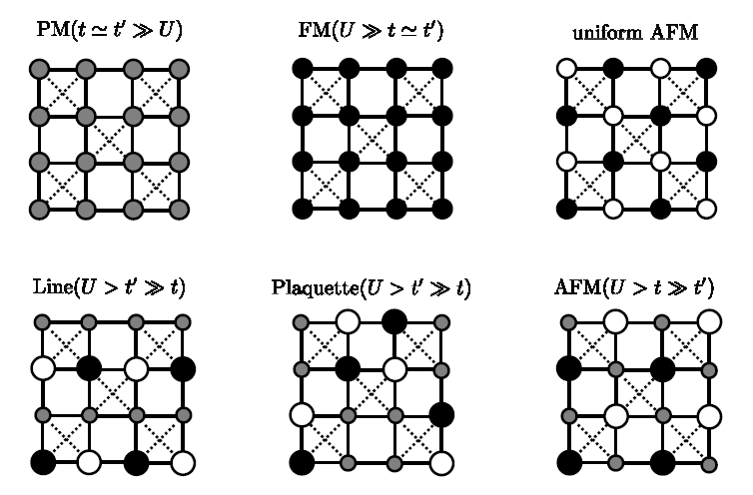
spin and charge density pattern

Slide 22
RPA
Eliashberg equation
singlet channel
k-meshes=128×128
-511πT≦ε_{n} ≦511πT
triplet channel

Slide 23
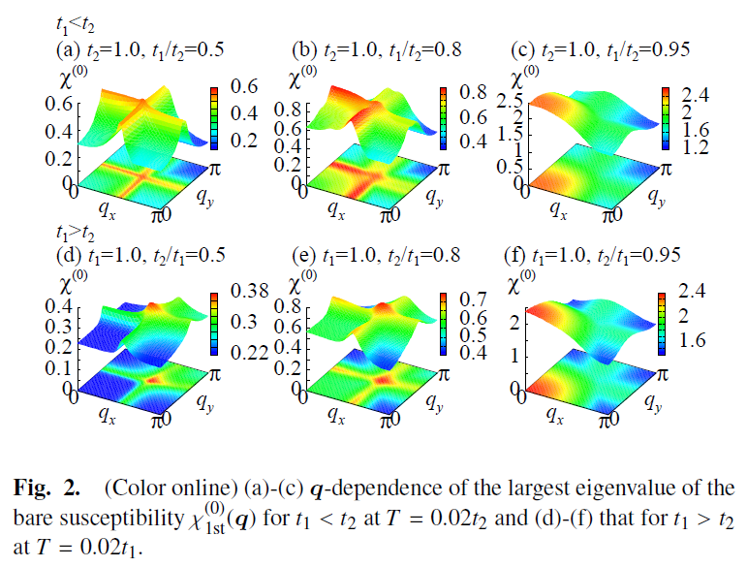
q-dependence of χ^{s} [n=0.5]

Slide 24
Magnetic phase diagram
– mean field approximation -

Slide 25
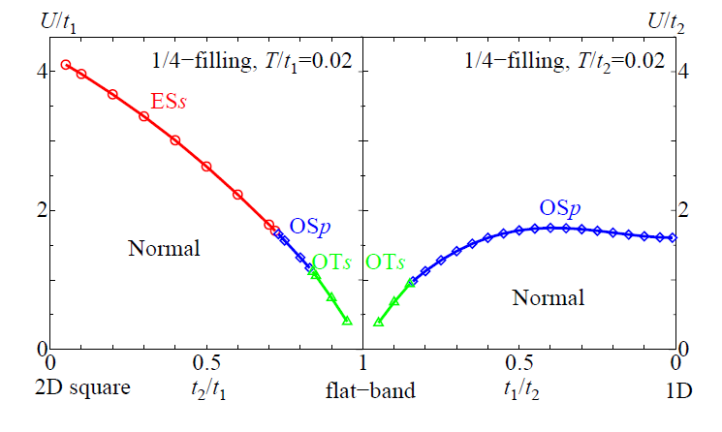
Phase diagram of superconductivity
obtained by the RPA

Slide 26
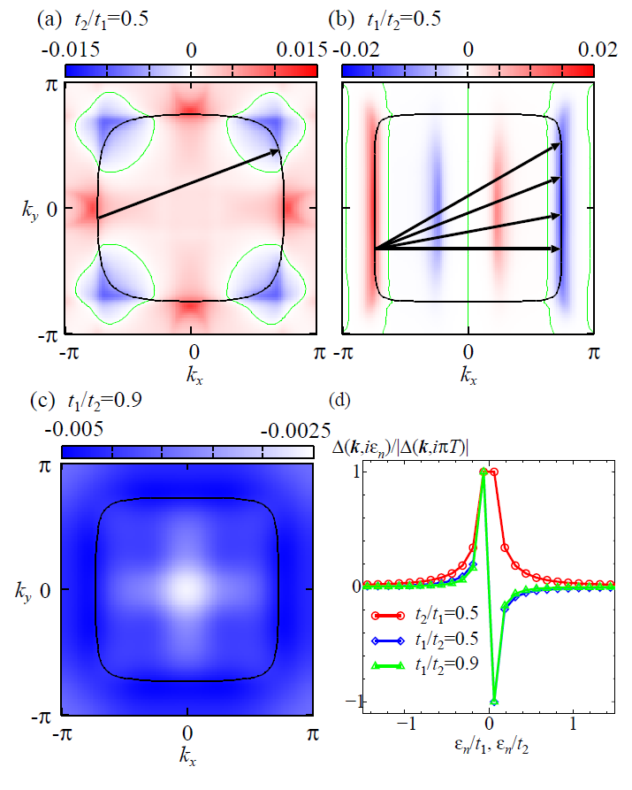
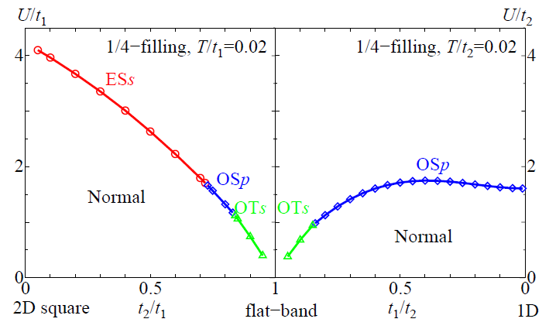
Gap function Δ(k,iπT)

Slide 27
t₁ dependence of the eigenvalue λ
n=0.5 (quarter-filling)
T=0.02, α_{s}=0.95
n=1.1 (near half-filling)
T=0.02, α_{s}=0.95

