Slide 1


Incommensurate correlations
& mesoscopic spin resonance in YbRh₂Si₂*
C. Broholm
Johns Hopkins University
*Supported by U.S. DoE
Basic Energy Sciences,
Materials Sciences & Engineering
DE-FG02-08ER46544
Notes:
I thank the organizers for the invitation and I am delighted that they plan to join the exploration of heavy fermion systems in a big way. As we have seen in talk after talk there are profound challenges that confront us as we try to understand the interface between localized and itinerant electron dynamics.
I will talk about the quantum phase transition from AF to PM by sharing with you some recent neutron scattering data for YbRh2Si2. These really are our latest and largely undigested results and I look forward to you comments and ideas

Slide 2
Overview
Introduction
  SDW Quantum Criticality in metals
  The case of YbRh₂Si₂
Results & Discussion
  Incommensurate spin correlations
  Quasi-FM Quantum Critical Scaling
  Unconventional spin resonance
Conclusions
Notes:
Here is an overview of the prepared remarks. In the introduction I want to remind you of relevant concepts for the interpretation of the results and explain my path into the subject.
The body of the talk is separated into a zero field and a finite magnetic field section. Experimental results and interpretation will be intertwined and I hope for frequent interruptions with your questions.

Slide 3
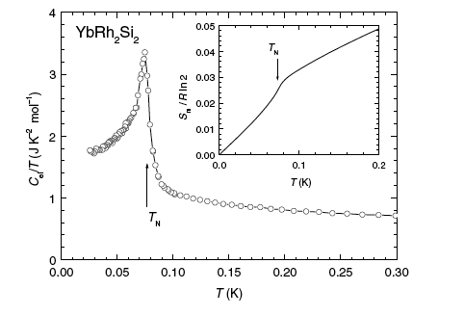
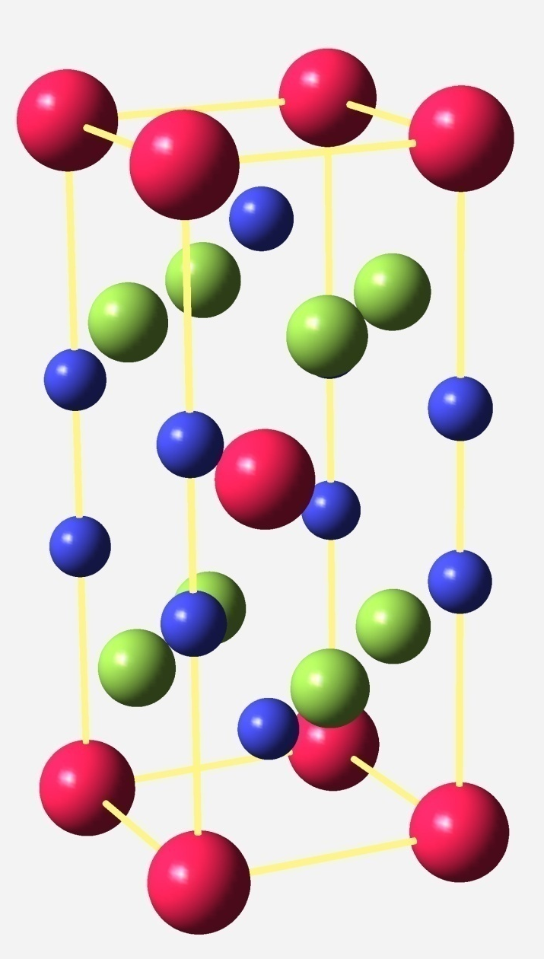
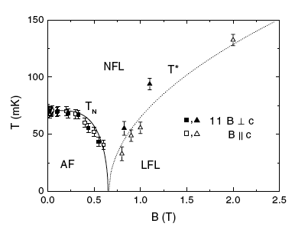
Field Driven QCP in YbRh₂Si₂
Rh
Gegenwart et al PRL (2002)
Si
Yb
11 ×
Notes:
Frank Steglich showed us a metallic compound which likewise can be tuned to quantum criticality through the convenient perturbation of a magnetic field.
Apart from experimental convenience, the great advantage of this form of perturbation is that it does not introduce additional disorder.
The structure of the material is shown in the image. It is the famous ThCr2Si2 structure which is identical to that for URu2Si2 and CaFe2As2.
The main frame shows the famous phase diagram for YbRh2Si2, which for brevity I will denote as YRS. There is a low field AF state and a high field magnetized LFL state. In this talk I shall provide indications of the nature of this ordered state and of a curious ESR in the high field phase.

Slide 4
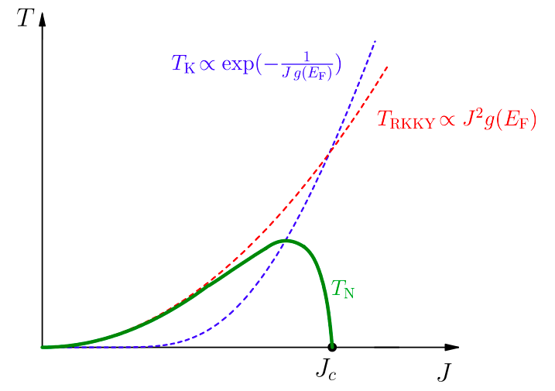
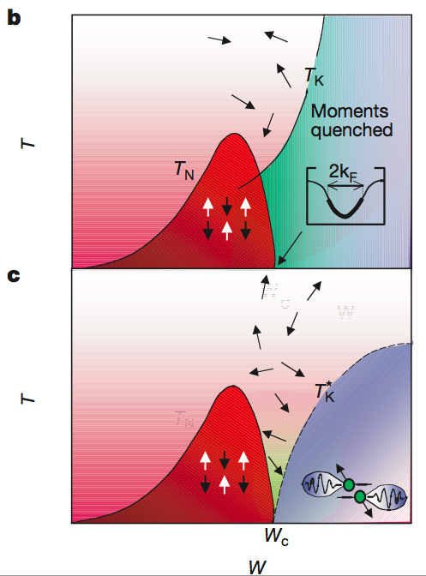
Kondo Lattice quantum criticality
Steglich et al J. Phys. Cond. Matter (2012)
Schroeder et al Nature (2003)
Notes:
For YRS, quantum criticality is thought to arise due to a competition between the spin screening Kondo effect and the RKKY interaction. Both consequences of conduction electron hybridization with 4f moments these depend differently on the basic interaction between local moments and conduction electrons. This leads to magnetic order at sufficiently low J where 4f spins form a localized band and a Kondo lattice fermi liquid phase at high Jc wherein 4f electrons are subsumed into the fermi surface. A uniform field disfavors the antiferromagnetic ordering and can be used to tune through this quantum critical point.
It is the nature of this quantum transition which is fundamentally of interest here. The question arises whether the transition out of the magnetic phase coincides with the inclusion of 4f electrons into the fermi surface or whether this transition is a nesting instability of dressed heavy conduction electrons.
I find that the inelastic neutron scattering data to be presented resemble expectations for the latter scenario of an nesting instability amongst the heavy electrons of a large fermi surface.

Slide 5
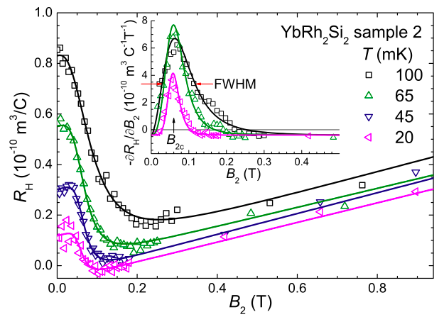
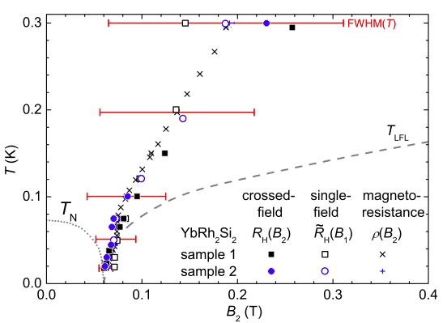
Fermi-surface reconstruction at T_{N}?
Friedemann et al PNAS (2010)
Notes:
of course there are large amounts of existing beautiful experimental results to learn from. Hall effect measurements by Friedemann et al show an abrupt transition from small to a large fermi surface as if the 4f electrons are joining the fermi sea upon breaking out of the magnetically ordered state.
The conventional interpretation of these data would be a partial gapping of the fermi surface due to SDW order but this is argued not to be able to account for the observations.

Slide 6
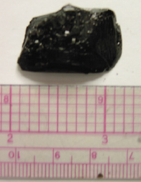
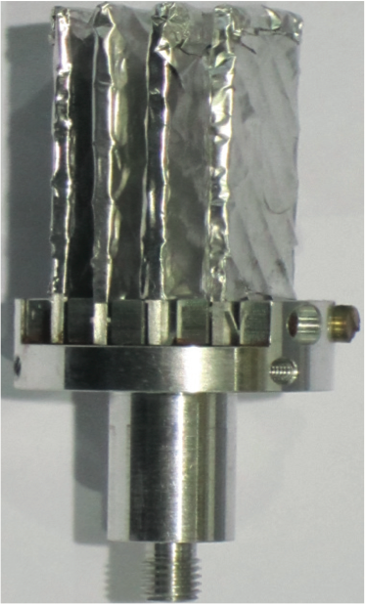
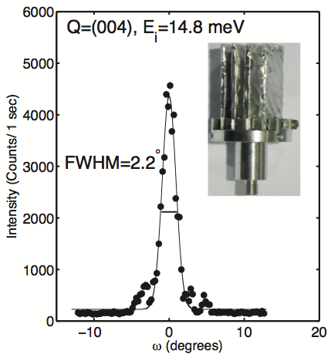
YbRh₂Si₂: neutrons come lately
200 x 5×5 mm² crystals
Mounted with H-free oil
Total mass 3 g
Mosaic FWHM 2º
Penetration depth ≈2 mm
Notes:
YRS was discovered almost seven years ago and yet you are only hearing of single crystal neutron scattering experiments today. Why are neutrons so late to the game?
Two factors: crystal availability and elemental composition. Cedomir Petrovic developed a special new spinning technique to be able to scale the sample size up as needed for these experiments.
Secondly, Rh is one of the most undesirable elements for a neutron scatterer. It is heavily absorbing and there is no transparent isotopic substitute.
To do these experiments, Chris Stock had to create large surfaces of hundreds of YbRh2Si2 single crystals held together by Fomblin hydrogen free pump oil. Such techniques are by now quite commonly in use. The overall sample mosaic rocking curve is illustrated here and does not compromise momentum space resolution.

Slide 7
Field Driven QCP in YbRh₂Si₂
No neutron yet
Rh
Gegenwart et al PRL (2002)
Si
No neutron yet
Yb
11 ×
Notes:
Returning to the phase diagram, I want to point out that one challenge still remains for us. We shall be focusing here on measurements which are above the critical regime associated with SDW ordering.
This is because of beam heating and because thermal anchoring of the samples is inadequate to reach below 100 mK in this experiment. And yet we will have important new information regarding the nature of magnetic correlations upon approaching this ordered state. We shall also be able to probe the high field phase where the energy scale is set by the Zeeman energy and low T becomes less important.

Slide 8
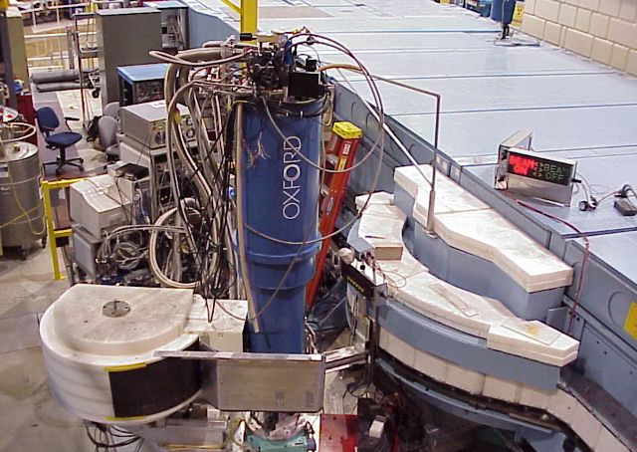
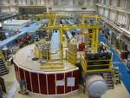
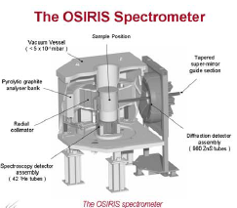

Collaborators
Chris Stock & F. Demmel
ISIS Facility, Rutherford Appleton Lab
C. Petrovic & R. Hu
Brookhaven National Laboratory
H. J. Kang & Y. Qiu
NIST Center for Neutron Research
SPINS
DCS
OSIRIS
Notes:
At this point I would like to acknowledge my collaborators. Particularly I emphasize the work of Chris Stock and Cedomir Petrovic. Chris did all of the experiments and Cedomir Petrovic grew the samples that made it all possible.
We used various types of cold neutron instrumentation both at NIST with the expert assistance of Kang and Qiu and at the ISIS facility assisted by Demmel. These are dilution fridge experiments so we also greatly appreciate the expert assistance of the sample environment groups at both of those facilities.

Slide 9
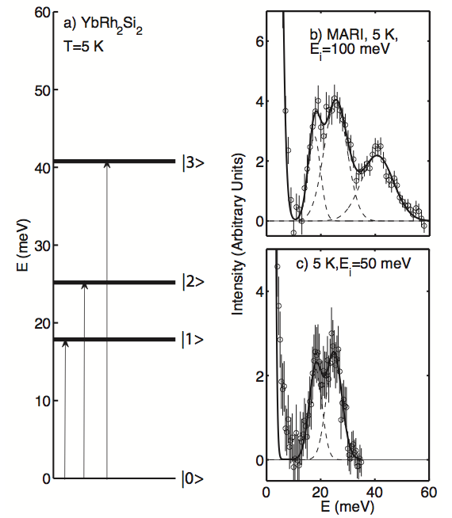
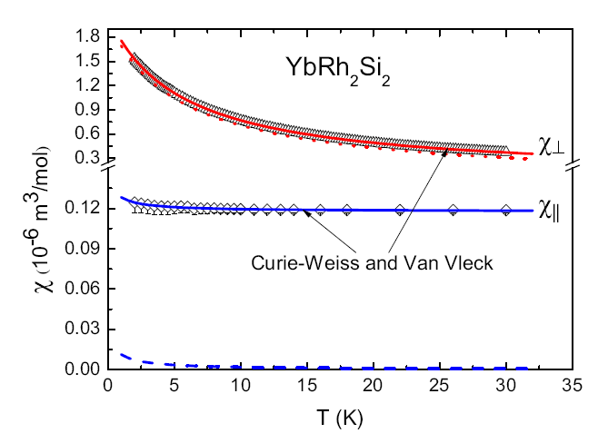
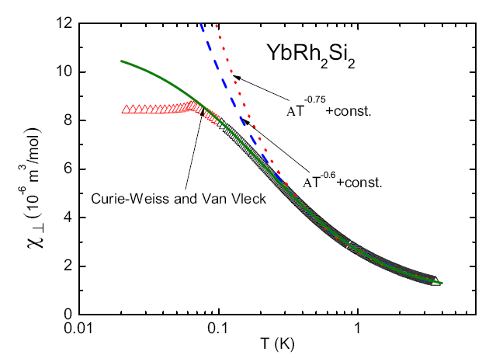
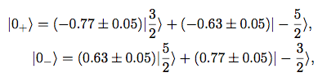
Four CF Kramer’s Doublets in YbRh₂Si₂
Kutuzov et al (2008)
Notes:
First I want to point out that fundamentally we are dealing with the spin and orbital angular momentum of the Yb3+linked through strong spin orbit interactions into a J=7/2 multiplet.
In the point group symmetry of the crystalline electric field, the 8-fold degenerate level is split as much as it can be in zero field into four Kramers doublets. And shown here are inelastic neutron scattering data that clearly resolve the corresponding three transitions from the ground state doublet to the three excited doublets.
The lowest lying level is at 18 meV which corresponds to 200 K and so just as Bruce did for Yb2Ti2O7, we can confine our attention to the lowest lying doublet ground state. By fitting bulk and neutron scattering data the wave function can be determined and is listed here. It represents a planar spin degree of freedom with a very small magnetic moment along the z-direction.
This accounts then for the easy plane response throughout the T<200 K regime. Even into the low T regime the calculation works well though it cannot of course account for the anomaly associated with the magnetic phase transition which fundamentally is a collective phenomenon.

Slide 10
Incommensurate critical fluctuations
Notes:
We were searching for signs of antiferromagnetism so a natural first place to look was (0.5,0.5,1) as well as (001). Nothing was found at those locations. However, we did find low energy magnetic inelastic scattering close to the (002) location in momentum space. (002) is an allowed nuclear Bragg peak so magnetic scattering there indicates FM correlations. Scanning in the perpendicular (hh0) direction we found that the magnetic response actually consists of two peaks slightly displaced along the (hh0) direction.
Recall that we are at a finite energy transfer here. Could the peak splitting be due to dispersion of FM spin waves or is this sign of incommensurability?

Slide 11
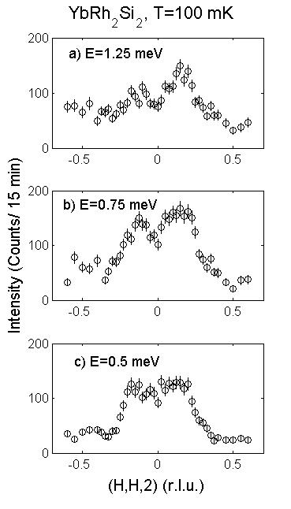
Incommensurate correlations
Notes:
To resolve that we probe the wave vector dependence of magnetic scattering for a range of energy transfers from 1.25 meV (15 K) and down. In the full range of energies we find that same characteristic splitting of (0.14,0.14,2). Note this is an incommensurability within the basal plane direction corresponding to a length scale of 3.6 times the body diagonal.

Slide 12
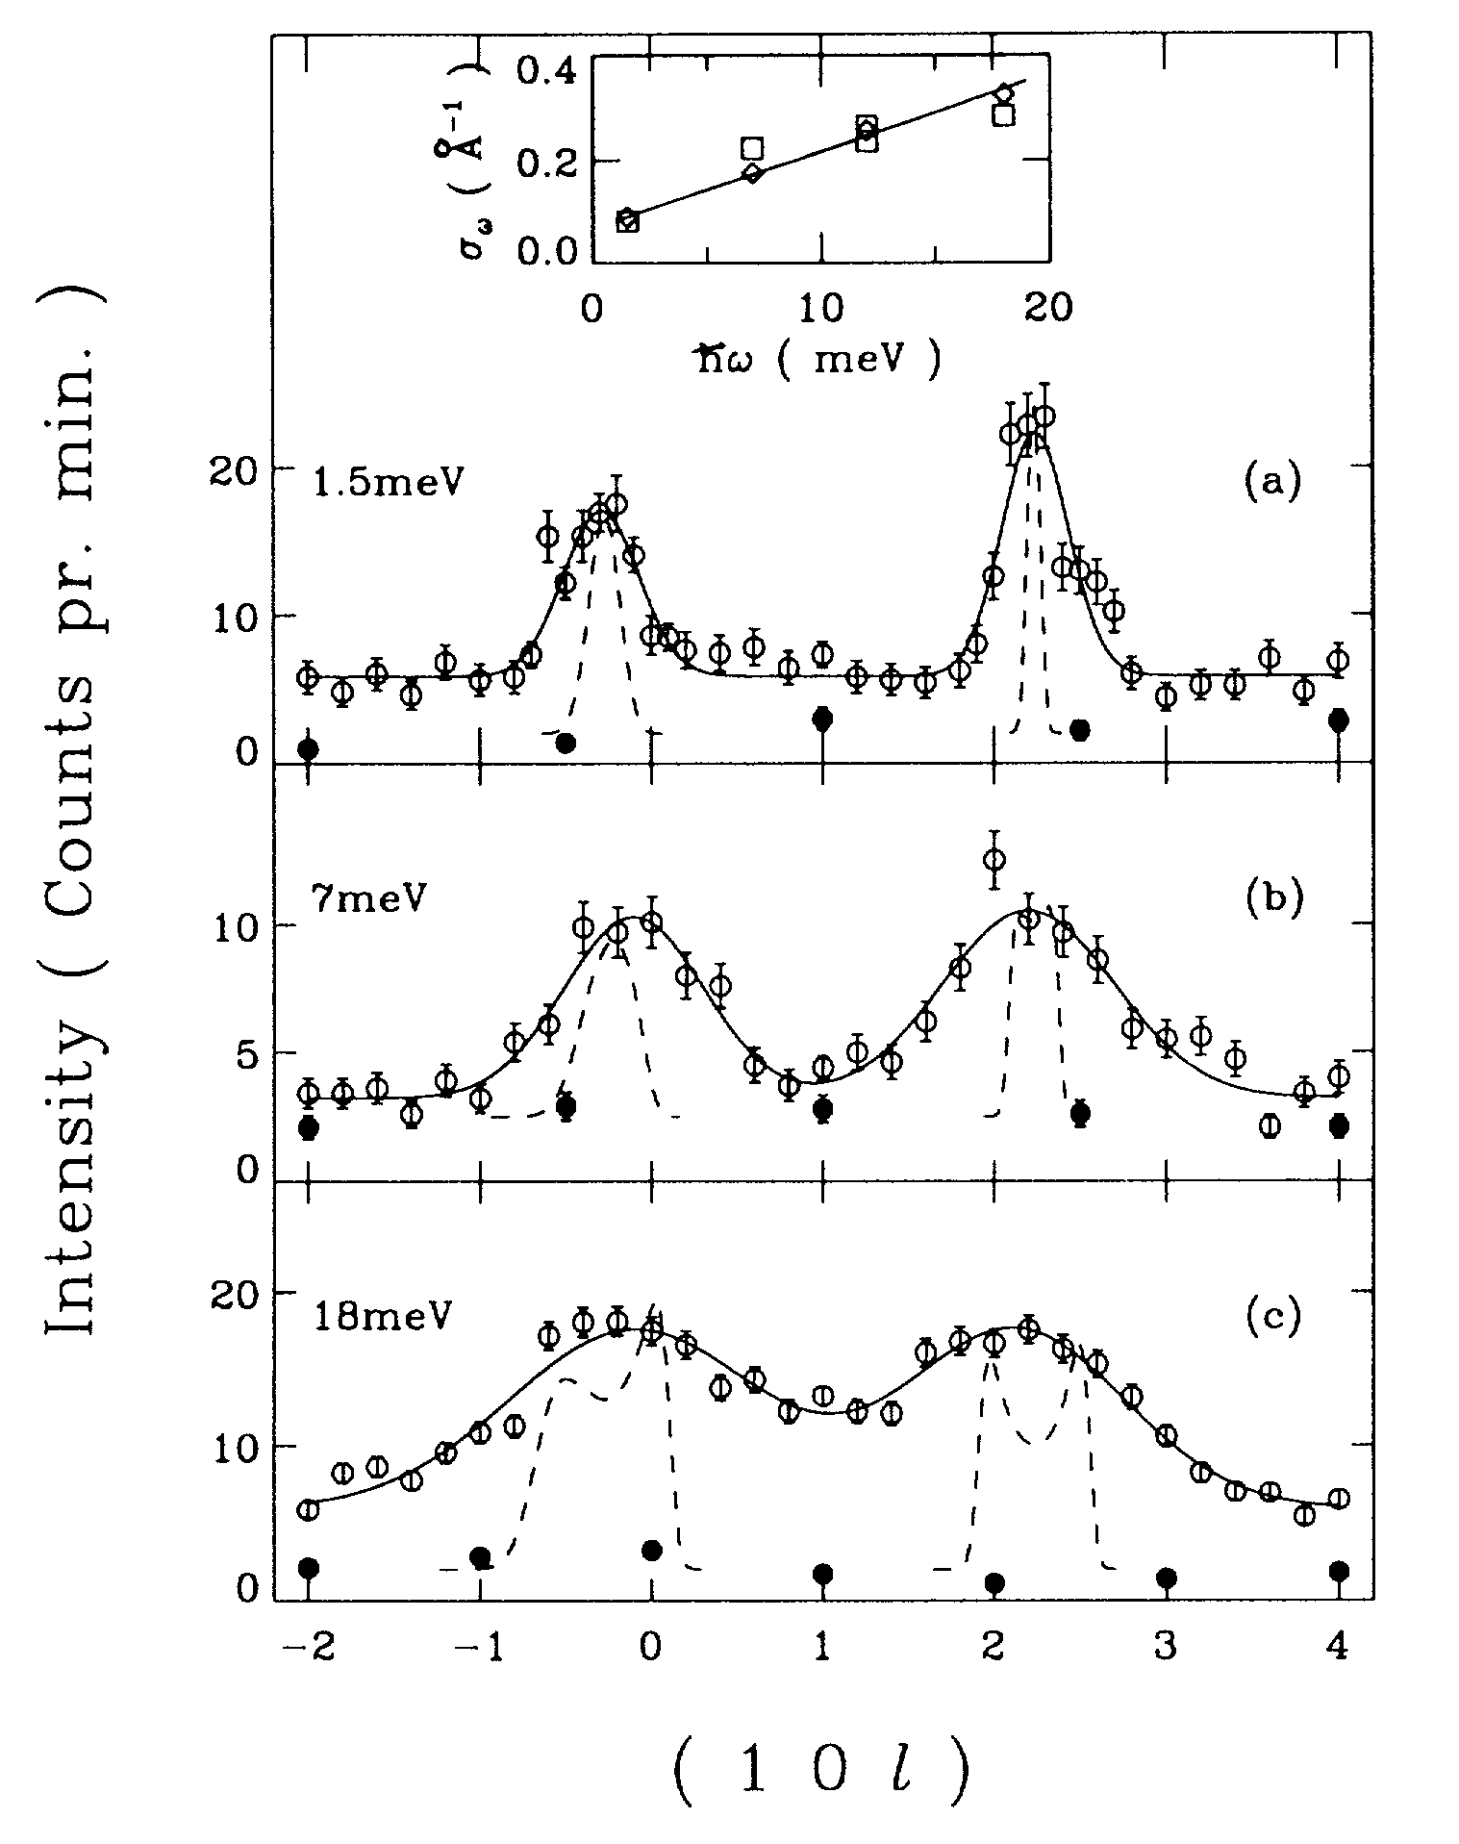
Spin Fluctuations & Neutrons Scattering
V_{2-y}O₃ Bao et al. PRL (1993)
Notes:
Before moving on to YRS, I’d like to discuss what kind of dipole active excitations may we find in a spin density wave system? Again we take the example of V2O3. We are showing wave vector dependence of magnetic neutron scattering but this time at finite energy transfer.
Magnetic neutron scattering measures the two point dynamic spin correlation function which can be related to the dissipative part of the generalized suscrptibility through the fluctuation-dissipation theorem.
There are two sources of wave vector dependence that must be taken into account. An exchange or correlation effect that is typically approximated by the listed RPA expression. J(q) is the lattice FT of the exchange integrals.
The effect of the bandstructure is manifest in the wave vector dependence of the lindhard susceptibility that we have denoted chi_0.
When there is a peak in the magnetic neutron scattering cross section this directly indicates a maximum in the conduction electron spin susceptibility. For metallic VO3 we find the same characteristic wave vector appearing again in the inelastic spectrum. There is broadening with increasing energy and this results from two particle process so that when energy transfer increases there is a broader range of momenta that can contribute.
Our interest is however, not in the ordered SDW state but what happens at the critical pressure or under the critical conditions for suppression of this order. In V2O3 the quantum critical pressure is thought to be xx Gpa. Neutron scattering at those pressures is quite a challenge and the corresponding experiments have not yet been carried out.

Slide 13
Spin fluctuations near MIT in V₂O₃
P I

Slide 14
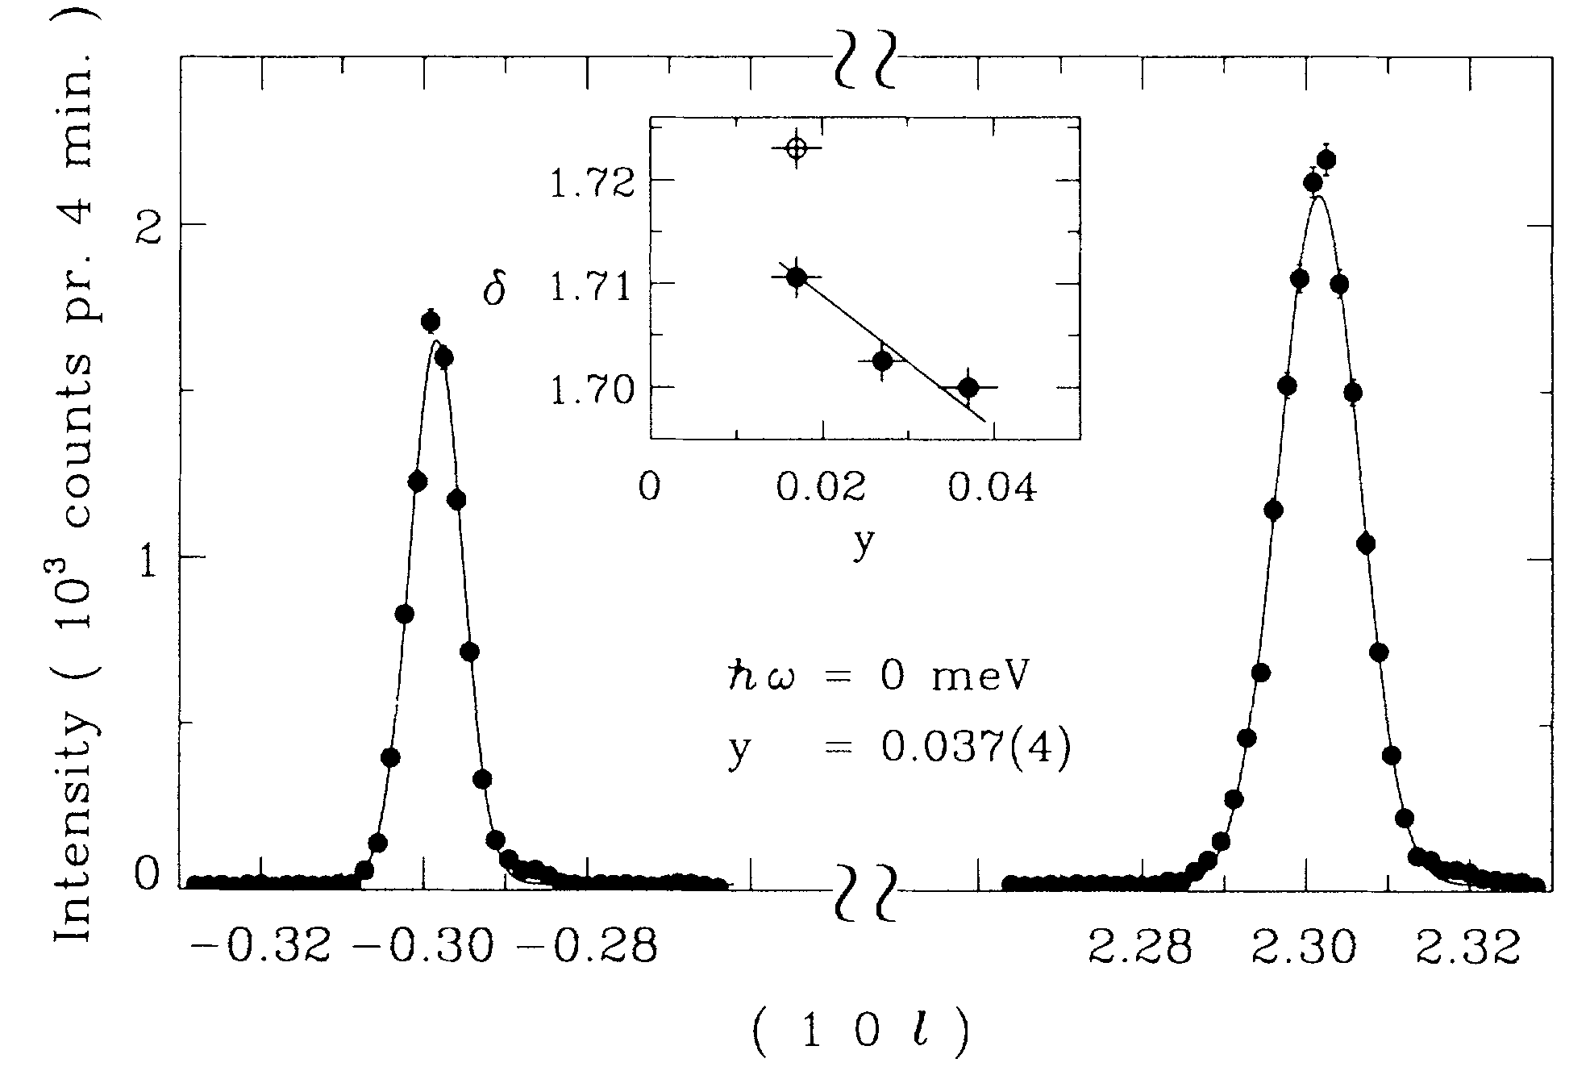
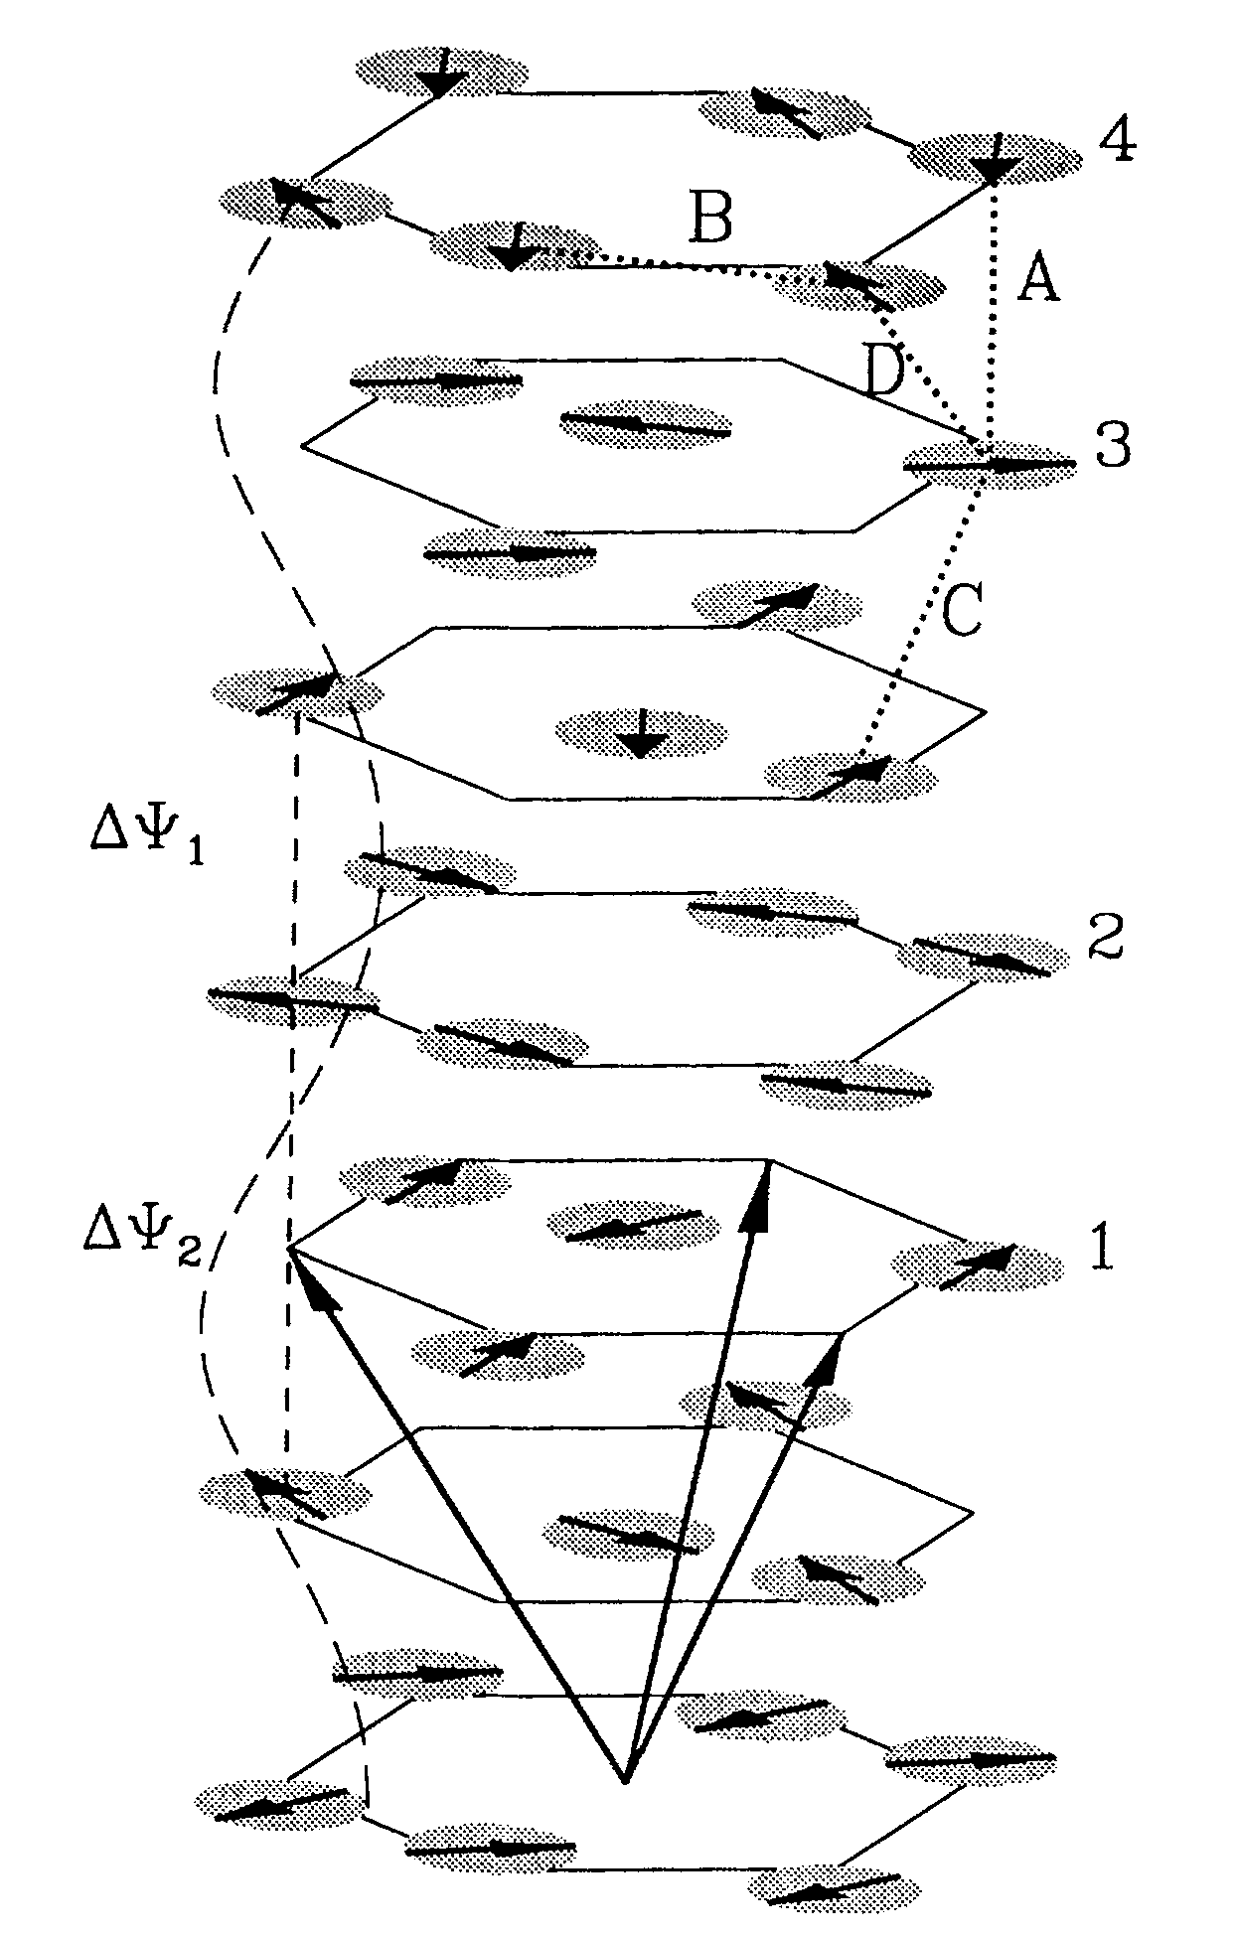
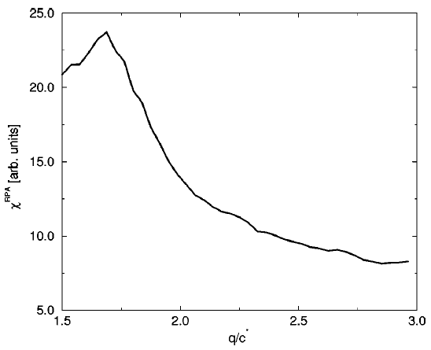
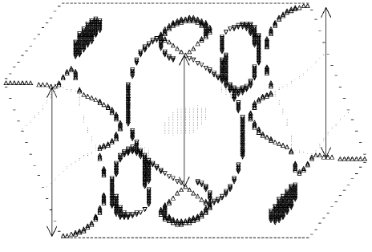
Spin Density Wave Order
Bao et al. PRL (1993)
Wolenski et al., PRB (1998)
Experimental Q_{c}
Notes:
Rather than a zero T transition from an AFI into a metal Bao and I detected some time back a spin density wave phase. The images show the resolution limited Bragg peaks and the inferred helical modulation of the spin density.
How can we distinguish this from a conventional long range ordered insulating magnet. Well we cannot. However, one finds that the wave vector varies with effective pressure whence effective electron density and fermi surface volume. This is consistent with a fermi surface nesting description and a spin density wave order. The band structure language used to describe magnetism here is quite similar to what is being used to think about the magnetism of iron pnictides.
Shown below is the complex fermi surface for V2O3 metal from which the wave vector dependent susceptibility was calculated. Low and behold one finds that this calculation can actually predict the wave vector of the incommensurate order and this generally constitutes convincing evidence that ordering arises from nesting.
And why am I reminding you of this? It’s because what we found years ago in this material reminds me quite a bit of what we are now seeing in YRS.

Slide 15
Incommensurate correlations
Notes:
To resolve that we probe the wave vector dependence of magnetic scattering for a range of energy transfers from 1.25 meV (15 K) and down. In the full range of energies we find that same characteristic splitting of (0.14,0.14,2). Note this is an incommensurability within the basal plane direction corresponding to a length scale of 3.6 times the body diagonal.

Slide 16
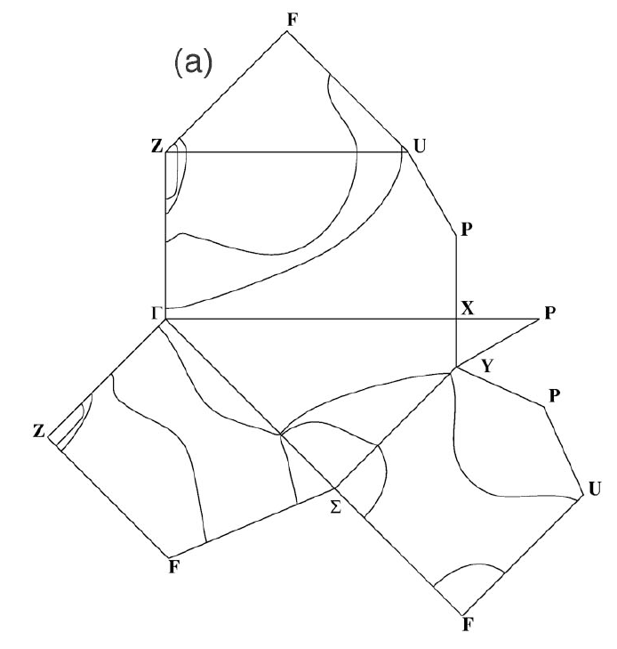
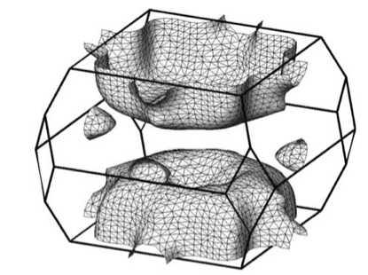
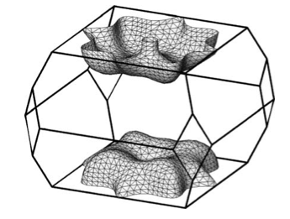
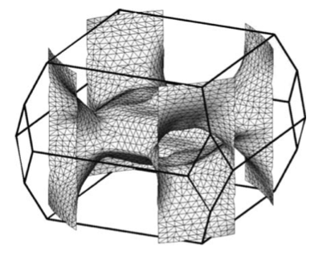
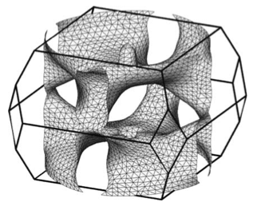
SDW from nesting instability?
Friedemann et al (2010)
Norman PRB (2005)
(1-(a/c)², 0,2)
(1-(a/c)², 1-(a/c)²,2)
(002)
(111)
(110)
(110)
Norman PRB (2005)
Notes:
Now where does this small wave vector come from? Well it happens that Mike Norman has calculated the fermi surface for this materials and he finds a complicated structure that consists of four different bands. Of these two carry more than 90% of the f-electon spectral weight and these bands are both hole bands.
Indicated here is an approximate nesting condition between two hole bands with a wave vector that I first though matched perfectly until Mike was so kind to point out a factor of 2 error. Still I think there is a potential for nesting along that body diagonal direction that is worth further exploration.
Looking at the actual FS calculated by Mike large areas of the two fermisurfaces nest and one may surmise that an elevated magnetic susceptibility can result from this LDA band structure.
This suggests the low T AF phase that is broken out from via applied field is an incommensurate spin density wave associated with a band description of the f electron system. This is important because being a FS based description of magnetism, it would indicate we are dealing with a dressed kondo lattice system throughout the phase diagram and that the FS does not fundamentally change across the magnetic phase transition. However, that was many ifs and further information and analysis is needed.
Lacking data from the relevant low T regime, I am going to examine the nature of the high field kondo lattice phase. From susceptibility data we know that YbRh2Si2 behaves almost as a FM with a greatly enhanced magnetic susceptibility in the low T limit and a Weiss temperature that is almost zero.

Slide 17
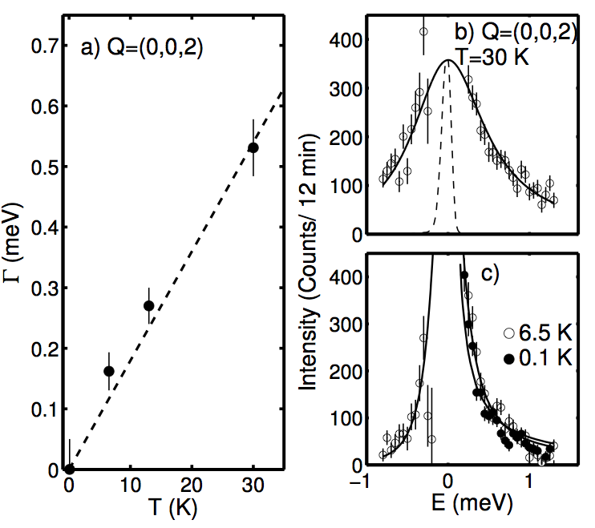
Apparent FM correlations upon heating
0.3 K
Notes:
The nearly FM nature of the system is also apparent in the neutron scattering data where the magnetic scattering is always close to the FM point and upon heating actually becomes centered at that location in momentum space.
In keeping with this and as we shall focus on the higher E and higher T features, In the following we shall examine the spectrum of excitations not at the incommensurate point but at the FM point.
There we find clear evidence that the spin relaxation rate decreases and actually tends towards zero as T->0. This is actually something that I have not previously observed in neutron scattering from a metallic system.

Slide 18
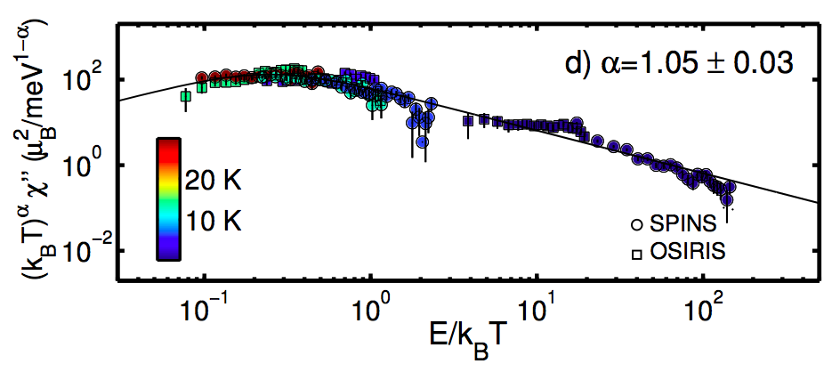
Quantum critical scaling for Q≈0
Notes:
So we can carry out a scaling analysis for the quasi-FM-critical fluctuations. Based on the fitting that we have conducted and the linear in T gamma we expect that T times chi” should be a function of E/T only.
In accordance with practices for CeCu6 we have expanded upon the scenario by allowing for an exponent alpha. Data from different T are plotted in different colors. We find scaling consistent with the data for alpha close to 1.

Slide 19
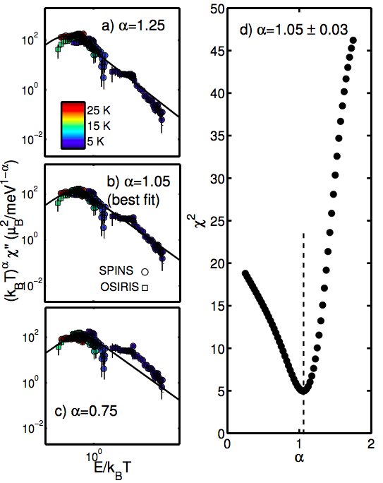
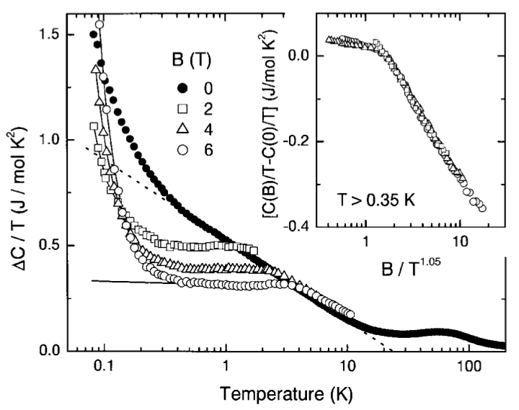
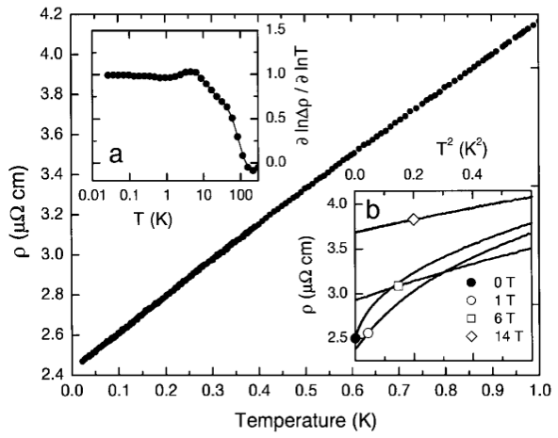
Critical Exponent
Trovarelli et al PRL (2010)
Notes:
We can examine the error bar on this exponent by re-plotting the data for different values of alpha and calculating the corresponding chi^2 deviation. We find the data place alpha anywhere from 1 to 1.1. We don’t think this scaling exponent is actually relevant for the really low T quantum critical regime for two reasons: 1) we are not in the relevant T and E regime 2) we are not at the relevant critical wave vector. However, we are dealing with some quasi-quantum-critical regime that may be compared to specific heat and resistivity data that also display scaling behaviors in that temperature regime.
I look forward to talking to theorist at this meeting about the appropriate understanding of this regime. Particularly I notice a nice papers from Chubukov some years ago indicating that the critical regime for an itinerant FM can be unstable towards an incommensurate state and this type of scenario does appear to be relevant here.
So in other words we may be looking at a separate high T quasi-critical regime with FM fluctuations replaced by incommensurate correlations from fermi surface nesting in the very low T limit.

Slide 20
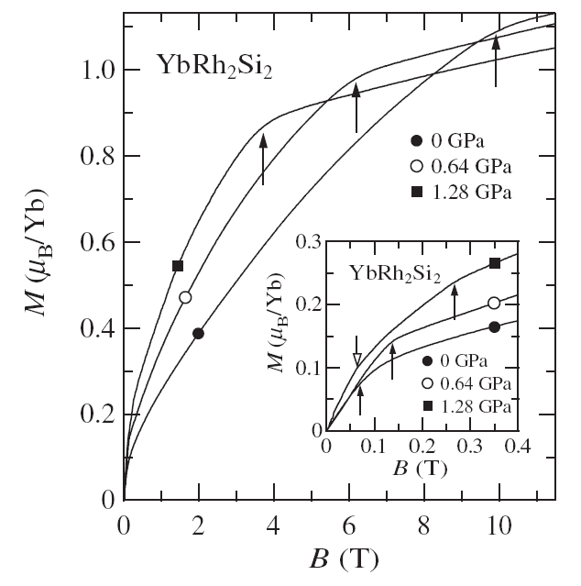
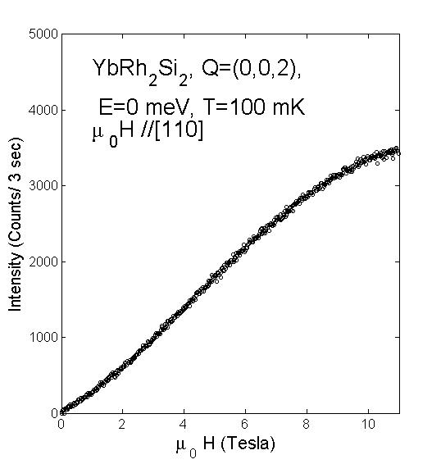
Magnetization SQUID & neutrons
Gegenwart et al., NJP (2006)
C. Stock et. al., (2009)
Notes:
We now turn to the ferromagnetic response. Near FM criticality we should see a large effect of applying a magnetic field As previously noted there is a high Q=0 susceptibility and hence the system can readily be magnetized much more than a typical antiferromagnetic heavy fermion system.
This graph shows on the left magnetization at various external pressures. These data indicate the collapse of a second energy scale upon approaching the critical pressure.
On the right are shown ambient pressure neutron diffraction data. They constitute confirmation of the magnetization data through neutron diffraction which measures the mod squared magnetization. Consistent with the SQUID magnetization data there is a characteristic 10 T saturation field scale.
What neutron scattering can contribute on top of a magnetization measurement is measurements of the Q_w dependent excitation spectrum in the magnetized state.

Slide 21
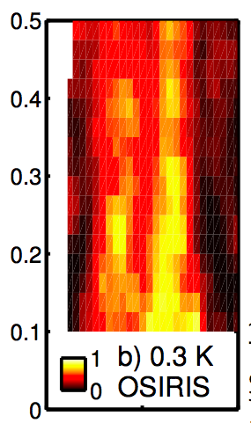
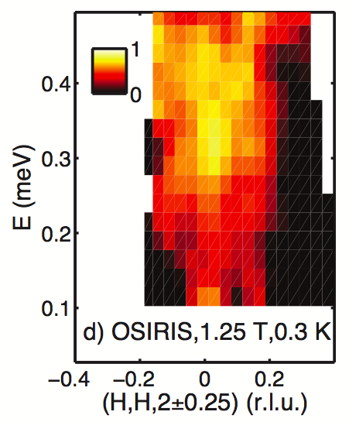
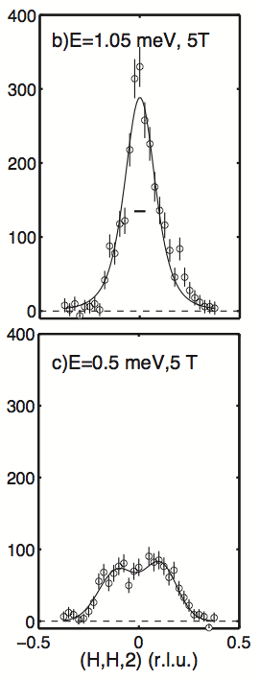
From SDW to FM correlations with field
Effects of field:
Upward shift of spectral weight
Sharp peak at FM position
Field induced resonance
-0.5 0 0.5
(hh2) [r.l.u.]
Notes:
I first show the low field and energy regime where as previously discussed one sees indications of ridges that may result from Fermi surface nesting. Upon appliication of a field one sees that the spectrum becomes dominated by a single ridge at Q=0.
At 5 T the features are more spread out so that it can be appreciated that at high energies there is now a single peak a the FM point whereas at lower energies the incommensurate features persist. This may be a crucial point in that as we shall see the resonance can be associated with a Kondo screened spin whereas the lower energy incommensurate features are associated with nesting instability. Both features present simultaneously indicates Kondo screened spins displaying the incommensurate hallmark of an impending SDW transition.

Slide 22
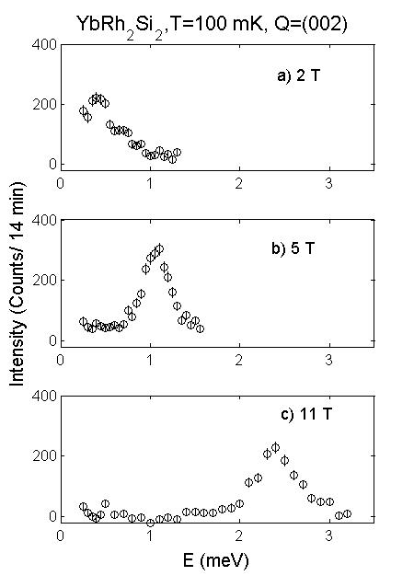
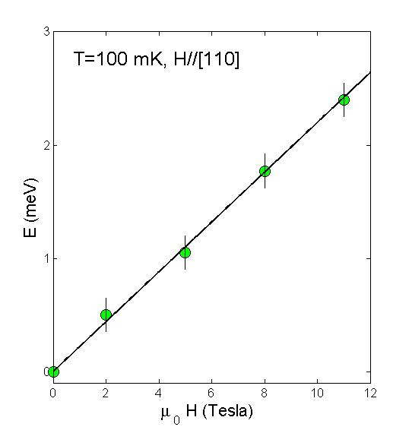

Field Induced Resonance
C. Stock et. al., PRL (2012)
Notes:
Going now to higher fields and higher energies we have the surprising discovery of a spin resonance emerging from the continuum. Plotting this resonance energy as a function of applied field, one finds that the resonance energy is in perfect agreement with lower field EPR measurements.
We can conclude that we see with neutrons EPR associated with the induced magnetization of this nearly FM system. This should perhaps not be a surprise. However, it is the first time I am aware of the observation of such a phenomenon in a heavy fermion system. I think this may be due to the fact that the uniform susceptibility is high so that the system is readily magnetized.
This raises the resonance energy to within the range readily probed with neutron scattering, it increases the corresponding spectral weight and it may also help to move the resonance beyond damping processes that would otherwise obscure it.

Slide 23
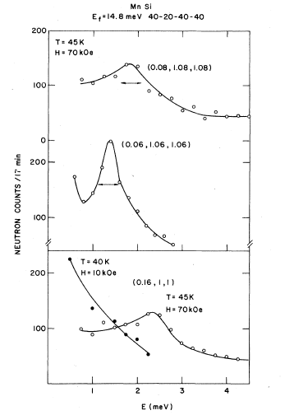
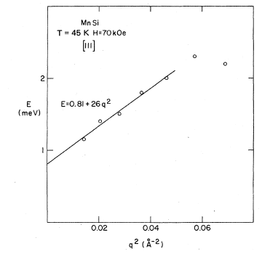
MnSi: Field induced “ferromagnons”
Tarvin et al., Phys. Rev. (1978).
Notes:
Something quite similar is actually seen in another weak itinerant FM MnSi in its paramagnetic state. As magnetization is induced there is a finite energy FM resonance in the spectrum. Again it is to be expected that the magnetization will have a mode of precession about the field direction.
In the case of MnSi there is a whole branch of excitations that develops emanating from the Q=0 resonance and it disperses according to Q^2. This is to be identified with the ferromagnon branch associated with the induced magnetization in a weak FM.

Slide 24
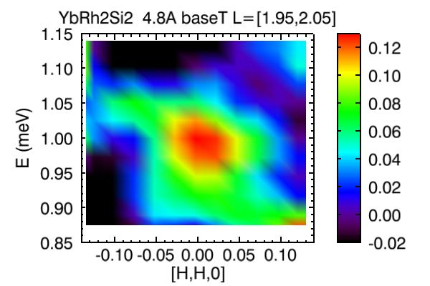
YbRh₂Si₂ : A spot in Q-space
1.25 Tesla
C. Stock et. al., PRL (2012)
Notes:
YbRh2Si2 is however, distinct in the sense that there is no propagation associated with this mode. As shown in this figure, intensity is strictly only found at the q=0 fm point such that a field generates something akin to a dynamic 3D Bragg peak.
So we should think of the resonance as a local property a precession that cannot propagate. This implies that the wave vector dependence should be interpreted as a form factor describing the spatial extent of the precessing spin density.

Slide 25
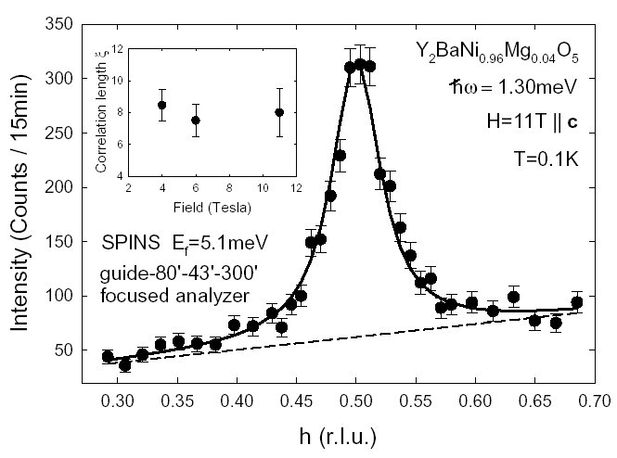
Form factor for chain-end spin
Kenzelmann et al. PRL (2003)
Notes:
We have observed similar spin precession phenomena in spin-1 Haldane chains. Doping with Mg creates a very large number of chain ends each of which carries a spin-1/2 edge state.
High field neutron scattering shows an ESR resonance with a Q-dependence that reveals an oscillatory nature of the magnetization density back into the spin chain.

Slide 26
Interpretation of the spin resonance
Coincident g-factors indicate this is Electron Spin Resonance
Coherent precession of spin density
Similar to a Kondo length scale
Kondo Screened spins for B>B_{c}
Notes:
A similar interpretation can be applied to our observations in YRS. The resonance energy coincides with the ESR frequency. From the Q-space peak width one obtains a spatial extent of 6 AA within the basal plane. Note that this greatly exceeds the size of the spin density distribution on a single 4f site.
It does however, compare well to the Kondo length scale that one might extract from dimensional analysis with an effective mass extracted from the Sommerfeld constant
Regardless of the numerology, the data clearly indicates dressed spins in the high field phase and this is consistent with the concept of this being a magnetized Kondo lattice fermi liquid.

Slide 27
Conclusions
Effective FM critical regime for T>1 K
Lower T: Incommensurate critical fluctuations
SDW instability may arise from nesting of hole fermi-surfaces
B suppresses SDW favoring FM polarized metal
Meso-scopic spin precession indicates Kondo screened 4f spin degree of freedom
SDW correlations persist at lower energies in magnetized kondo lattice state
Stock et al PRL (2012)
Notes:
That concludes our results and now I would like to restate conclusions. We have observed quantum critical spin fluctuations in YbRh2Si2. These are excitations that are relaxational in nature and lack a finite energy scale in the low T limit.
The fluctuations do however have a characteristic finite wave vector. This indicates a proximate spin density wave instability. I identified this characteristic wave vector as associated with nesting of the large hole fermi surfaces obtained using LDA by Mike Norman.
Application of a magnetic field suppresses the SDW response in favor of commensurate FM fluctuations. At elevated fields we see a sharp FM resonance mode which seems to be the manifestation in neutron scattering of the previously observed EPR peak. As opposed to other weak itinerant magnets there is however, not a Ferromagnon branch associated with the high field spin resonance. This indicates strong FM damping at any finite wave vector where the resonance is no longer protected by a conservation law.

Slide 28
Outlook
SDW phase
  Can band-theory account for incommensurate Q_{c}
  Q_{c} may help to clarify nature of low field state and field driven transition
  Detect SDW Bragg peak and measure critical exponents
  Pressure or doping driven changes in Q_{c}
QCP
  Inelastic scattering at lower T and ħω
  Identify field driven QC metal with higher critical temperatures and/or less neutron absorption
Notes:
I presented the first inelastic neutron scattering data from a single crystal sample. These are preliminary data and much remains to be done. In the putative spin density wave phase we need to get cold enough and detect the magnetic Bragg peak. With that we will also be able to measure the order parameter critical properties as a function of applied magnetic field.
With a SDW nesting description of AFM we should expect that the critical wave vector changes with the Fermi surface. Hence we are interested in looking at the pressure dependence and the doping dependence of the SDW and nesting wave vector. This can in principle be done with diffraction or inelastic scattering.
The experiments thus far have not detected deviation from omega/T scaling. This does not conflict with lower T bulk data because we are not in the relevant regime of temperature and energy transfer.
These are difficult experiments because of the very low characteristic energy scale so it would be of interest to identify a material that is more appropriate for neutron scattering experiments both with a somewhat higher energy scale but also without the problematic neutron absorbing Rh isotope.
Thank you for your attention.

