Slide 1
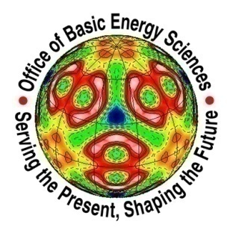


Evolution of spin excitations in high-temperature FeAs-based superconductors
Pengcheng Dai
The University of Tennessee (UT)
Institute of Physics, Chinese Academy of Sciences (IOP)
http://pdai.phys.utk.edu

Slide 2
Miaoyin Wang, L. W. Harriger, O. Lipscombe, Chenglin Zhang, Mengshu Liu
UT
Meng Wang, Huiqian Luo, Shiliang Li
IOP/Beijing
Jeff Lynn, Songxue Chi
NIST center for neutron research
M. D. Lumsden, D. L. Abernathy
HFIR and SNS, ORNL
G. F. Chen, Nanlin Wang
IOP, Beijing
D. T. Adroja, T. G. Perring
ISIS
Tao Xiang (IOP, Beijing),
Jiangping Hu (Purdue, IOP, Beijing)
G. Kotliar and K. Haule
Rutgers University

Slide 3
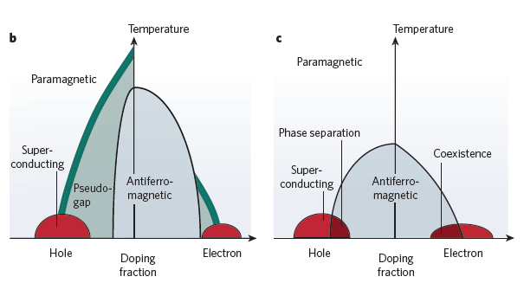
Phase diagrams of copper oxide and iron arsenide superconductors.
Mazin, Nature 464, 183 (2010).

Slide 4
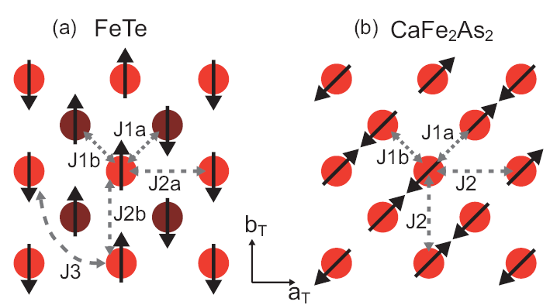
Spin structures of Fe-based parent compounds
FeTe
11
CaFe2As2
122

Slide 5
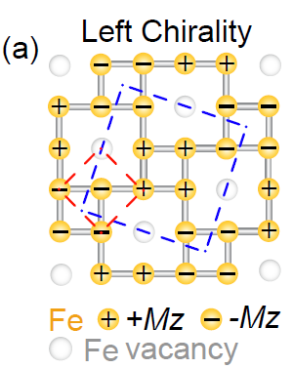
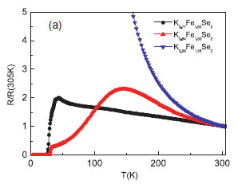
Spin structures of Fe-based parent compounds
(Rb,K,Cs)Fe1.6Se2
Tn=550 K, and parent compound is an insulator!

Slide 6
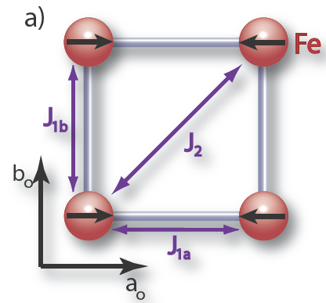
The Heisenberg Model

Slide 7
Low Temperature Ca(122)
Ca(122)

Slide 8
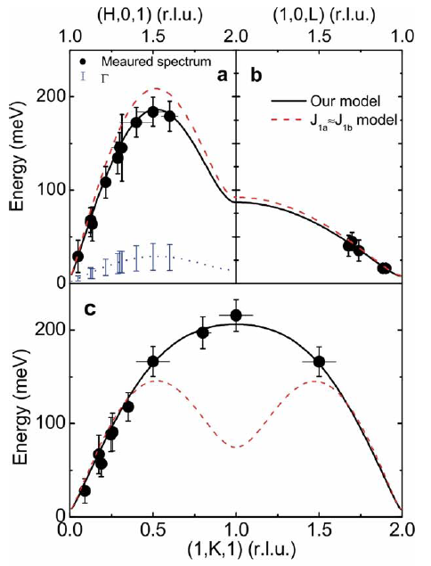
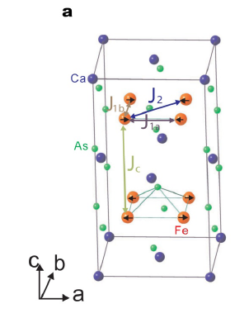
Magnetic exchange couplings in CaFe₂As₂
SJ1a = 49
SJ1b = -5.7
SJ2 = 19
SJc = 5.3 meV
Jun Zhao et al., Nature Physics 5, 555 (2009).

Slide 9
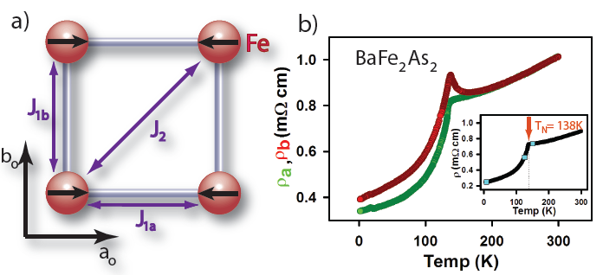
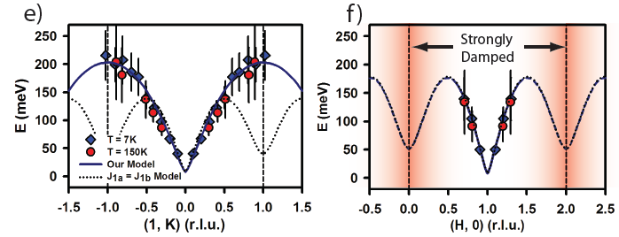
Wave vector dependence of spin-waves in BaFe₂As₂

Slide 10
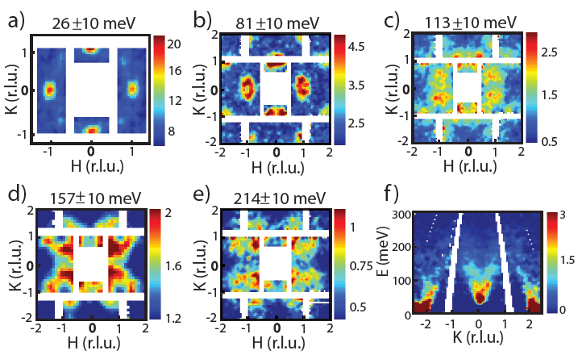
Wave vector dependence of spin-waves in BaFe₂As₂

Slide 11
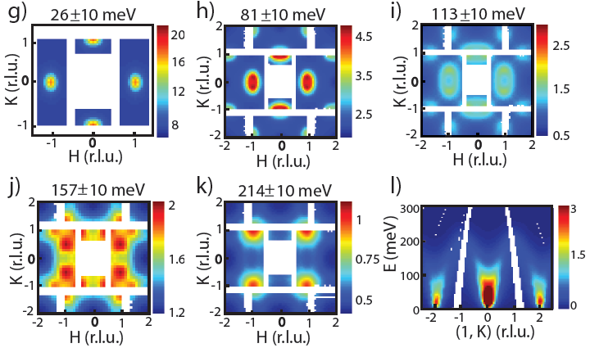
Model calculation of spin-waves in BaFe₂As₂
SJ1a = 59 meV
SJ1b = -9 meV
SJ2= 13 meV
SJ3 = 2 meV,
Harriger, PRB, (2011).

Slide 12
Comparison of Low T Exchange Couplings
 | J_{1a} | J_{1b} | J₂ | J_{c}
BaFe₂As₂ (7K) | 59.2 | -9.2 | 13.6 | 1.8
CaFe₂As₂ (10K) | 49.9 | -5.7 | 18.9 | 5.3

Slide 13
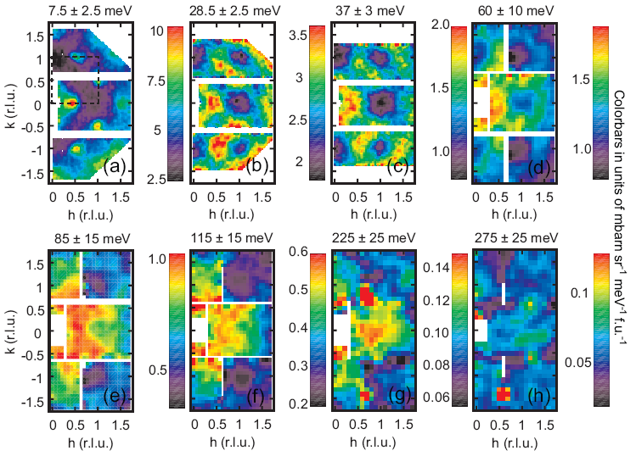
Spin waves in FeTe

Slide 14
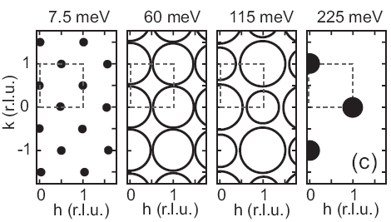
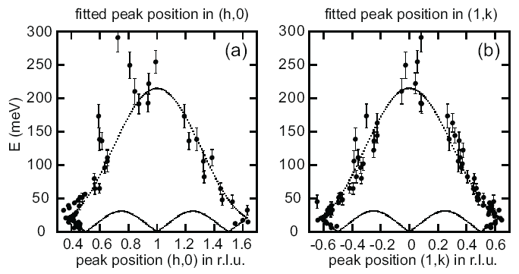
Spin waves in FeTe
SJ1a = -17 meV
SJ1b = -51 meV
SJ2a=SJ2b = 22 meV
SJ3 = 6.8 meV
Lispcombe et al., PRL (2011).

Slide 15
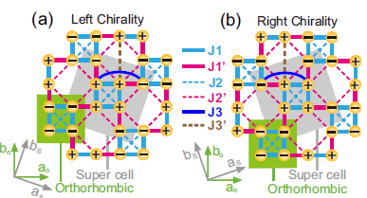
Spin structures of Rb_{0.8}Fe_{1.6}Se₂ insulating parent compounds

Slide 16
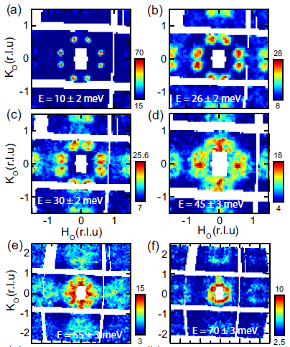

Slide 17
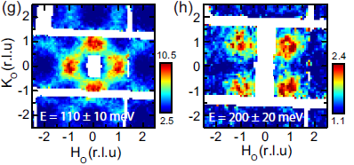
Spin waves of RbFe_{1.6}Se₂ in the ab-plane

Slide 18
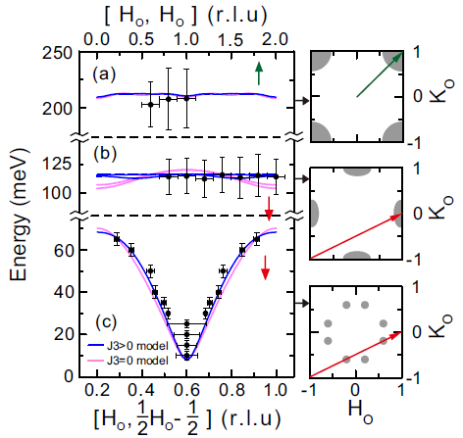

Slide 19
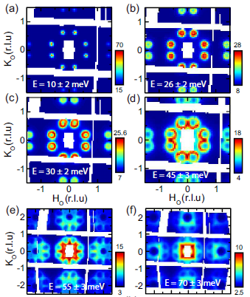

Slide 20
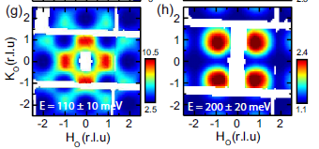
Model spin waves of RbFe_{1.6}Se₂
M. Y. Wang et al., Nature Comm. 2, 580 (2011).

Slide 21
Bottom line, similarities between different Fe-based parent compounds
 | J_{1a} | J_{1b} | J₂ | J_{c}
BaFe₂As₂ (7K) | 59.2 | -9.2 | 13.6 | 1.8
CaFe₂As₂ (10K) | 49.9 | -5.7 | 18.9 | 5.3
 | J_{1a} | J_{1b} | J₂ | J_{c}
FeTe (7K) | -17 | -51 | 22 | 0
RbFe_{1.6}As₂ (5 K) | -36 | 15 | 12 to 16 | 1.4

Slide 22
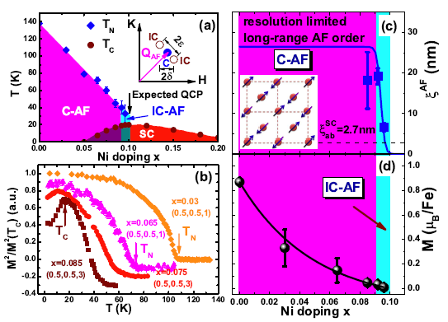
How superconductivity coexists with AF order in
Ni-doped Ba122 compounds?

Slide 23
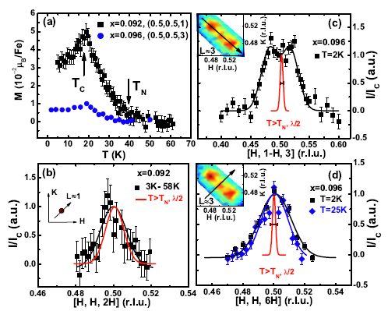
Commensurate to incommensurate transition near x=0.093 Ni-doping in Ni-doped Ba122
See previous work by Pratt et al., PRL 106, 257001 (2001).

Slide 24
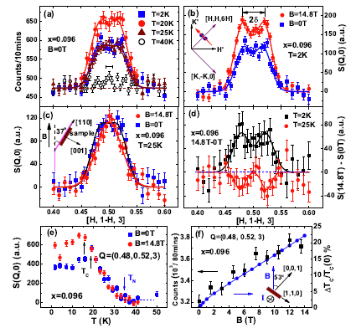
Short-range incommensurate AF order competes with superconductivity for x=0.096

Slide 25
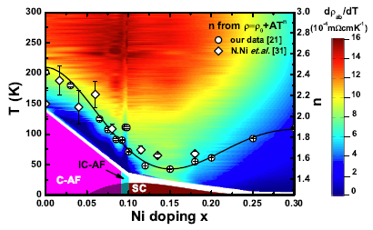
Possible Quantum Critical Point?
Microscopic or mesoscopic coexisting AF order and superconductivity in the underdoped regime?

Slide 26
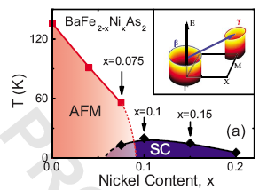
Why does this have anything to do with superconductivity?

Slide 27
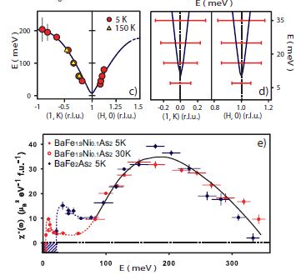
Electron-doping hardly affects spin excitations in Fe-based superconductors

Slide 28
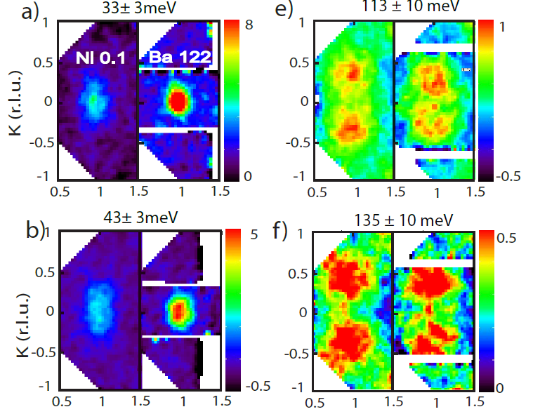
The effective of electron-doping on spin excitations

Slide 29
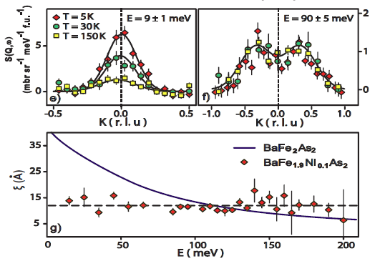
Low-energy spin excitations knows superconductivity, and can mediate pairing.

Slide 30
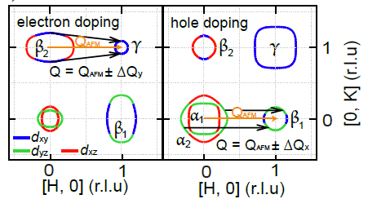
The effective of electron and hole doping?

Slide 31
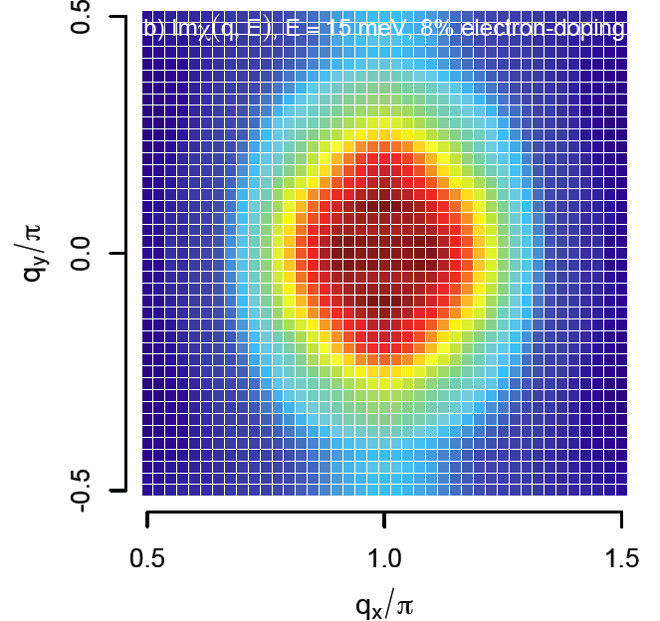
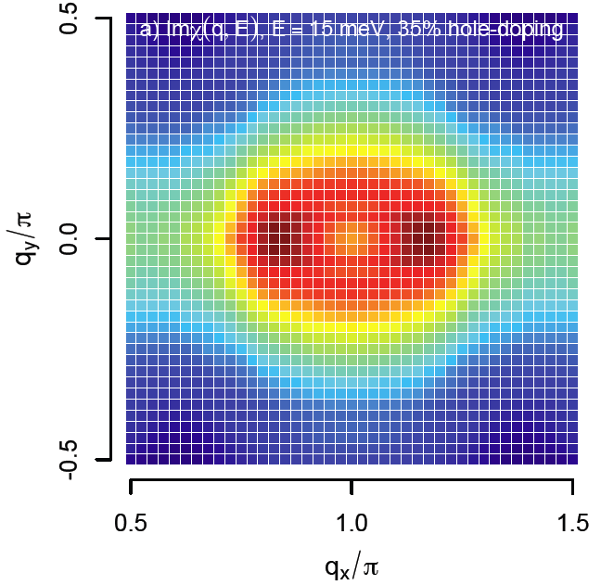
The line shape of spin excitations in
electron and hole doped BaFe2As2 from RPA.

Slide 32
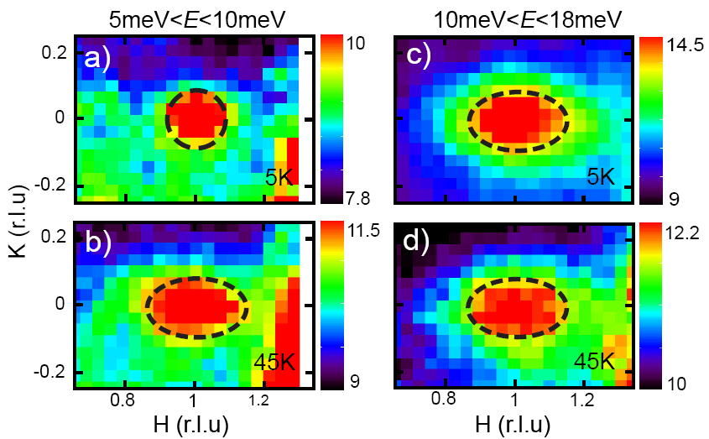
Temperature dependence of the spin excitations for superconducting Ba_{0.6}K_{0.4}Fe₂As₂

Slide 33
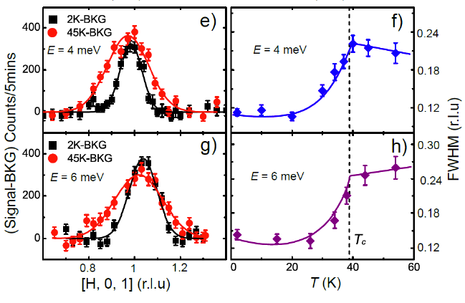
Energy-Temp dependence of the spin excitations for superconducting Ba_{0.6}K_{0.4}Fe₂As₂
Chenglin Zhang et al., Scientific Reports 1, 115 (2011).

Slide 34
Summary
Spin waves in parent compounds have a common feature that is associated with J2 of the effective exchange coupling constant.
There are no long-range AF order coexists with superconductivity near optimal doping.
Coexisting AF and SC phase may either be microscopic or mesoscopic.
Electron-doping hardly affects the high-energy spin excitations in Fe-based superconductors.
Hole-doping dramatically affects the spin excitations spectra of undoped parent compounds!

