Slide 1
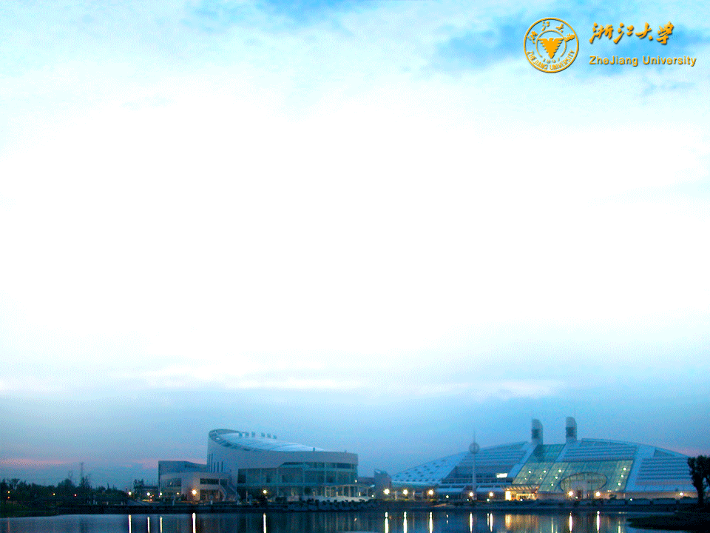
Field-induced Fermi surface reconstruction near the magnetic quantum critical point in CeRhIn₅
Huiqiu Yuan
Department of Physics, Zhejiang University, CHINA
Workshop on Heavy Fermion Physics: Perspective and Outlook, IOP, CAS, 2012/1/7-9

Slide 2
Collaborators
Zhejiang U:
Lin Jiao
Tian Shang
Ye Chen
Jinglei Zhang
MPI-CPfS:
Frank Steglich
Ramzy Daou
Sungkyunkwa U:
Tuson Park
Rice U:
Qimiao Si
LANL:
Yoshimitsu Kohama
Marcelo Jaime
John Singleton
Eric Bauer
H. O. Lee
Joe Thompson

Slide 3
OUTLINE
Introduction
The H-T phase diagram of CeRhIn5
Field induced changes of Fermi surface
Summary and outlook

Slide 4



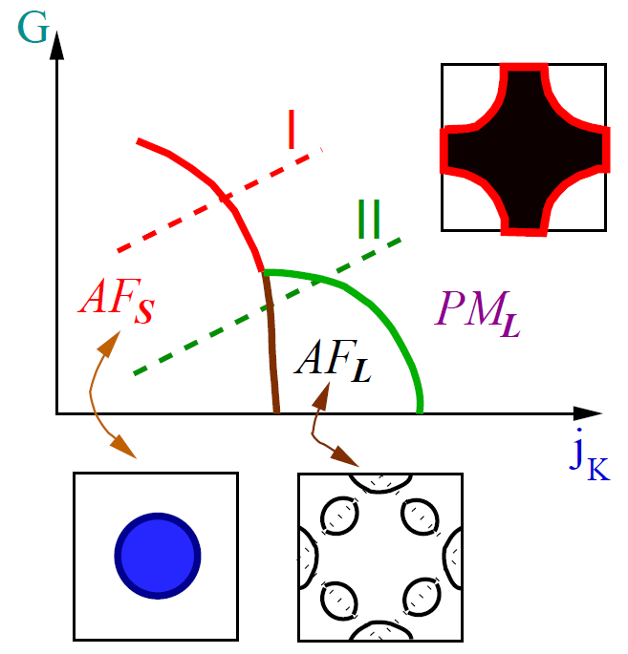
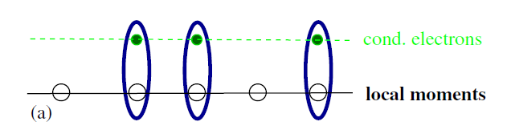
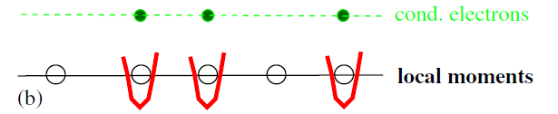
The global phase diagram in Kondo Lattice
QM Si, Phys. B (2006)
H=Hf+Hc+Hk
= + +
I: Local QCP
II: SDW-type QCP
G=Innn/Inn:
spin frustration
AFs: AFM with small FS, No static Kondo screening
PML: HF Fermi liquid
Kondo screening fully developed
Lifshitz transition
AFL: Intermediate region.
Kondo screening develops
inside AFM state
Notes:
Our results seem to be able to be described by the global phase diagram in Kondo lattice proposed by Qimiao Si. Here the parameter G describe the degrees of spin frustrations, that is the ratio of the antiferromagnetic next-nearest-neighbor interaction over the nearest neighbor one and jK is antiferromagnetic Kondo intereaction. From this phase diagram, one can see that there exists two type of Quantum critical points: the first one is the local quantum criticality, which shows a direct change from AFM with small fermi surface to a paramagnet with large Fermi surface. In this case, the f-electron is delocalized while crossing the QCP. The second scenario is the SDW-type quantum criticality. In this case, the Kondo screening develops inside the AFM state, leading to an increase of Fermi surface volume even inside the AFM state. With further increasing the Kondo coupling Jk, the AFM state is suppressed and converted to a paramagnetic state. The SDW scenario seems to nicely describe our experimental findings in CeRhIn5.

Slide 5
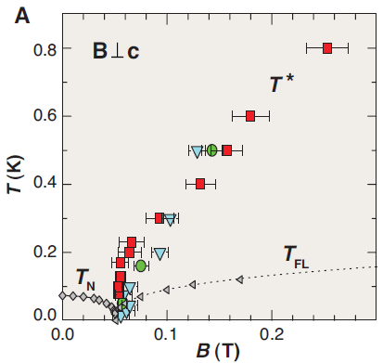
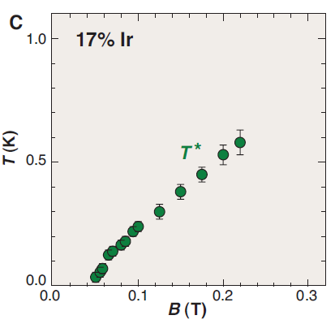
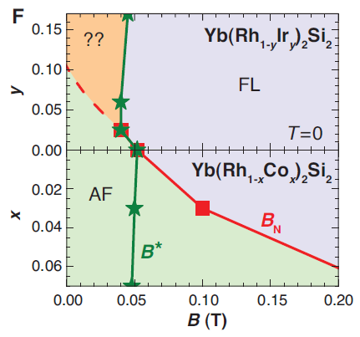
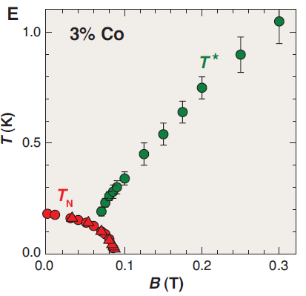
YbRh₂Si₂: Prototype of local QCP
S. Friedemann et al, Nature Phys. (2011)
YbRh2Si2:
T*: crossover temperature for the Kondo breakdown.
T* meets T_{N} line the QCP.
Changes from small FS to large FS crossing the T* line?
T_{FL}: FL region.
Co→Rh→Ir:
Negative pressure, suppressing AFM.
T* line reaches zero in AFM, at QCP and away from QCP.
T* is determined by Hall effect and thermal properties.
Problem:
Impossible to study the real reconstruction of FS.

Slide 6
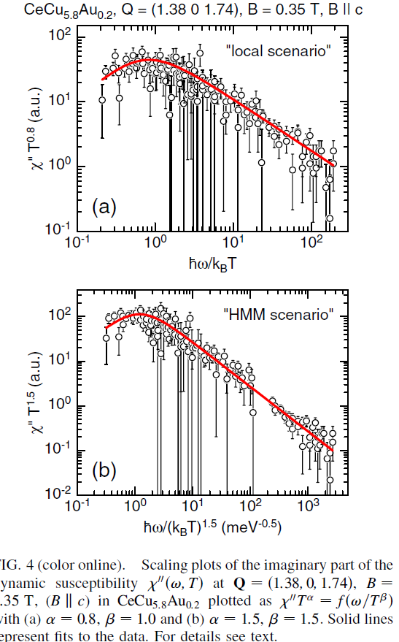
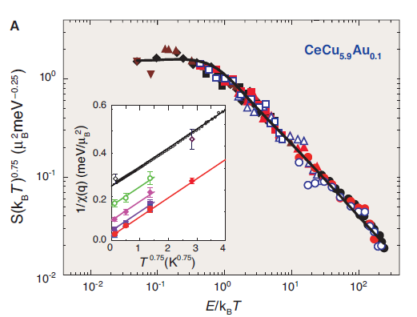
CeCu_{6-x}Au_{x}: local vs. SDW QCP for doping vs. field-induced QCP?
_{(H. von Lohneysen,‘96)}
O. Stockert, PRL(2007)
A. Schröder, Nature (2000)
E/T scaling of the inelastic neutron-scattering cross-section S in CeCu_{5.9}Au_{0.1} : α=0.75.
CeCu_{5.8}Au_{0.2}: field induced QCP at B~0.35T! HMM scenario fits better!

Slide 7
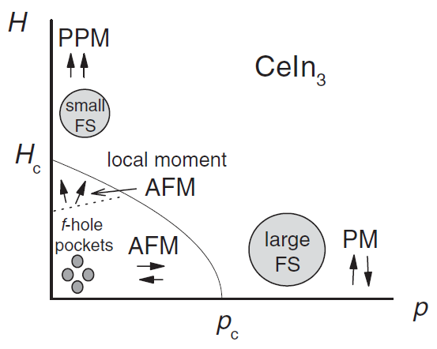
Quantum criticality: various tuning parameters
N. Harrison et al, PRL (2007)
Issues:
Quantum criticality tuned by various parameters (e.g., H, P …)
➔ Similar or different?
Direct evidence of Fermi surface reconstruction around the QCP?
Pressure: Small FS to large FS at P_{c}=2.6 GPa ➔Delocalization of f-electrons?
Magnetic field: Polarization of f-electron moments ➔Small FS above H_{c}=61T.

Slide 8
Heavy fermions CeMIn₅ (M = Co, Rh, Ir)
Mn
3d⁵ 4s²
Fe
3d⁶ 4s²
Co
3d⁷ 4s²
Ni
3d⁸ 4s²
Cu
3d¹⁰ 4s¹
Ru
4d⁷ 5s¹
Rh
4d⁸ 5s¹
Pd
4d¹⁰ 5s⁰
M=Co, Rh, Ir
Os
5d⁶ 6s²
Ir
5d⁷ 6s²
Pt
5d¹⁰ 6s⁰
In(2) site
Ce-In
1) CeCoIn₅ (M=Co) – heavy fermion SC
C/T = 290 mJ mol⁻¹ K⁻² at T_{c} = 2.3 K
M-In
2) CeIrIn₅ (M=Ir) – heavy fermion SC
C/T = 700 mJ mol⁻¹ K⁻² at T_{c} = 0.4 K
Ce-In
In(1) site
3) CeRhIn₅ (M=Rh) – AFM
C/T = 420 mJ mol⁻¹ K⁻² at T_{N} = 3.7 K,
Q = (1/2, 1/2, 0.297), μ_{eff} = 0.79 μ_{B} (0.84)
Petrovic et al. JPCM 13, (2001)

Slide 9
CeRhIn₅: Localized 4f-electrons?
Similarity between LaRhIn₅ and CeRhIn₅
Comparison of exp. and theory.
Calculations assuming localized f-el.
N. Harrison et al, PRL (2004); H. Shishido et al, JPSJ (2002); D. Hall et al., PRB (2001);S. Elgazzar., PRB (2004)

Slide 10
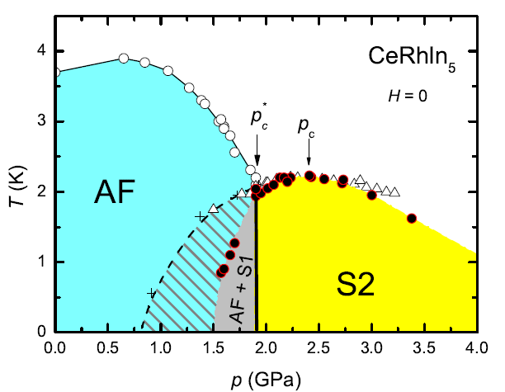
CeRhIn₅: pressure induced QCP
T. Park et al, Nature (2006)
G. Knebel et al (2006)
G. Knebel et al (2006)
Magnetic order disappears around 1.9 Gpa where TN=Tc.
Pressure induced QCP at p_{c}=2.4GPa.
Field induced magnetism inside the superconducting state.

Slide 11
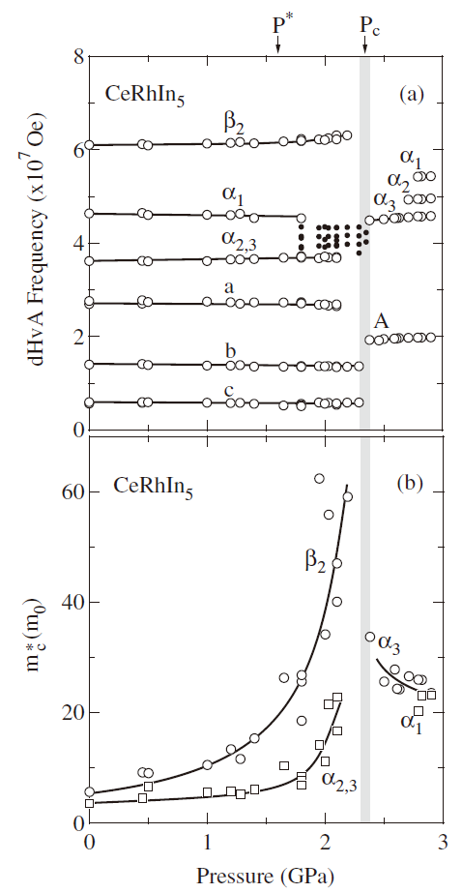
Dramatic changes of Fermi surface at p-induced QCP
Dramatic changes of dHvA frequencies at P_{c} =2.4GPa.
Sharp enhancement of m* at P_{c}.
Evidence for local AFM QC or valence QC?
Complications of magnetic field effect on the AFM transition!
H.Shishido et al, JPSJ (2005)

Slide 12
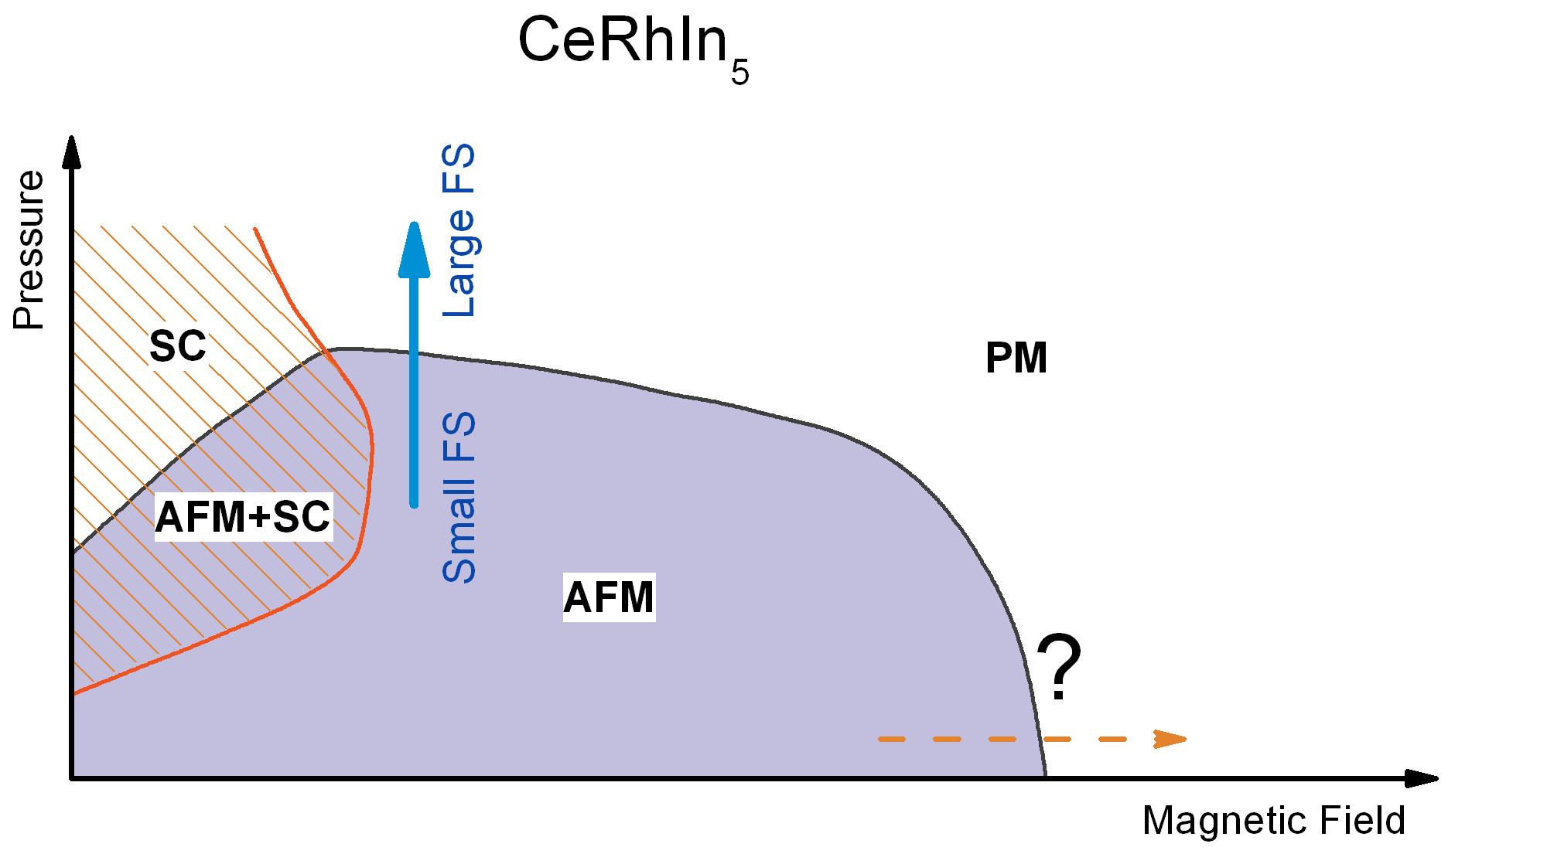
CeRhIn₅: Any new physics in high field?
T=0K

Slide 13
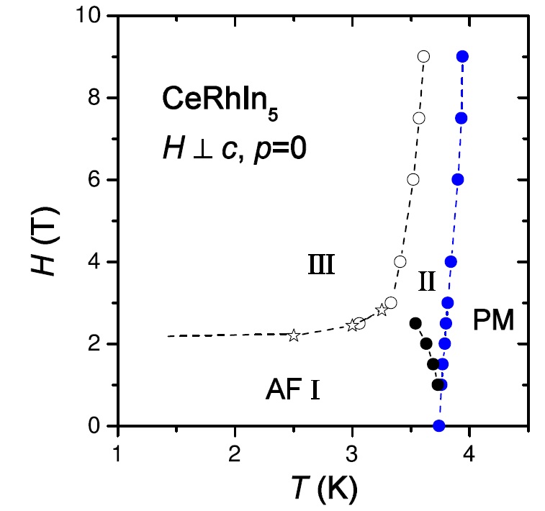
The magnetic order and its field dependence in CeRhIn5
S. Raymond ey al, JPCM (2007)
(1/2, 1/2, 0.298)
T. Takeuchi et al., JPSJ (2001)
k=(1/2, 1/2, 1/4)
(1/2, 1/2, 0.298)
H_{M}~2.5T: metamagnetic transition from incommensurate AFM to commensurate one.
AFM seems to be suppressed by applying a magnetic field of 50T.
Notes:
CeRhIn5 is a heavy fermion AFM with an incommensurate magnetic structure. It shows rich properties in a magnetic field. For example, there exists a metamgnetic transition around 2.2T and the magnetic transition seems to be suppressed at very high magnetic field, over 50T. An important question is whether there exists a field-induced QCP in CeRhIn5? If so, what new physics can we learn from it? In order to address this problem, we have studied the specific heat and the dHvA effect in a pulsed magnetic field and obtained some important findings.

Slide 14
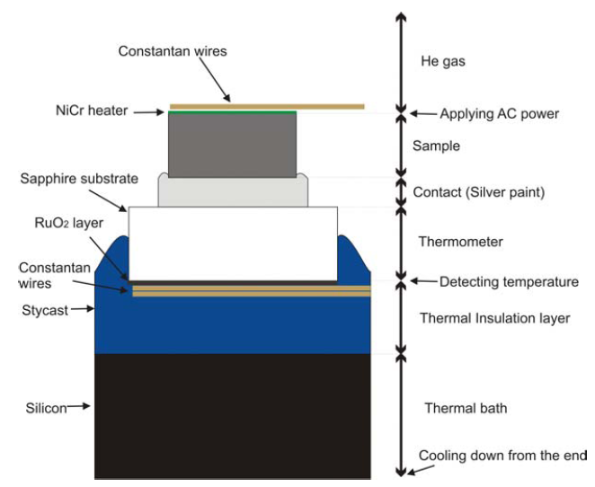
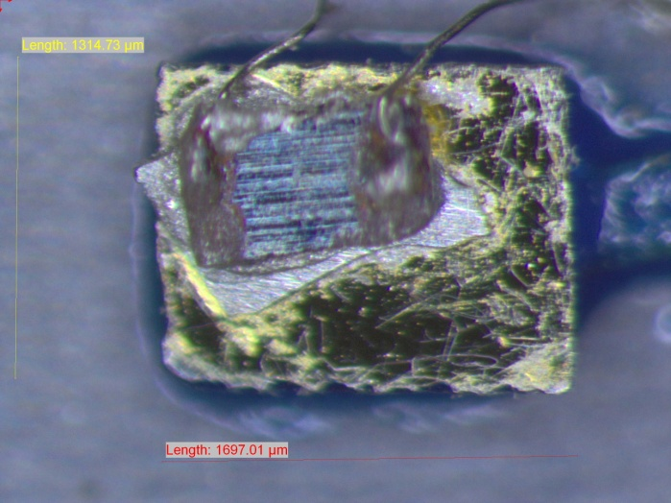
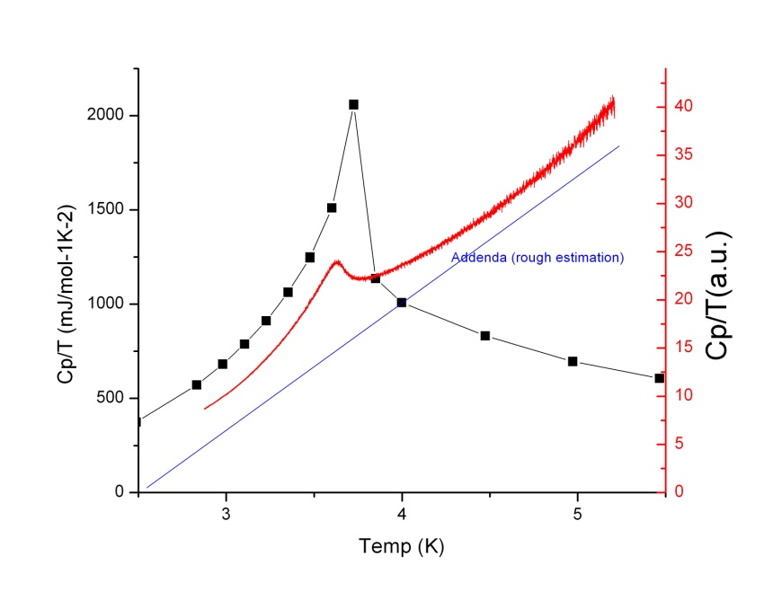
Experimental setup for ac specific heat measurements in a pulsed magnetic field
Yoshimitsu Kohama et al, Rev. Sci. Ins. (2010)

Slide 15
Thank you!

Slide 16
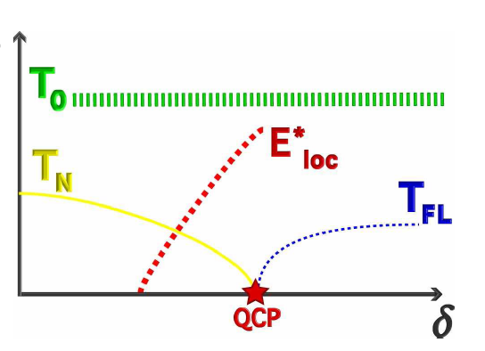
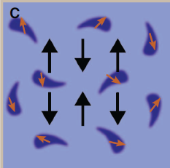
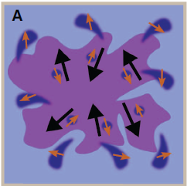
Magnetic quantum criticality: Two scenarios
P. Gegenwart et al, Nature Physics (2008)
Local QCP
SDW QCP
Local QCP
YbRh₂Si₂, CeCu_{1-x}Au_{x}
CeCu₂Si₂, CeNi₂Ge₂…
Parameter δ can be tuned by doping, pressure and magnetic field.
E*_{loc} characterizes the breakdown of the entangled Kondo singlet state.
Critical modes: fluctuations of magnetic order parameter (SDW type); additional modes related to the breakdown of Kondo effect (local QCP).
f electrons: itinerant (large Fermi surface) or localized (small Fermi surface)?
P. Gegenwart et al, Nature Physics (2008)

Slide 17
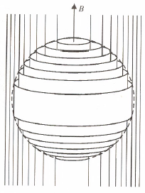


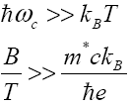
dHvA effect and Fermi surface topology
Landau quantization:
Quantization of orbital motion of a charged particle in a magnetic field.
Allowed orbits are confined in a series of Landau tubes, constant energy surfaces in k-space.
Magnetization, resistivity etc: periodic function of 1/B.
dHvA effect:
F_{i}: oscillatory “dHvA” frequency;
S_{i}: Fermi surface extremal cross-section in plane perpendicular to B.
Fermi surface topology:
Conditions for the dHvA effect:
Large magnetic field and low temperature
For m* = 100 me: B/T >> 75 T/K
HF: very high fields are required
High quality samples

Slide 18
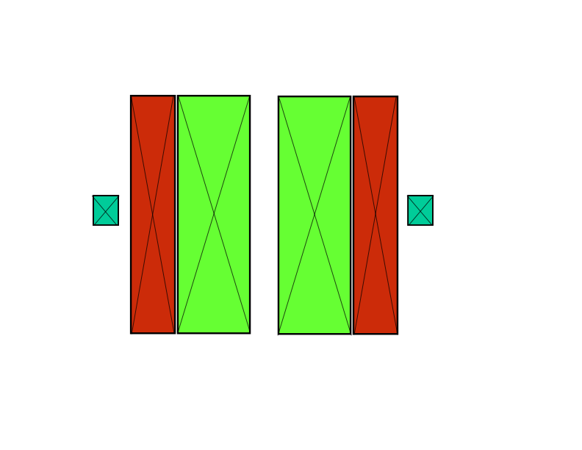
Measurements of dHvA effect
in a pulsed magnetic field
Induced voltage :
V=dφ/dt
(φ: magnetic flux, surface integral of B through the coil)
B=μ₀(H+M)
V ∝ dM/dt=(dM/dH)(dH/dt)
(V=0 for empty compensated coil)
Magnetic susceptibility
∝ V/(dH/dt)
dH/dt measured by an additional coil surrounding the signal coil.
Coil compensation:
When the probe is used, the induced voltages from both the signal coil and the compensation coil are amplified. A fraction of the voltage from the compensation coil is then added to or subtracted from the signal coil voltage to null out any remaining induced voltage.
sample
compensation
coil
H
signal coil

