Slide 1




Superconductivity, spin and charge order, and
quantum critical behavior in correlated electron materials
M. Brian Maple
University of California, San Diego
Research supported by the US DOE, NSF, and AFOSR-MURI

Slide 2
Superconductivity, spin and charge order, and quantum critical
behavior in correlated electron materials
Theme
  Correlated electron materials that exhibit spin or charge ordered phases
  Superconductivity and other quantum phases or phenomena that emerge
  when ordered phase is suppressed → 0 K through variation of external
  control parameter (e.g., composition x, pressure P, magnetic field H)
Objectives
  Explore interrelation of ordered phase, emergent phase, and non-Fermi liquid
  (NFL) behavior
  Gain insight into generality of this phenomenon and underlying physics
  Strategy in search for new superconductors (particularly, high T_{c} superconductors!)
This talk
  Discuss some of the issues concerning quantum criticality in correlated f-electron materials and suggest some future directions
  Several examples of recent research in our laboratory

Slide 3
Correlated electron phenomena in f-electron materials
Origin:
  Hybridization of localized f- and conduction electron-states
Hybridization strength:
  Weak ⇒ ionic behavior (f-electron shell occupation number <n> integral)
  Moderate ⇒ Kondo physics (<n> nearly integral)
  Appreciable ⇒ Valence fluctuation physics (<n> nonintegral)
  Strong ⇒ f-electron bands
Materials
  Multinary compounds based on lanthanide or actinide elements
  with partially-filled f-electron shells
  Localized f-electron states admixed with conduction electron states
  Emphasis on f-electron systems based on lanthanide or actinide ions with
  unstable valence: Ce, Pr, Sm, Eu, Tm, Yb, U, Pu, Np, . . . .
  Complex structures – large unit cells, molecular units, atomic cages, low D, etc.

Slide 4
Superconductivity, spin and charge order, and quantum critical
behavior in correlated electron materials
    Coupled charge, spin, orbital, lattice degrees of freedom
    Competing interactions
      Readily “tuned” by x, P, H (“knobs”)
Wide variety of correlated electron ground states and phenomena: e.g.,
  Superconductivity (SC)
  Magnetic order
  Quadrupolar order
  Spin and charge density wave (SDW and CDW) order
  Heavy fermion (HF) behavior
  Valence fluctuations (VFs)
  Hybridization gap semiconductivity (Kondo insulator behavior)
  Non-Fermi liquid (NFL) behavior
  Metal – insulator (M-I) transitions
Remarkably rich and complex phase diagrams: T vs x, P, H
“Materials driven physics”

Slide 5
Organization of talk
Discuss some aspects of quantum phase transitions and emergent phases in
correlated f-electron materials
Noncentrosymmetric compounds M₂Fe₁₂P₇
  Yb₂Fe₁₂P₇: Two distinct NFL regimes in AFM and PM phases in magnetic field
  SmFe₁₂P₇: Heavy fermion FM
    Heavy electron compound URu₂Si₂ under pressure and substituted with Re and Fe
  Interplay of SC, “hidden order” (HO), AFM order, FM order, NFL behavior
    Rare earth tritelluride compounds RTe₃ under pressure
  Interplay of SC, CDW’s, and R-AFM order
Remarks about electronic correlations
Thoughts, questions and directions for future research
    Progress report on ongoing research

Slide 6
Quantum phase transitions and criticality
Quantum phase transition (QPT)
  Occurs at critical value δ_{c} of external control parameter δ
  where spin or charge ordered phase suppressed to 0 K
  δ = x, P, H
  1st order; e.g., θ_{c} → 0 K (clean FM)
  2nd order; e.g., T_{N} → 0 K (AFM), θ_{c} → 0 K (dirty FM)
Quantum critical point (QCP)
  QCP: δ_{c} where 2nd order phase transition → 0 K
  Order parameter (OP) fluctuations near QCP
  Breakdown of Landau Fermi liquid paradigm in vicinity of QCP
  Non-Fermi liquid (NFL) behavior at low T
  (physical properties exhibit weak power law, logarithmic divergences in T)
  ρ(T) ~ T^{n} (0.5 ≤ n ≤ 1.5; usually close to 1)
  C(T)/T = γ(T) ~ -log(T)
  χ(T) ~ various non-Curie Weiss forms
  χ’’(ω,T) scales as ω/T

Slide 7
Quantum phase transitions and criticality
NFL characteristics
  Nearly universal!
  Found in both chemically substituted systems and stoichiometric compounds
  Observed near different types of QCPs (e.g., AFM, FM, SG) and sometimes
  in the absence of any readily identifiable QCP
Emergence of other phases near the QCP
  Envelop and “protect” QCP (remove degeneracy)
  Exotic types of magnetic order (e.g., MnSi)
  Unconventional superconductivity (e.g., CeIn₃, CeRhIn₅)
  Two viewpoints:
    Cooperation between ordered phase and SC:
    SC’ing electron pairing mediated by OP fluctuations near QCP
    (e.g., spin fluctuations, quadrupolar fluctuations)
    Competition between ordered phase and SC:
    SC is “liberated” by suppression of ordered phase
Interplay of superconductivity, spin or charge order, and NFL behavior

Slide 8
Classical quantum critical point (QCP) scenario
NFL behavior confined to “V” shaped region
emanating from QCP
External control parameter:
δ = x, P, H
T
Quantum fluctuations:
ħΓ >> k_{B}T
T_{FL}
T_{N} , T_{C} , ...
NFL crosses over to FL behavior:
Disordered
ρ ~ T²
C/T = γ_{ο}
χ = χ₀
(FL)
NFL
Ordered
FL
δ
δ_{c}
QCP
Heavy fermion materials: δ tunes competition between
(1) RKKY interaction (ordering of f-electron localized moments) and
(2) Kondo interaction or valence fluctuations (demagnetize f-electron shell);
e.g., Doniach “Kondo necklace“ model – Doniach, Physica B 91, 231 (1977)

Slide 9
Quantum criticality (QC) in heavy fermion (HF) systems
T
T₀
T
T₀
T_{N}
T_{K}
T_{FL}
T_{N}
T_{K}
T_{FL}
NFL
NFL
δ = P, B, x
ordered
small FS
ordered
FL
large FS
FL
δ_{c}
δ
δ_{c}
δ
QCP
QCP
δ tunes the competition between RKKY and Kondo interactions
SDW QCP scenario (CeIn₃: T vs P)
Local QCP scenario (YbRh₂Si₂: T vs H)
Fluctuations of magnetic order parameter
Kondo screening extends into ordered phase
Dynamical scaling in dimension d+z
Local magnetic moment scenario
Fluctuations of magnetic order parameter
AND additional quantum fluctuations
⇒ destruction of Kondo singlets
Breakdown of Kondo screening at δ_{c}
⇒ breakdown of heavy FL
⇒ localization of f-electron
⇒ jump in Fermi surface volume
Hertz, Millis, Moriya, Contenintino, Rosch, et al.
Si, Coleman, Pepin, et al.

Slide 10
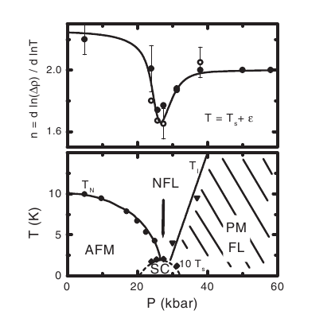
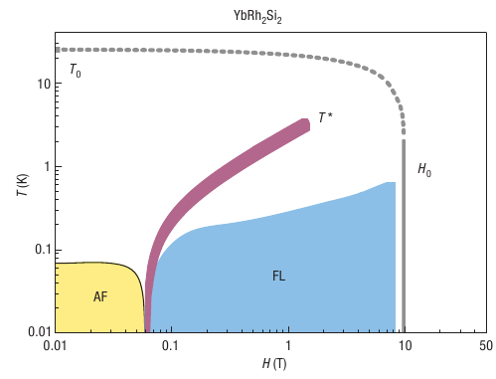
Quantum criticality (QC) in heavy fermion (HF) systems
T
T₀
T
T₀
T_{N}
T_{K}
T_{FL}
T_{N}
T_{K}
T_{FL}
NFL
NFL
δ = p, B, x
ordered
small FS
ordered
FL
large FS
FL
δ_{c}
δ
δ_{c}
δ
QCP
QCP
δ tunes the competition between RKKY and Kondo interactions
SDW QCP scenario
Local QCP scencario
CeIn₃
Walker et al. Physics C
(1997)
Mathur et al. Nature (1998)
Knebel et al. HPR (2002)
YbRh₂Si₂
Paschen et al.
Nature (2004)
Also:
CeRhIn₅
CeCu_{6-x}Au_{x}(?)
Also:
CeCoIn₅
CePd₂Si₂
CeNi₂Ge₂
Review: Löhneysen, Rosch, Vojta, Wölfle, Rev. Mod. Phys. 79, 1015 (2007)
Gegenwart , Si, and Steglich, Nature Physics 4, 186 (2008)

Slide 11
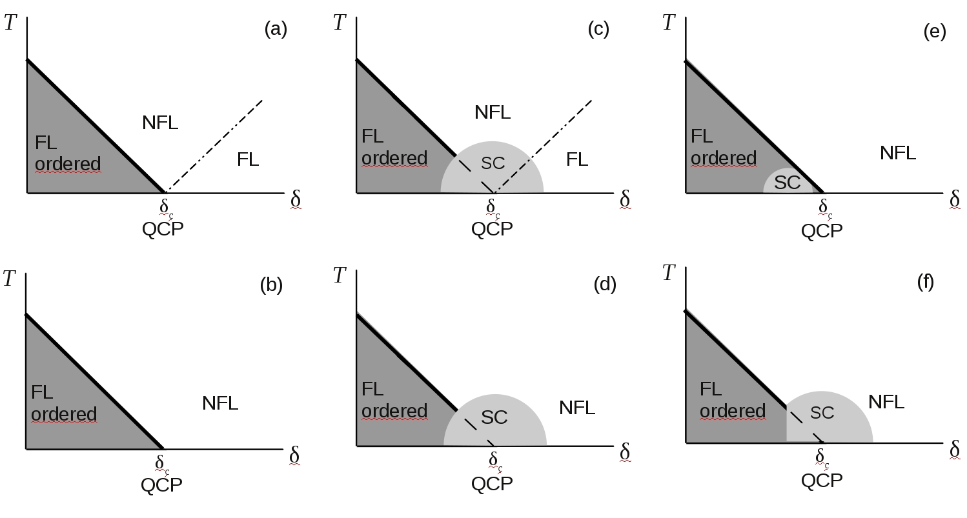
Unconventional SC and NFL behavior?
Other scenarios for quantum criticality and non-Fermi liquid behavior?
Review: M. B. Maple, R. E. Baumbach, N. P. Butch, J. J. Hamlin, M. Janoschek, J. Low. Temp. Phys. 161, 4 (2010)

Slide 12
Other scenarios for quantum criticality
Experiments suggest scenarios involving both single ion and
inter-ionic interactions
Theoretical models for both cases
Single ion models
    Quadrupolar Kondo effect (two-channel spin-1/2 Kondo effect)
    Type of multichannel Kondo effect
    Single channel Kondo effect with disorder — P(T_{K})
Interacting ion models
    Fluctuations of OP above 2nd order phase transition at 0 K
    (classic case)
    Griffiths’ phase — interplay between disorder, anisotropy, and
    competing Kondo and RKKY interactions

Slide 13
T vs x, P, H phase diagrams – magnetic order,
superconductivity, quantum critical behavior

Slide 14
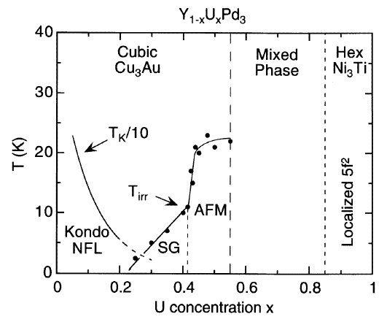
T-x phase diagram of Y_{1-x}U_{x}Pd₃ system
First f-electron system in which NFL observed
SG QCP
C. L. Seaman et al., PRL 67, 2882 ‘91
D. A. Gajewski, N. R. Dilley, R. Chau, M. B. Maple, J. Phys.: Condens. Matter 8, 9793 ‘96

Slide 15
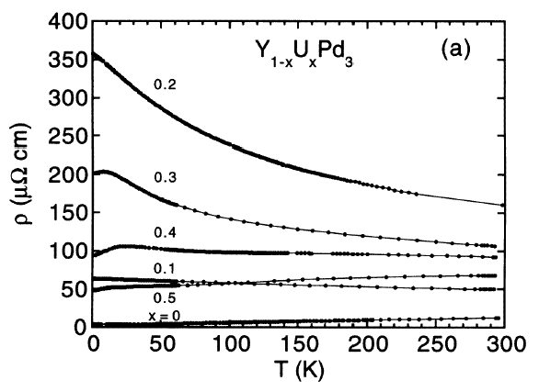
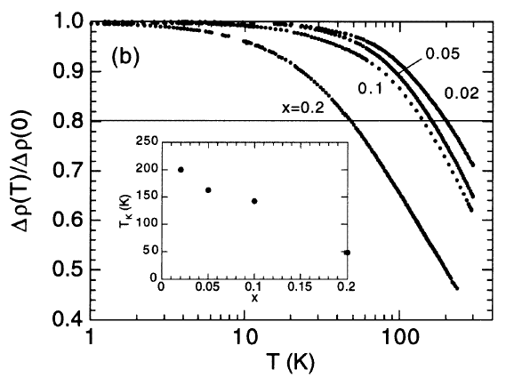
Electrical resistivity ρ vs T for the Y_{1-x}U_{x}Pd₃ system (high T)
M. B. Maple, R. P. Dickey, J. Herrmann, M. C. de Andrade, E. J. Freeman,
D. A. Gajewski, R. Chau, J. Phys.: Condens. Matter 8, 9773 ‘96

Slide 16
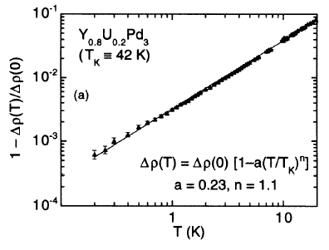
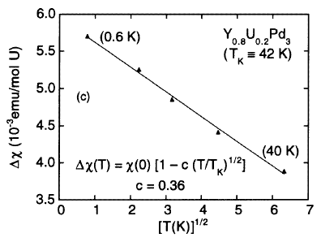
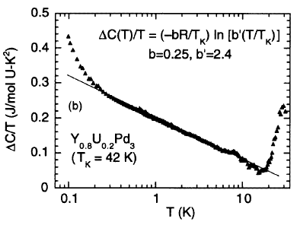
Low-T NFL behavior in near SG QCP for Y_{1-x}U_{x}Pd₃
T_{K} decreases with x
(Fermi level tuning)
(T < T_{K} ≈ 42 K): ρ(T), C(T), χ(T)
scale with T_{K}
NFL behavior – associated with
quadrupolar KE or SG QCP?
M. B. Maple et al., J. Phys.:
Condens. Matter 8, 9773 ‘96

Slide 17
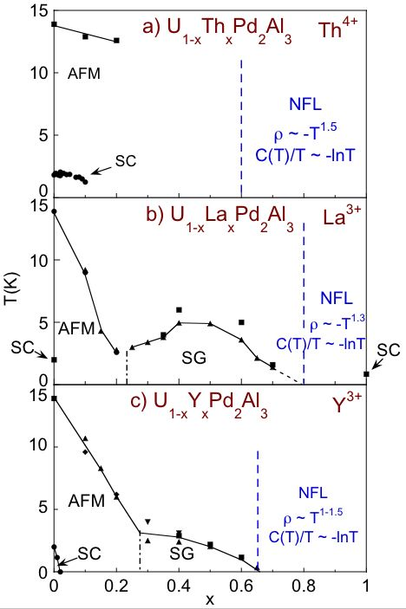
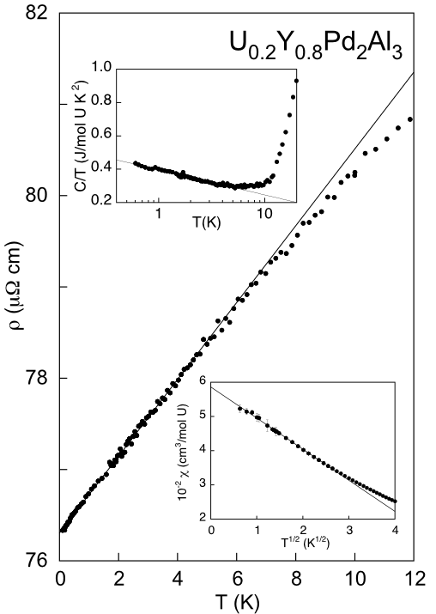
T-x phase diagrams for U_{1-x}M_{x}Pd₂Al₃ (M = Th, Y, La)
NFL behavior in U_{1-x}Y_{x}Pd₂Al₃
near QCP at x_{c} ≈ 0.65
UCSD ‘01

Slide 18
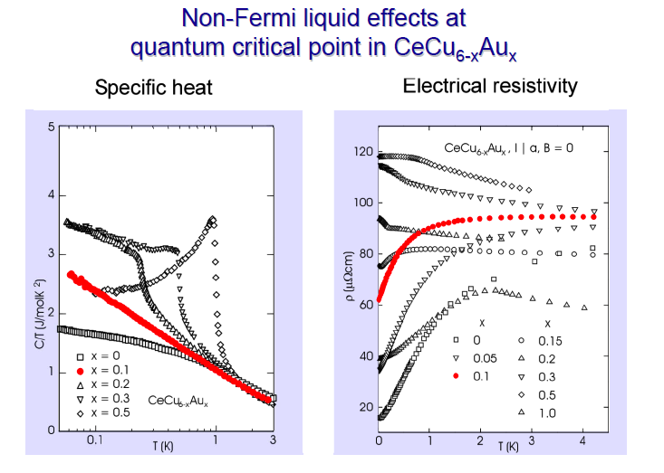
After H. v. Löhneysen

Slide 19
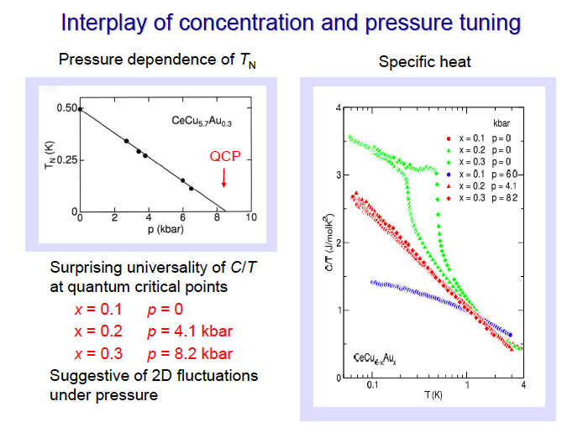
After H. v. Löhneysen

Slide 20
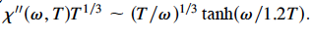
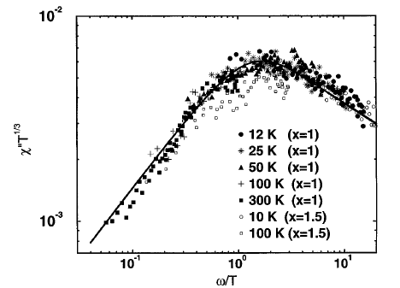
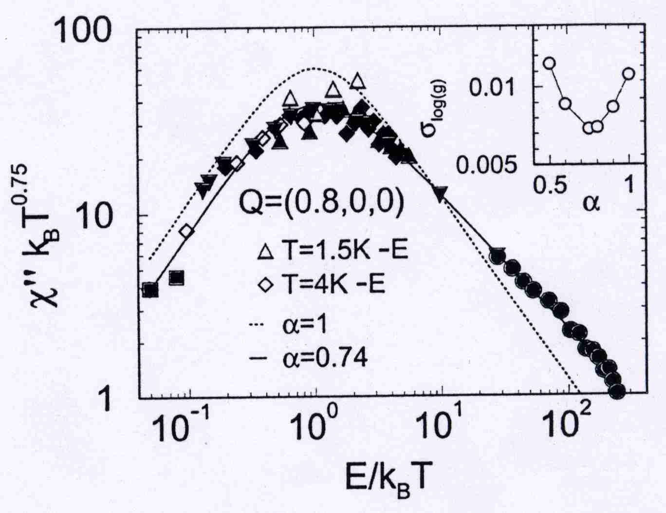
Inelastic neutron scattering: ω/T scaling
UCu_{5-x}Pd_{x} (x = 1.0, 1.5) – AFM QCP
CeCu_{5.9}Au_{0.1} – AFM QCP
Solid line:
M. C. Aronson et al., PRL 75,725 (1995)
A. Schröder et al,. Nature 407, 351 (2000)
Other examples scaling of χ’’ with ω/T:
Sc_{0.7}U_{0.3}Pd₃ – SG QCP: S. D. Wilson et al..PRL 94, 056402 (2005)
URu_{2-x}Re_{x}Si₂ – FM QCP: V. V. Krishnamurthy et al., PRB 78, 024413 (2008)

Slide 21
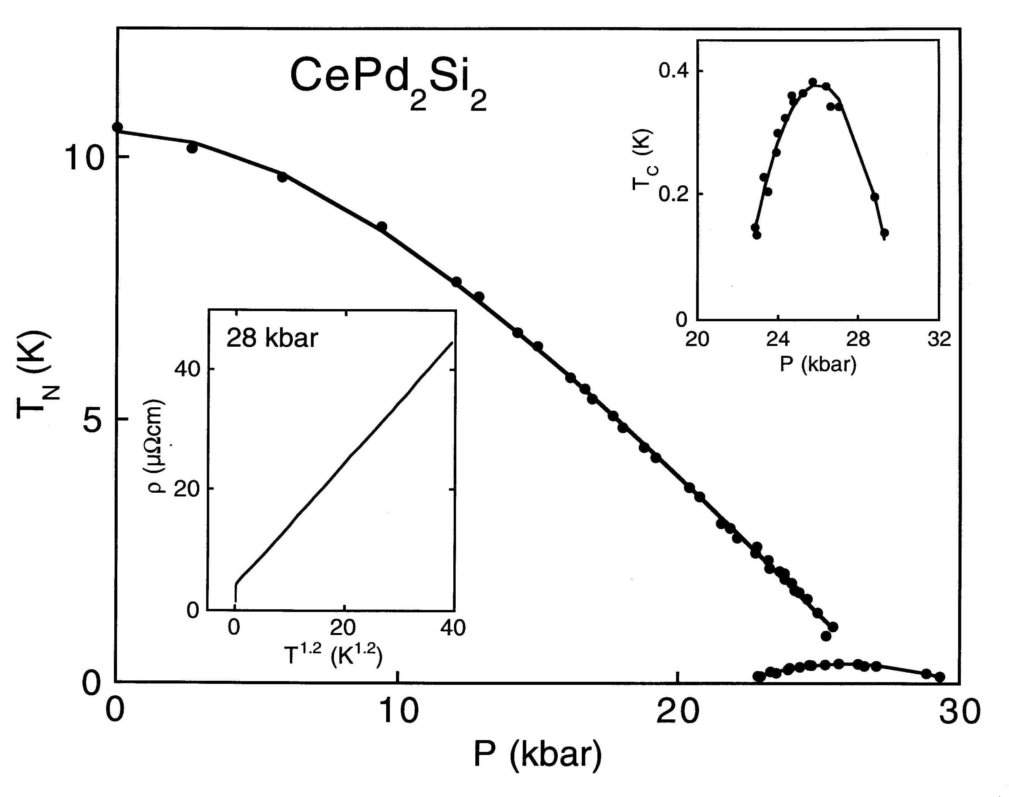
Superconductivity near pressure-induced AFM QCP
AFM QCP:
P_{c} ≈ 28 kbar
ρ(T) ≈ ρ_{o} + AT^{1.2}
T_{c} ≤ T ≤ 40 K
T_{c}(max) ≈ 0.4 K
Similar behavior
for CeIn₃ under P
Julian, Lonzarich et al. (98)
Suggests AFM spin fluctuations responsible for
NFL behavior in ρ(T) and SCing electron pairing

Slide 22
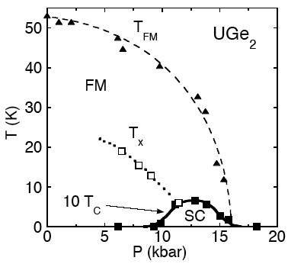
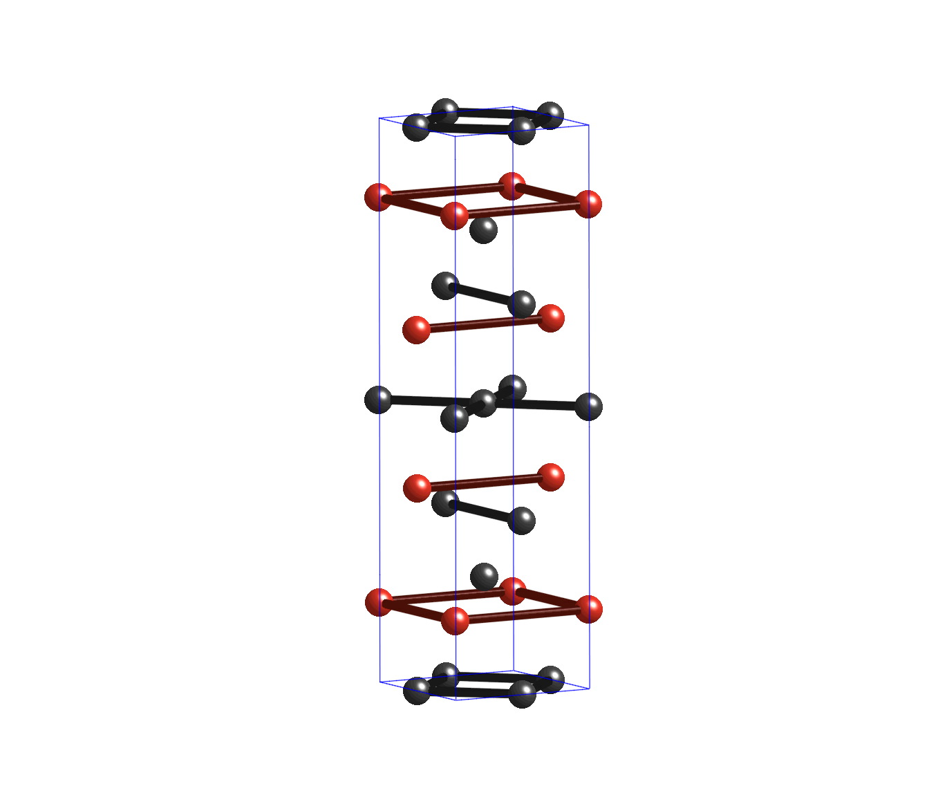
Superconductivity within the ferromagnetic state in UGe₂
First P-induced FM-SC
Saxena et al. (00)
High purity crystal (l >> ξ)
⇒ microscopic coexistence of triplet-spin SC & FM?
Itinerant electron FM
θ_{C} = 53 K (P = 0)
γ ≈ 35 mJ/mol K²
m* ≈ 20 m_{e}
Onuki et al. (93)
θ_{C} → 0 K at P_{c} ≈ 16 kbar
Oomi et al. (98)
Experiments on polycrystalline UGe₂ (l ≈ ξ)
Inhomogeneous state: coexistence of singlet-spin SC regions & FM regions?
Bauer, Zapf, Ho, Maple (01)

Slide 23
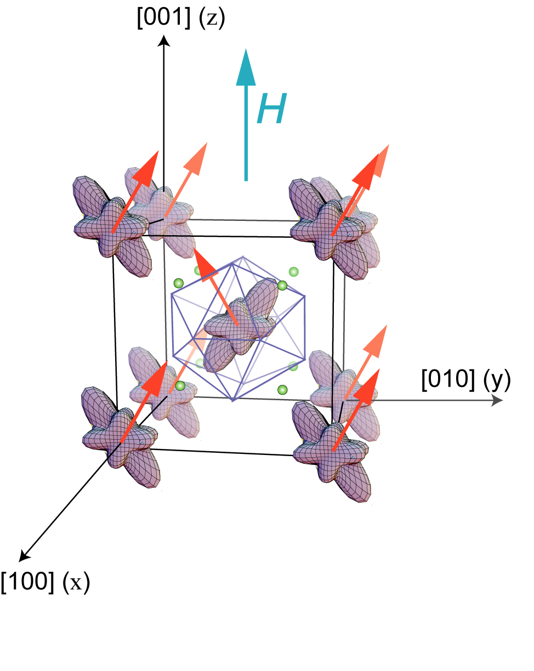
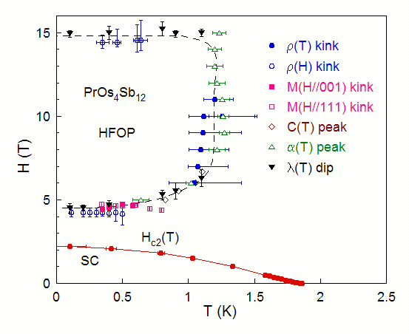
H–T phase diagram of PrOs₄Sb₁₂
Heavy fermon behavior (m* ~ 50 m_{e})
Nonmagnetic groundstate
Unconventional superconductivity
QCP
T. Yanagasawa (06)
AFQ order
HFOP
Related to crossover of CEF energy levels
Identified with antiferro- quadrupolar order:
neutron diffraction
Kohgi et al., JPSJ (03)
Anisotropic phase
boundary: M(H,T)
Tayama et al., JPSJ (03)
SC in vicinity of antiferro-quadrupolar QCP!
QCP
Ho et al., PRB (03)

Slide 24
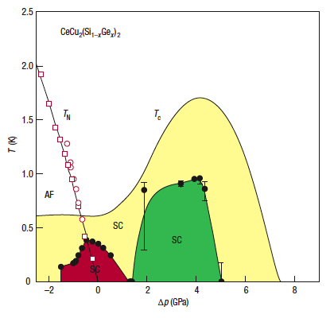
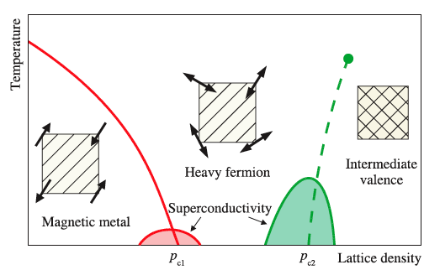
Pressure dependence of AFM order and superconductivity in Ce(Cu_{1-x}Ge_{x})₂Si₂
H. Q. Yuan et al., Science 32, 2104 (2003)
Previous research on CeCu₂Ge₂
D. Jaccard et al., Phys. Lett. A 163, 475 (1992)

Slide 25
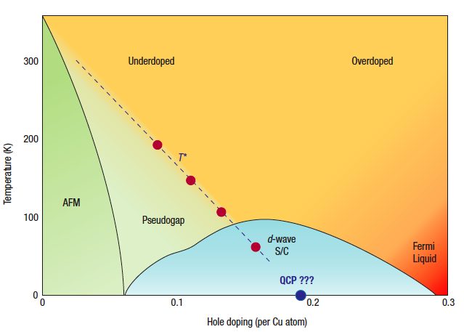
Generalized T – x phase diagram for hole-doped cuprates
After D. M. Broun, Nature Physics 4, 178 (2008)

Slide 26
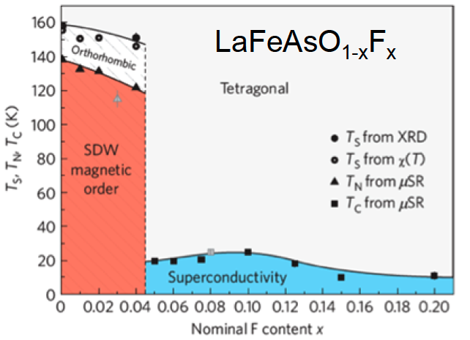
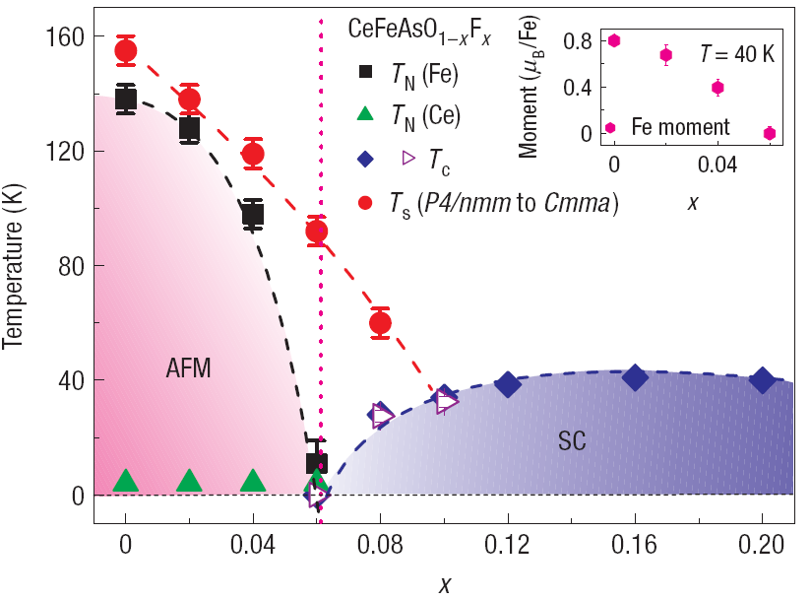
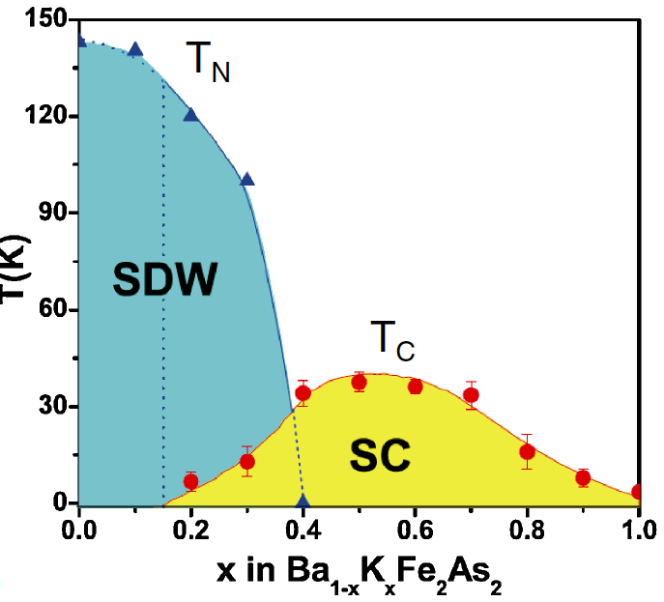
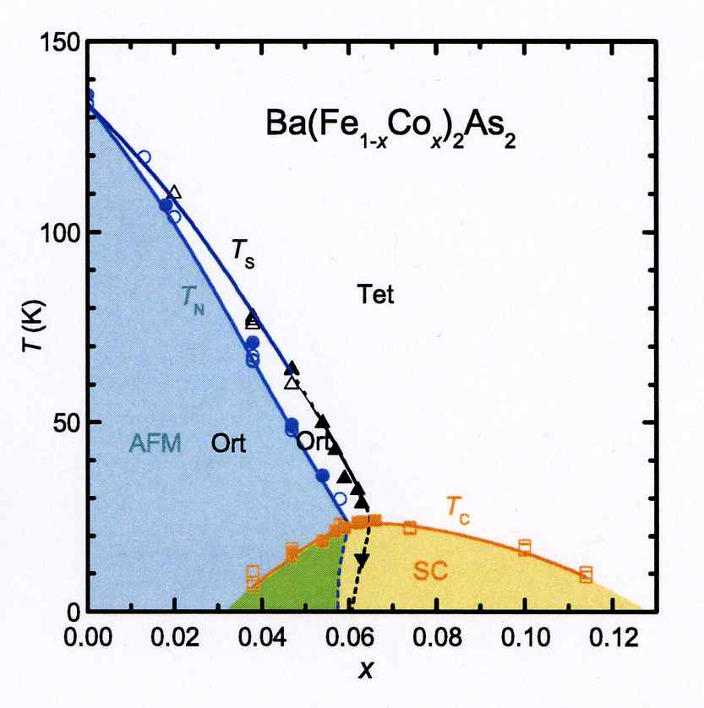
T – x phase diagrams of Fe pnictide systems
H. Luetkens et al.,Nature Materials 8, 305 (2009)
J. Zhao et al., Nature Materials 7 (2008)
phase separation?
H. Chen et al., Europhys. Lett. 85, 17006 (2009)
S. Nandi et al., PRL 104, 057006 (2010)

Slide 27
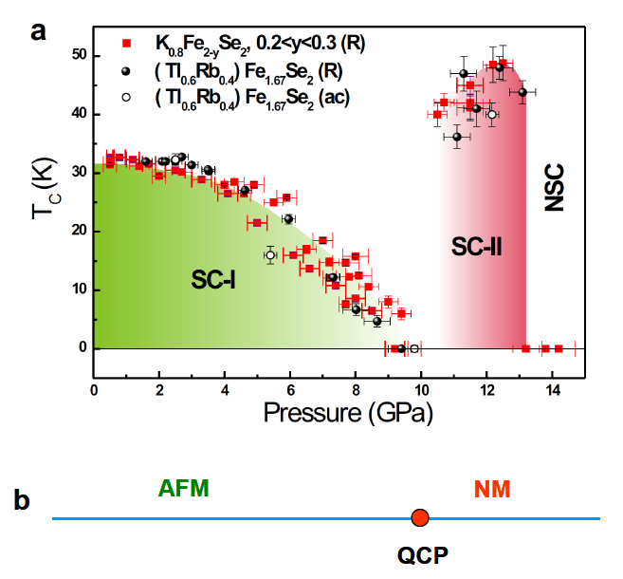
Re-emergence of superconductivity under pressure
L. Sun et al., ArXiv (2011)

Slide 28
Correlated electron phenomena in
noncentrosymmetric M₂Fe₁₂P₇ compounds

Slide 29
Noncentrosymmetric M₂Fe₁₂P₇ compounds
Coworkers:
University of California, San Diego
R. E. Baumbach (LANL)
J. J. Hamlin
M. Jonaschek (LANL)
I. K. Lum
L. Shu (Fudan U., China)
B. D. White
D. A. Zocco (KIT, Germany)
CSU, Fresno
P.-C. Ho
Quantum Design
J. R. O’Brien
Yb₂Fe₁₂P₇ – R. E. Baumbach, J. J. Hamlin, L. Shu, D. A. Zocco, J. R. O’Brien, P.-C. Ho,
M. B. Maple, PRL 105, 106403 (2010)
Sm₂Fe₁₂P₇ – M. Janoschek, R. E. Baumbach, J. J. Hamlin, I. K. Lum, M. B. Maple,
JPCM 23, 094221 (2011)
U₂Fe₁₂P₇ – R. E. Baumbach, J. J. Hamlin, M. Janoschek, I. K. Lum, M. B. Maple,
JPCM 23, 094222 (2011)
Yb₂Co₁₂P₇ – J. J. Hamlin, M. Janoschek, R. E. Baumbach, B. D. White, M. B. Maple,
submitted to Phil. Mag.

Slide 30
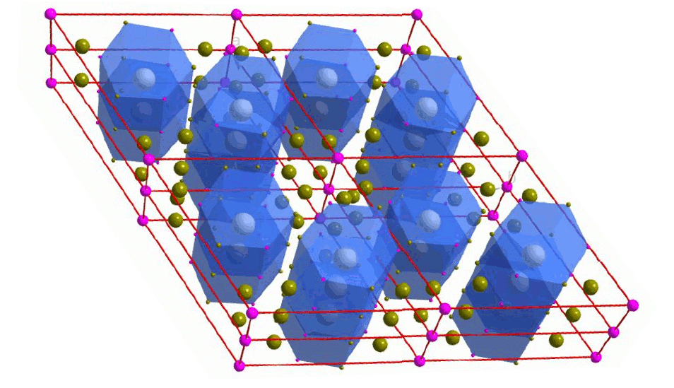
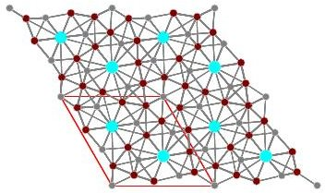
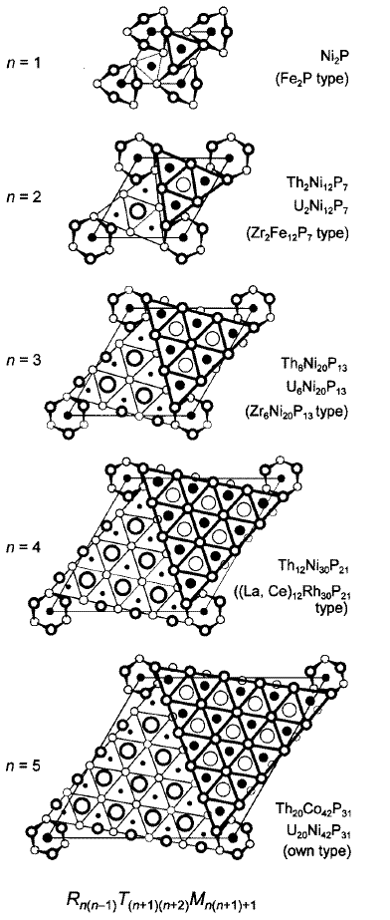
“2-12-7s”: a new reservoir for strong electronic correlations
M_{n(n-1)}T_{(n+1)(n+2)}Pn_{n(n+1)+1}
(M = metall, T = transition metal, Pn = P, As)
M
T
Pn
Figure by K. Grube
Large number of compounds M₂T₁₂Pn₇ (n = 2)
M = Li, Na, Ca, Mg, Ti-Hf, Nb, Sc, Y, La-Lu, U
T = Mn, Fe, Co, Ni, Ru
Pn = P, As
Space group P-6, no inversion symmetry
W. Jeitschko et al., J. Solid State Chem. 25, 309 (1978)
W. Jeitschko et al., J. Alloy Compd. 196, 105 (1993).
A. Hellmann, A. Mewis, Z. Anorg. Allg. Chem. 627, 1357 (2001)
Transition metal sublattice can be tuned from
nonmagnetic (T = Fe or Ni) to magnetic (T = Co)
W. Jeitschko et al., JSSC 25, 309 (1978)
Y. Prots et al., IC 37, 5431 (1998)

Slide 31
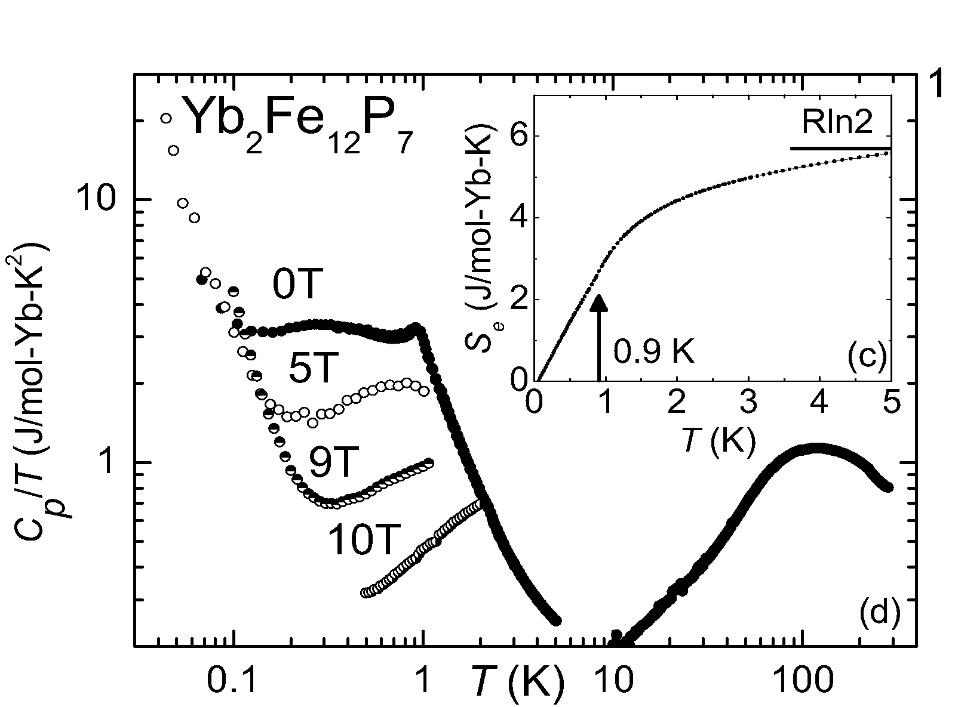
Yb₂Fe₁₂P₇ : Specific heat C(H,T)
T*
H = 0 T: Strong electronic correlations
[C(T,H=0)/T]_{max} ~ 3.4 J/mol-Yb K²
Phase transition: T* ~ 0.9 K
Low T upturn: Nuclear Schottky anomaly?
H > 0 T: Electronic correlations reduced with H
T* suppressed by H = 1 T
C(T)/T: Low T upturn suppressed with H
[C(T,H=0)/T]_{max} moves up with T

Slide 32
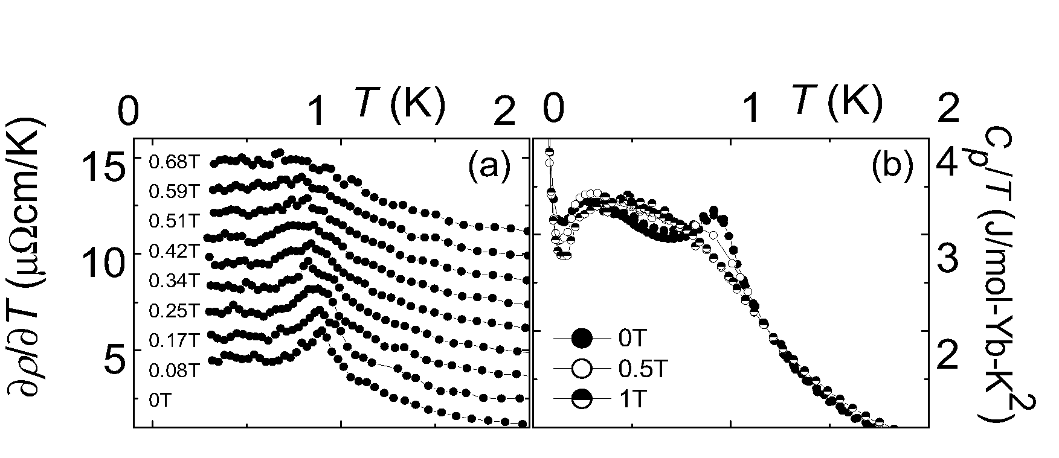
Yb₂Fe₁₂P₇ : Suppression of T* with H
Similar shapes for ∂ρ/∂T and C(T)/T
Maxima in ∂ρ/∂T and C(T)/T are suppressed by H = 0.7 T
Possible AFM phase transition suppressed to T = 0 K
Quantum critical point?

Slide 33
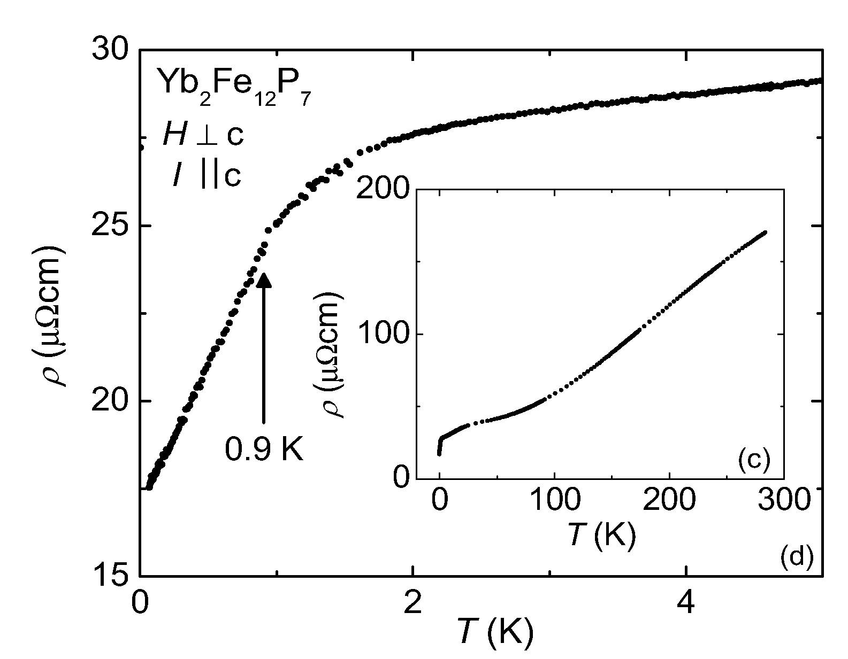
Yb₂Fe₁₂P₇ : Electrical resistivity ρ(T)
RRR = ρ(300 K)/ρ(50 mK) ~ 10
T ~ 30 K: broad shoulder
∂ρ/∂T maximal at T* ~ 0.9 K
50 mK < T < 0.9 K: nearly linear (nearly two orders of magnitude in T)
NFL-like behavior in the ordered state

Slide 34
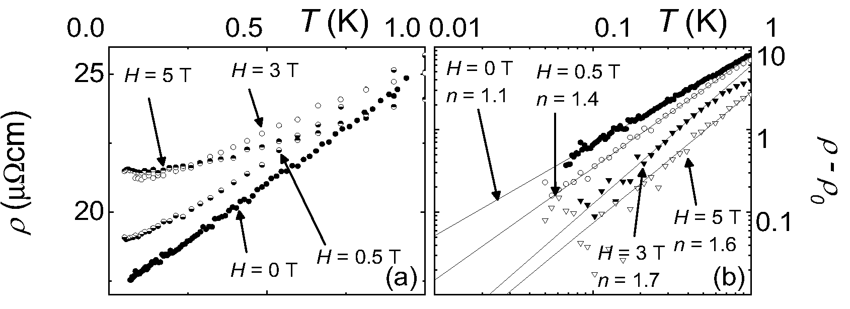
Yb₂Fe₁₂P₇ : ρ(H,T) – indications of NFL behavior
(T) = ρ₀ + AT^{n} for 50 mK < T < 0.9 K and 0 T < H < 7 T
Fitting procedure: ln[ρ(T) – ρ₀] = lnA + nlnT
n evolves from ~1.1 to ~1.5 with increasing H
ρ₀ increases with increasing H
A decreases with increasing H

Slide 35
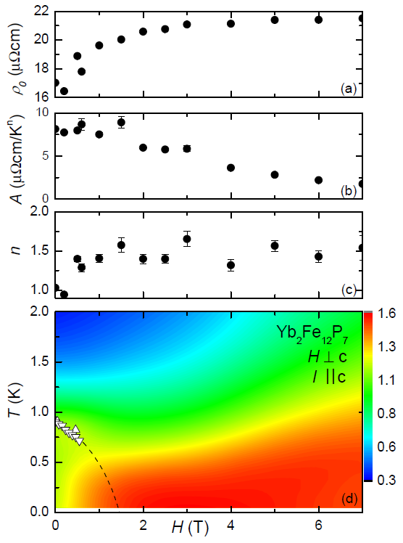
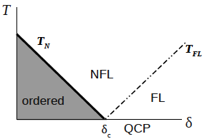
Yb₂Fe₁₂P₇ : Phase diagram
Strong electronic correlations for T < 10 K
Magnetic ordering for T* ~ 0.9 K
T_{M} suppressed with H ⇒ possible QCP
Cannot track T_{M} for H > 0.7 T
1st order transition near 0.7 T or
2nd order transition for larger H?
NFL behavior over entire T-H phase diagram
No similarity to conventional QCP scenario (e.g., CeCu_{1-x}Au_{x} or YbRh₂S₂)
Electrical transport behavior decoupled from only obvious candidate QCP

Slide 36
Investigation of URu₂Si₂ under pressure and
substituted with Re and Fe

Slide 37
Investigation of URu₂Si₂ under pressure and substituted with Re and Fe
Enormous amount of interest in URu₂Si₂ during past 25 years (~600 papers!)
Delicate interplay between competing interactions in URu₂Si₂ produces a wide variety of correlated electron phenomena
  Superconductivity (SC)
  “Hidden order” (HO) phase (OP not yet identified!)
  Antiferromagnetism (AFM)
  Ferromagnetism (FM)
  Heavy fermion (HF) behavior
  Quantum criticality
  Non-Fermi liquid (NFL) behavior
Interactions “tuned” via
  Pressure (P)
  Magnetic field (H)
  Chemical substituent composition (x)
THIS WORK: Study the interplay of these phenomena in URu₂Si₂ via application of P and substitution of Re and Fe for Ru

Slide 38
Investigation of URu₂Si₂ under pressure and substituted with Re and Fe
COWORKERS:
UCSD
R. E. Baumbach Los Alamos National Laboratory
N. P. Butch Lawrence Livermore National Laboratory
J. J. Hamlin
K. Haung
M. Janoschek Los Alamos National Laboratory
J. R. Jeffries Lawrence Livermore National Laboratory
N. Kanchanavatee
T. A. Sayles Quantum Design, San Diego
B. T. Yukich UCSD, SOM
D. A. Zocco KIT, Germany
NIST
S. X. Chi
J. B. Leao
J. W. Lynn

Slide 39
URu₂Si₂: Initial experiments
Heavy fermion superconductivity and phase transition at 17 K
(polycrystalline specimens)
Schlabitz, Baumann, Pollit, Rauchschwalbe, Mayer, Alheim, Bredl, ZP (86)
(Poster, 4th ICVF, Cologne, 1984, unpublished)
Anisotropy of physical properties
(single crystal specimens)
Palstra, Menovsky, van den Berg, Dirkmaat, Kes, Nieuwenhuys, Mydosh, PRL (85)
“Partial gapping scenario” involving formation of SDW or CDW with energy
gap Δ ~ 100 K over ~40% of FS
(polycrystalline specimens)
Maple, Dalichaouch, Kohara, Rossel, Torikachvili, McElfresh, Thompson, PRL (86)
Neutron scattering experiments – SMAFM with μ ~ 0.03 μ_{B} || c-axis
(single crystal specimens)
Broholm, Kjems, Buyers, Matthews, Palstra, Menovsky, Mydosh, PRL (86)
Followed by enormous number of papers (experimental, theoretical)
Many papers devoted to establishing identity of “hidden order” (HO) phase

Slide 40
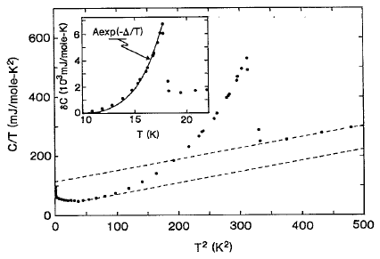
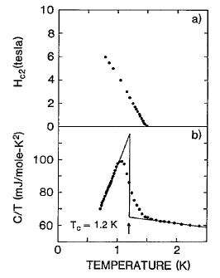
Low temperature specific heat of URu₂Si₂
C’(T)/T=γ’+βT²
γ’
C(T)/T=γ+βT²
γ(0)
SCing transition
Maple, Dalichaouch, Kohara, Rossel,
Torikachvili, McElfresh, Thompson, PRL (86)
BCS-type mean field transition at T_{o} = 17.5 K
  δC ≈ Aexp(-Δ/T); Δ ~ 10² K ⇒ SDW or CDW
  γ(0)/γ’ ≈ 0.6 ⇒ ~ 40 % Fermi surface removed by SDW or CDW
  SDW or CDW competes with SC for Fermi surface!
δS ≈ 0.2ln(2) too large for AFM with small μ ≈ 0.03 μ_{B} ⇒ Hidden order (HO)?
Superconductivity below T_{c} ≈ 1.5 K (onset)

Slide 41
URu₂Si₂: Characteristics of “hidden order” phase
“Hidden order” (HO) phase
  Energy gap Δ ~ 100 K
  Itinerant character (“partial gapping scenario”)
  SMAFM phase resides within HO phase
  Extrinsic? Caused by internal strains due to sample defects
  Intrinsic? Samples of widely differing quality ⇒ μ ~ 10⁻² μ_{B}; AFM onset at T_{o}
Energy gap observed in many experiments: e.g.,
Features in many types of bulk measurements consistent with energy gap
  Electrical resistivity Palstra et al. ’85; Maple et al. ’86; Schlabitz et al. ‘86
  Magnetic susceptibility Palstra et al. ’85; Maple et al. ’86; Schlabitz et al. ‘86
  Ultrasound Kuwahara et al. ‘97
  Thermal expansion de Vissar et al. ‘86
  Lattice thermal conductivity Behnia et al. ’05; Sharma et al. ‘06
  Gaps observed in
  Tunneling spectra Hasselbach et al. ‘92
  Spin excitation spectra Wiebe et al. ‘07
  STM spectra Schmidt et al. ’10; Aynajian et al. ‘10

Slide 42
Models for “hidden order” HO phase in URu₂Si₂
Partial list of HO models
Density wave (early experiment) (Mineev, Zhitomirsky 05)
Multipolar order (Santini 98) (Kiss, Fazekas 05) (Harima, Miyake, Flouquet 10)
Orbital currents (Chandra, Coleman, Mydosh, Tripathi 02)
Helicity order (Varma, Zhu 06)
Fluctuating moments (Elgazzar, Rusz, Amft, Oppeneer, Mydosh 09)
Itinerant multipoles (Cricchio, Bultmark, Granas, Nordstrom 09)
  Hexadecapole (Haule, Kotliar 09)
  Hybridization waves (Dubi, Balatsky 11)
  Electronic “nematic” phase (Okazaki, Matsuda, et al. 11)
  Modulated spin liquid (Pepin, Norman, Burdin, Ferraz 11)
  Γ₅ composite density wave (Coleman, Chandra, Flint 11)
  Hastatic order (Chandra, Coleman, Flint 12)

Slide 43
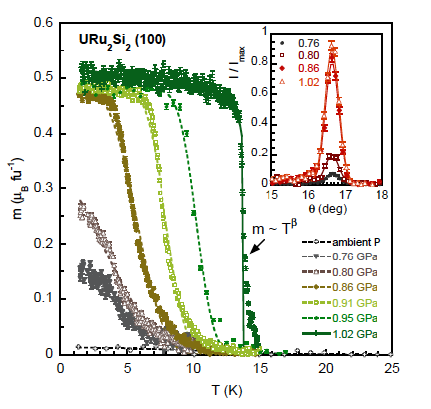
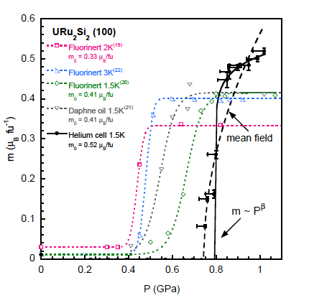
URu₂Si₂ under hydrostatic pressure (helium)
    Pressure transmitting medium: Helium (most hydrostatic medium available)
    1st order transition to LMAFM phase with T and P
N. P. Butch, J. R. Jeffries, S. X. Chi, J. B. Leao, J. W. Lynn, and M. B. Maple (2010)

Slide 44
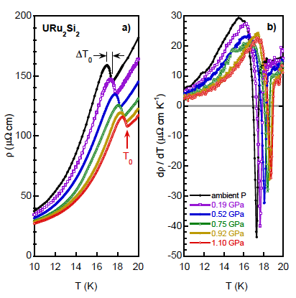
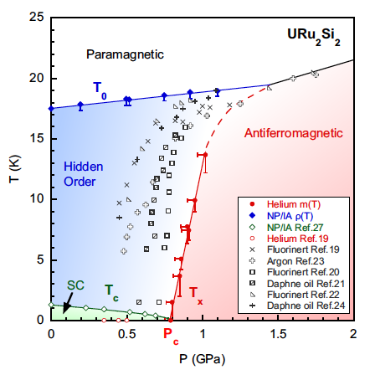
URu₂Si₂ under hydrostatic pressure (helium)
ρ(T,P) measurements in 1:1 mixture n-pentane/isoamyl alcohol
Neutron scattering experiments in helium
1st order HO-LMAFM transition at T_{x}; T_{c}(P) &T_{x}(P) meet at 0 K and 8 kbar;
bicritical point at15 kbar
N. P. Butch, J. R. Jeffries, S. X. Chi, J. B. Leao, J. W. Lynn, and M. B. Maple (2010)

Slide 45
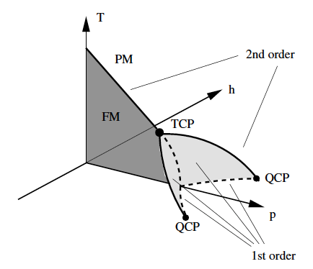
Investigation of URu_{2-x}Re_{x}Si₂ system
Belitz et al, PRL (05)
MOTIVATION
Insight into HO phase
Investigate quantum criticality near
FM QCP
  Many studies of quantum criticality
  near AFM QCP’s, but relatively few
  near FM QCP’s
  As Θ_{C} is suppressed towards 0 K
    Transition to another magnetic structure (e.g., AFM)
    FM transition changes from 2nd to 1st order with
    increasing δ at tricritical point (TCP) (e.g., UGe₂, MnSi, ZrZn_{x})
  Disorder can suppress the tricritical point yielding QCP
Experiments indicate URu_{2-x}Re_{x}Si₂ has FM QCP (like, e.g., Ni_{1-x}V_{x} A.Schroder)
Theory ⇒ FM QCP may not exist for 3D FM’s with long mean free path
D. Belitz et al, PRL (05): Sandeman, PRL (05)

Slide 46
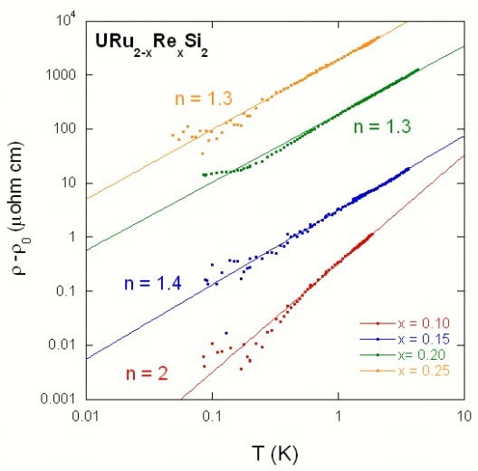
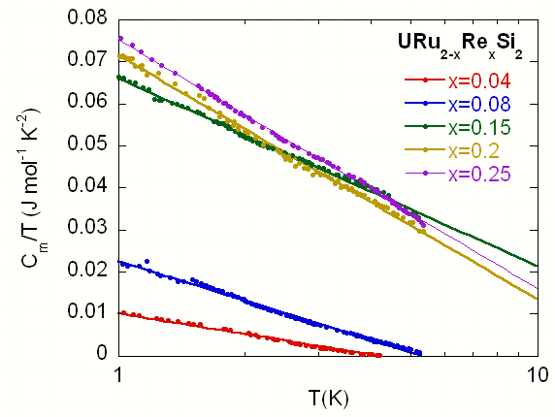
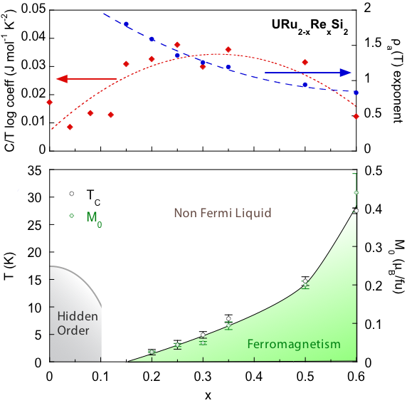
URu_{2-x}Re_{x}Si₂ : NFL behavior deep in FM phase
Butch, Maple (09)
C(T)/T = γ_{o} – c_{o}lnT
ρ(T) ∝ T^{n} (n ≈ 1 - 1.5)
Results qualitatively similar to our previous research
on polycrystalline URu_{2-x}Re_{x}Si₂ – Bauer et al., PRL (05)

Slide 47
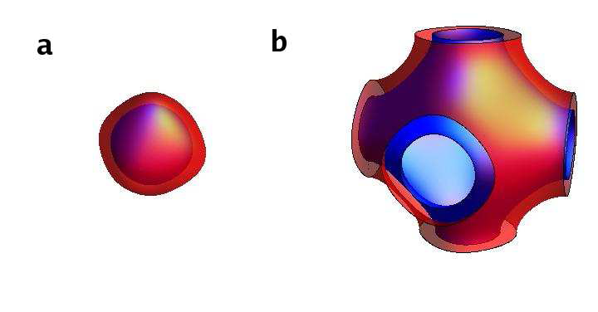
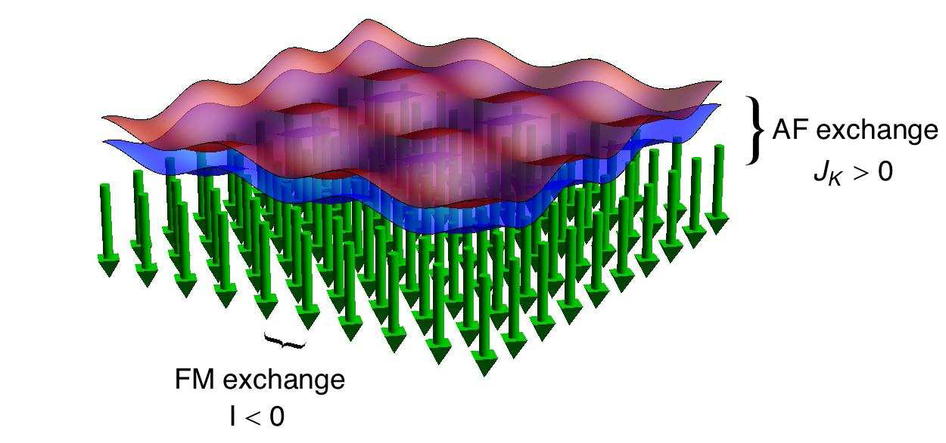
Ferromagnetic Kondo lattice
S. J. Yamamoto & Q. Si, PNAS (2010)
Ferromagnetic Kondo lattice model
Regime where Kondo screening is destroyed
and Fermi surface is small (e.g., CeRu₂Ge₂)
J_{K} << |I| << W
NFL features deep in FM phase
2D: C/T ~ T^{-1/3}, ρ ~ T^{4/3}
3D: C/T ~ log(1/T), ρ ~ T^{5/3}
Applicable to URu_{2-x}Re_{x}Si₂?
Small FS
Large FS
(encloses μ’s)
Red: spin-up electrons
Blue: spin-down electrons
Green: Local moments
Spin-up electrons have
higher probability density
than spin-down electrons

Slide 48

Enhancement of HO/LMAFM phase boundary in the URu_{2−x}Fe_{x}Si₂ system
N. Kanchanavatee, M. Janoschek, R. E. Baumbach, J. J. Hamlin,
D. A. Zocco, K. Huang, M. B. Maple, PRB 84, 245122 (2011)

Slide 49

Enhancement of HO/LMAFM phase boundary in the URu_{2−x}Fe_{x}Si₂ system
N. Kanchanavatee, M. Janoschek, R. E. Baumbach, J. J. Hamlin,
D. A. Zocco, K. Huang, M. B. Maple, PRB 84, 245122 (2011)

Slide 50


Enhancement of HO/LMAFM phase boundary in the URu_{2−x}Fe_{x}Si₂ system
Electrical resistivity ρ vs T
Magnetization M vs T
N. Kanchanavatee, M. Janoschek, R. E. Baumbach, J. J. Hamlin,
D. A. Zocco, K. Huang, M. B. Maple, PRB 84, 245122 (2011)

Slide 51
    High pressure studies of charge density waves,
    R magnetic order, and superconductivity In
    rare earth tritelluride RTe₃ compounds

Slide 52
    Rare earth tritelluride RTe₃ compounds under pressure
Interplay between CDW’s, R AFM order, and SC
Coworkers: .
University of California, San Diego
J. J. Hamlin
    T. A. Sayles Quantum Design
    D. A. Zocco KIT, Germany
Stanford University
J.-H. Chu
I. R. Fischer

Slide 53


Rare-earth tritellurides (RTe₃): chemical pressure
pressure
N. Ru, J.-H. Chu, and I. R. Fisher, Phys. Rev. B 78, 012410 (2008)
Incommensurate CDW at T_{CDW,1} with lattice modulation characterized by single in-plane
wavevector of about 2/7 c* = 0.57 π/c (c* = 2π/c)
Second incommensurate CDW order occurs at T_{CDW, 2} < T_{CDW, 1} characterized by a lattice modulation of 1/3 c* = 0.66 π/c and orthogonal to the first CDW
Antiferromagnetic order of the rare-earth sublattice occurs at T_{N} << T_{CDW}
Chemical pressure ≈ applied pressure
A. Sacchetti, E. Arcangeletti, A. Perucchi, L. Baldassarre, P. Postorino, S. Lupi, N. Ru, I. R. Fisher, and L. Degiorgi, Phys. Rev. Lett. 98, 026401 (2007)

Slide 54




GdTe₃ and DyTe₃

Slide 55






Critical field measurements of DyTe₃ and GdTe₃
1T-TiSe₂
A. F. Kusmartseva et al., Phys. Rev. Lett. 103, 236401 (2009)

Slide 56

T vs P phase diagram of LnTe₃ compounds
D. A. Zocco, J. J. Hamlin, M. B. Maple, UCSD; J. H. Chu, I. R. Fisher, Stanford

Slide 57





T vs P phase diagram of LnTe₃ compounds
I. V. Berman et al., Fiz. Tverd. Tela 14, 2527 (1972)
[Sov. Phys. Solid State 14, 2192 (1973)].
1T-TiSe₂
A. F. Kusmartseva et al., Phys. Rev. Lett. 103, 236401 (2009)
D. A. Zocco, J. J. Hamlin, M. B. Maple, UCSD; J. H. Chu, I. R. Fisher, Stanford

Slide 58

T vs P phase diagram of LnTe₃ compounds
I. V. Berman et al., Fiz. Tverd. Tela 14, 2527 (1972)
[Sov. Phys. Solid State 14, 2192 (1973)].
1T-TiSe₂
A. F. Kusmartseva et al., Phys. Rev. Lett. 103, 236401 (2009)
At 700 K, insulator–metal transition occurs at lower pressures, so we could expect that pure Te will remain non-metallic at 1 K above 4 GPa
C. Hejny et al., Phys. Rev. B 74, 174119 (2006)
D. A. Zocco, J. J. Hamlin, M. B. Maple, UCSD; J. H. Chu, I. R. Fisher, Stanford

Slide 59
T vs P phase diagram of LnTe₃ compounds
1T-TiSe₂
A. F. Kusmartseva et al., Phys. Rev. Lett. 103, 236401 (2009)
At 700 K, insulator–metal transition occurs at lower pressures, so we could expect that pure Te will remain non-metallic at 1 K above 4 GPa
C. Hejny et al., Phys. Rev. B 74, 174119 (2006)
D. A. Zocco, J. J. Hamlin, M. B. Maple, UCSD; J. H. Chu, I. R. Fisher, Stanford

Slide 60
Electronic correlations

Slide 61




2nd breakthrough in superconducting materials?

Slide 62


Superconductivity in LaFePO
J. J. Hamlin, R. E. Baumbach, D. A. Zocco,
T. A. Sayles, M. B. Maple, JPCM 20, 365220 (08)
LaFePO single crystals grown
in Sn flux
Superconductivity: T_{c} = 6.7 K
Significant anisotropy of resistively determined H_{c2}(T)
curves

Slide 63

Comparison of T_{c} vs Ln for Pn = P, As
Solid circles: LnFeAsO_{1-x}F_{x}
Open circles: LnFeAsO_{1-x}
Solid squares: LnFePO
Ln = La, Ce, Pr, Nd (UCSD)
Pn = As: T_{c} increases with Ln to maximum value of 55 K for Sm
Pn = P: T_{c} much smaller and decreases with Ln (magnetic pair breaking?)
Suggests difference in character of SC of “1111” Fe
arsenides and phosphides
“1111” Fe phosphides do not exhibit structural or SDW transitions
R. E. Baumbach, J. J. Hamlin, L. Shu, D. A. Zocco,
N. M. Crisosto, and M. B. Maple, NJP 11, 025018 (09)

Slide 64



An IR probe of electronic correlations
Coulomb repulsion
Mott insulators
Correlated Metals
Conventional Metals
E_{F}
E_{F}
band
theory
Paul Drude
M.Qazilbash J. Hamlin, R. E. Baumbach, L. Zhang, D.J. Singh, M.B. Maple, and D.N. Basov et al. Nature-Physics 5, 647 (2009)
A.J. Millis et al. PRB 72, 224517 (2005)

Slide 65
Electronic correlations in pnictides
NiO
La₂CuO₄
Nd₂CuO₄
A₃C₆₀
Correlated Metals
Conventional Metals
Mott Insulators
Cu
Ag
Ba122
Co-,K-doped
LaFePO
MgB₂
M.Qazilbash J. Hamlin, R. E. Baumbach, L. Zhang, D.J. Singh, M.B. Maple, and D.N. Basov et al. Nature-Physics 5, 647 (2009)
A.J. Millis et al. PRB 72, 224517 (2005)

Slide 66
Some thoughts, questions, and directions for future research
New materials ⇒ new phenomena, enhanced properties (“materials driven physics”)
Chemical substitution, high pressure, high magnetic field studies of known materials
Is there a more general theory that could account for the nearly universal NFL
characteristics found in a wide variety of chemically substituted and stoichiometric
f-electron materials in disparate situations (different types of, or unidentifiable, QCP)?
Can the multichannel Kondo effect be generalized to include interactions and applied
to concentrated f-electron materials?
SC is found in the proximity of different types of ordered phases (e.g., AFM, FM, SDW,
CDW, quadrupolar, insulating). What is the role of the ordered phase in these cases?
Does the suppression of the ordered phase “liberate” SC or provide excitations that
mediate SCing electron pairing?
Detailed studies of the interplay of SC and spin or charge ordered phases (transport,
thermal, magnetic, spectroscopic measurements)
More investigations of quantum phase transitions in FM systems, particularly in
connection with quantum criticality and SC
Studies of SC in f-electron compounds that exhibit weak FM (triplet SC or phase
separated regions of singlet SC and FM?)
General theories that provide qualitative understanding of phenomena
Sophisticated electronic structure calculations that incorporate electronic correlations

Slide 67

UCSD RESEARCH GROUP
CURRENT GROUP
Alexander Ellington
James Hamlin
Yoonho Heo
Kevin Huang
Sooyoung Jang
Nor Kanchanavatee
Ivy Lum
Colin McElroy
Duygu Yazici Tütün
Christine Coffey (Assistant)
Camus (“Lab”radoodle)
RECENT GROUP ALUMNI
Ryan Baumbach (LANL)
Nick Butch (LLNL)
Pei-Chun Ho (CSU, Fresno)
Marc Janoschek (LANL)
Jason Jeffries (LLNL)
Johnpierre Paglioni (U. Maryland)
Todd Sayles (Quantum Design)
Lei Shu (Fudan U., China)
Ben Taylor (SPAWAR)
Diego Zocco (KIT, Germany)
Page 67 of 21

Slide 68
END

